Slide 1
RESTORE REBUILD RENEW
welcome
we are glad to
Have you with us
IN 2022
WHEELER
CHURCH
OF
CHRIST

Slide 2
Songs of Praise To God

Slide 3
Opening Prayer

Slide 4
Songs of Praise To God

Slide 5
1-1 Pierce my ear
Pierce My Ear
0

Slide 6
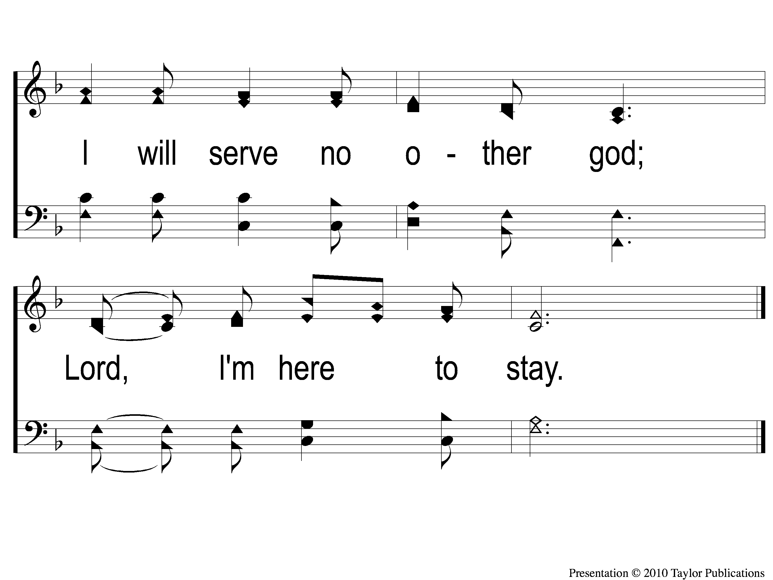
1-2 Pierce my ear
Pierce My Ear
0

Slide 7
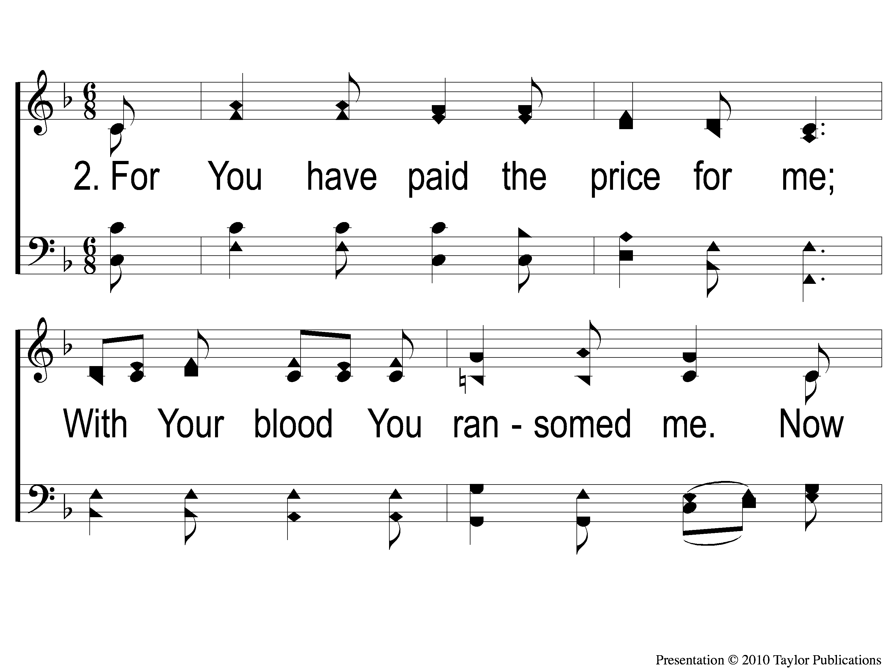
2-1 Pierce my ear
Pierce My Ear
0

Slide 8
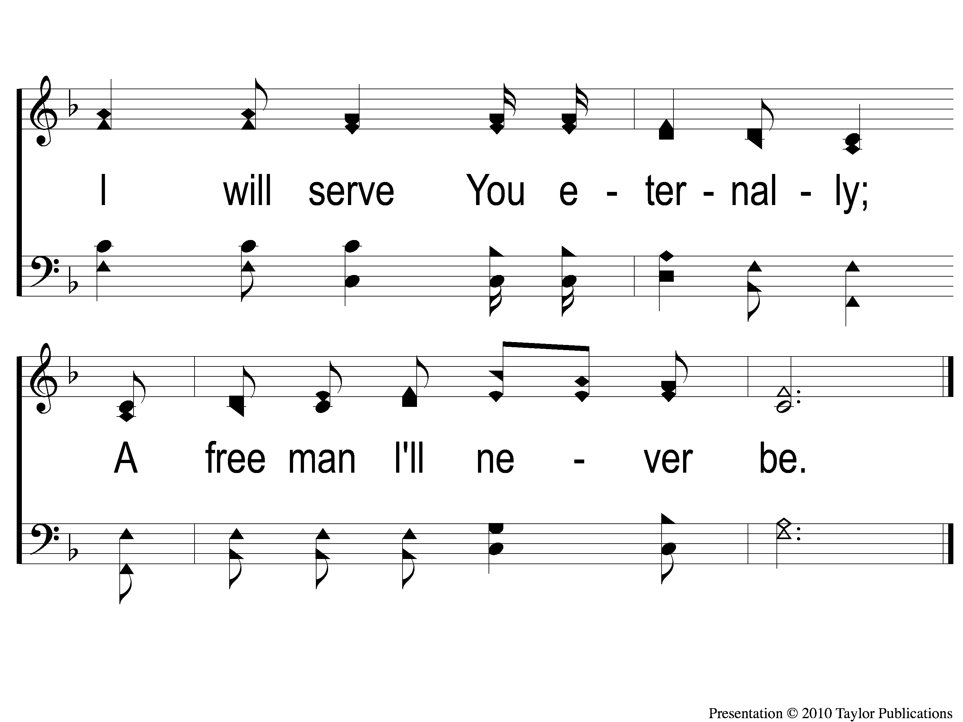
2-2 Pierce my ear
Pierce My Ear
0

Slide 9
3-1 Pierce my ear
Pierce My Ear
0

Slide 10
3-2 Pierce my ear
Pierce My Ear
0

Slide 11
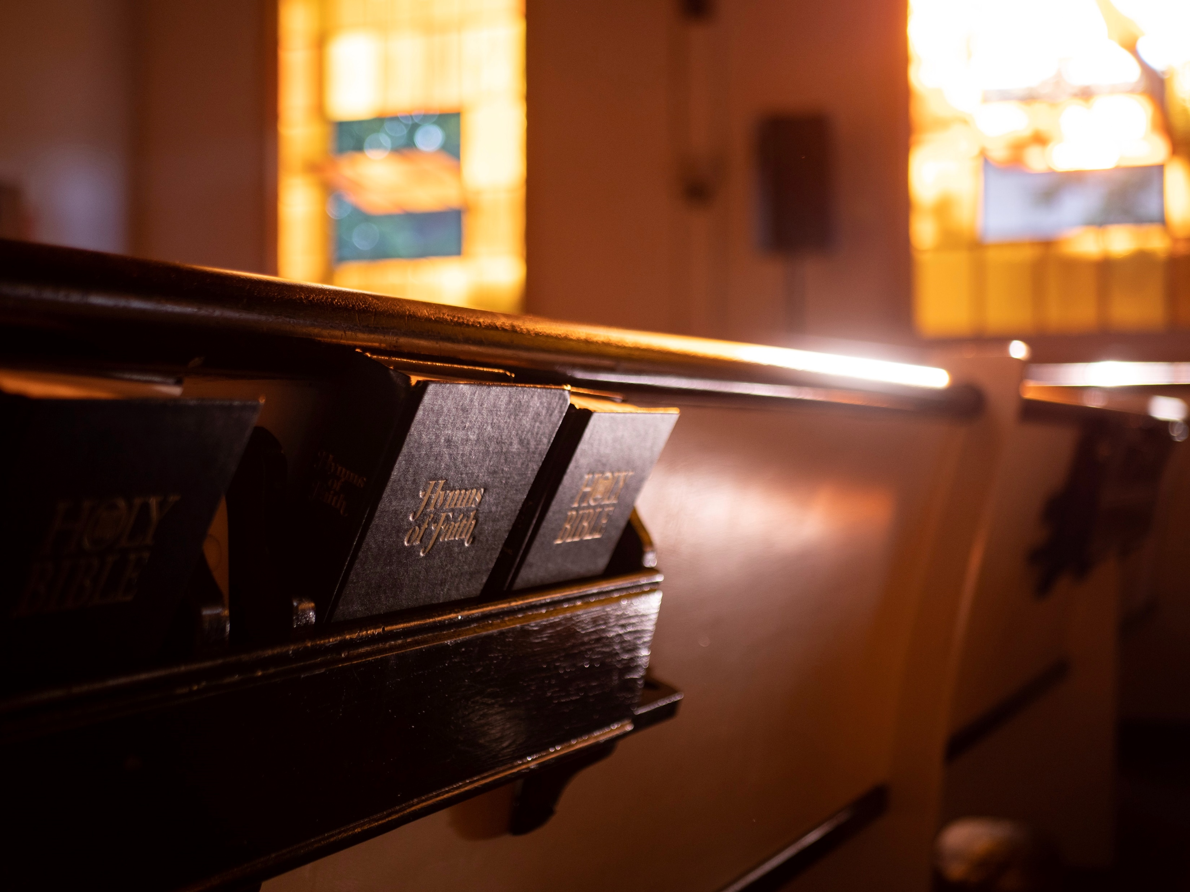
Renewed
by
Hymns

Slide 12
Pierce
My Ear

Slide 13
Hymn History
Words & Music: Steve Croft
Published: 1980
Occasion: Unknown
Text: Exodus 21:1-6, Deut. 15:12-18

Slide 14
Slavery In The Law of Moses
Ex. 21:1-6 & Deut. 15:12-18
Book of the Covenant (Exodus 21-23)
Example: Jacob Working for Laban (Gen. 20-30)

Slide 15
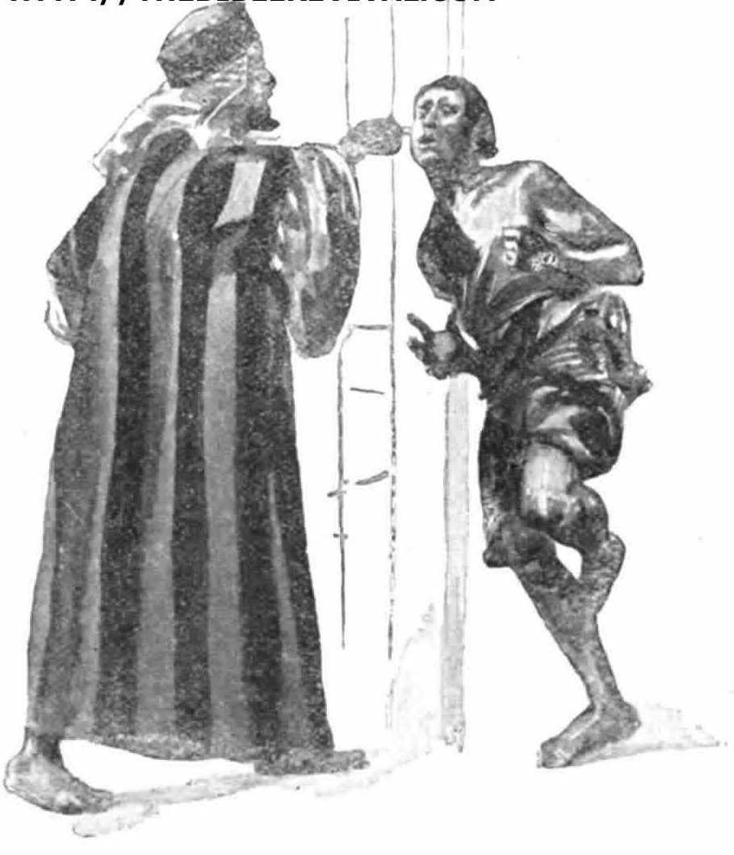

Slide 16
Choosing To Stay
Exodus 21:5

Slide 17
Choosing To Stay
Exodus 21:5
Reciprocal Love
The Master Treated You Well

Slide 18
Symbolism In The Song
Why Piercing?

Slide 19
Symbolism In The Song
Why Piercing?
Jesus’ Pierced Hands, Feet, & Side
Psa. 22:16, Jn. 19:34, 37 (Zech. 12:10)

Slide 20
Symbolism In The Song
Why An Ear?
The Function of the Ear to Hear
Deut. 6:4, Psa. 40:6, Lk. 6:47, 8:21, 9:35

Slide 21
Symbolism In The Song
Why An Ear?
The Function of the Ear to Hear
Deut. 6:4, Psa. 40:6, Lk. 6:47, 8:21, 9:35
The Consecration of the Priests
Exodus 29:20

Slide 22
Symbolism In The Song
Why A Door?
The Decree – Deut. 16:18, 17:8

Slide 23
Symbolism In The Song
Why A Door?
The Decree – Deut. 16:18, 17:8
The Entry – Jn. 10:7-9

Slide 24
Symbolism In The Song
Why A Door?
The Decree – Deut. 16:18, 17:8
The Entry – Jn. 10:7-9
The Imagery – Ex. 12-13

Slide 25
Lessons
We Committed to Serve God & God Alone
Matt. 6:24, Rom. 6:19-22

Slide 26
Lessons
We Committed to Serve God & God Alone
Matt. 6:24, Rom. 6:19-22
We Committed to Serve God Forever
Gal. 2:20, Rev. 2:10

Slide 27
Songs of Praise To God

Slide 28
The Lord’s Supper
Acts 20:7

Slide 29
Closing Prayer

Slide 30
Songs of Praise To God

Slide 31
RESTORE REBUILD RENEW
Wednesday
Worship & Classes @ 6:30 pm
IN 2022
WHEELER
CHURCH
OF
CHRIST

