Slide 1
1 We Shall Assemble
We Shall Assemble
718

Slide 2
2 We Shall Assemble
We Shall Assemble
718

Slide 3
3 We Shall Assemble
We Shall Assemble
718

Slide 4
4 We Shall Assemble
We Shall Assemble
718

Slide 5
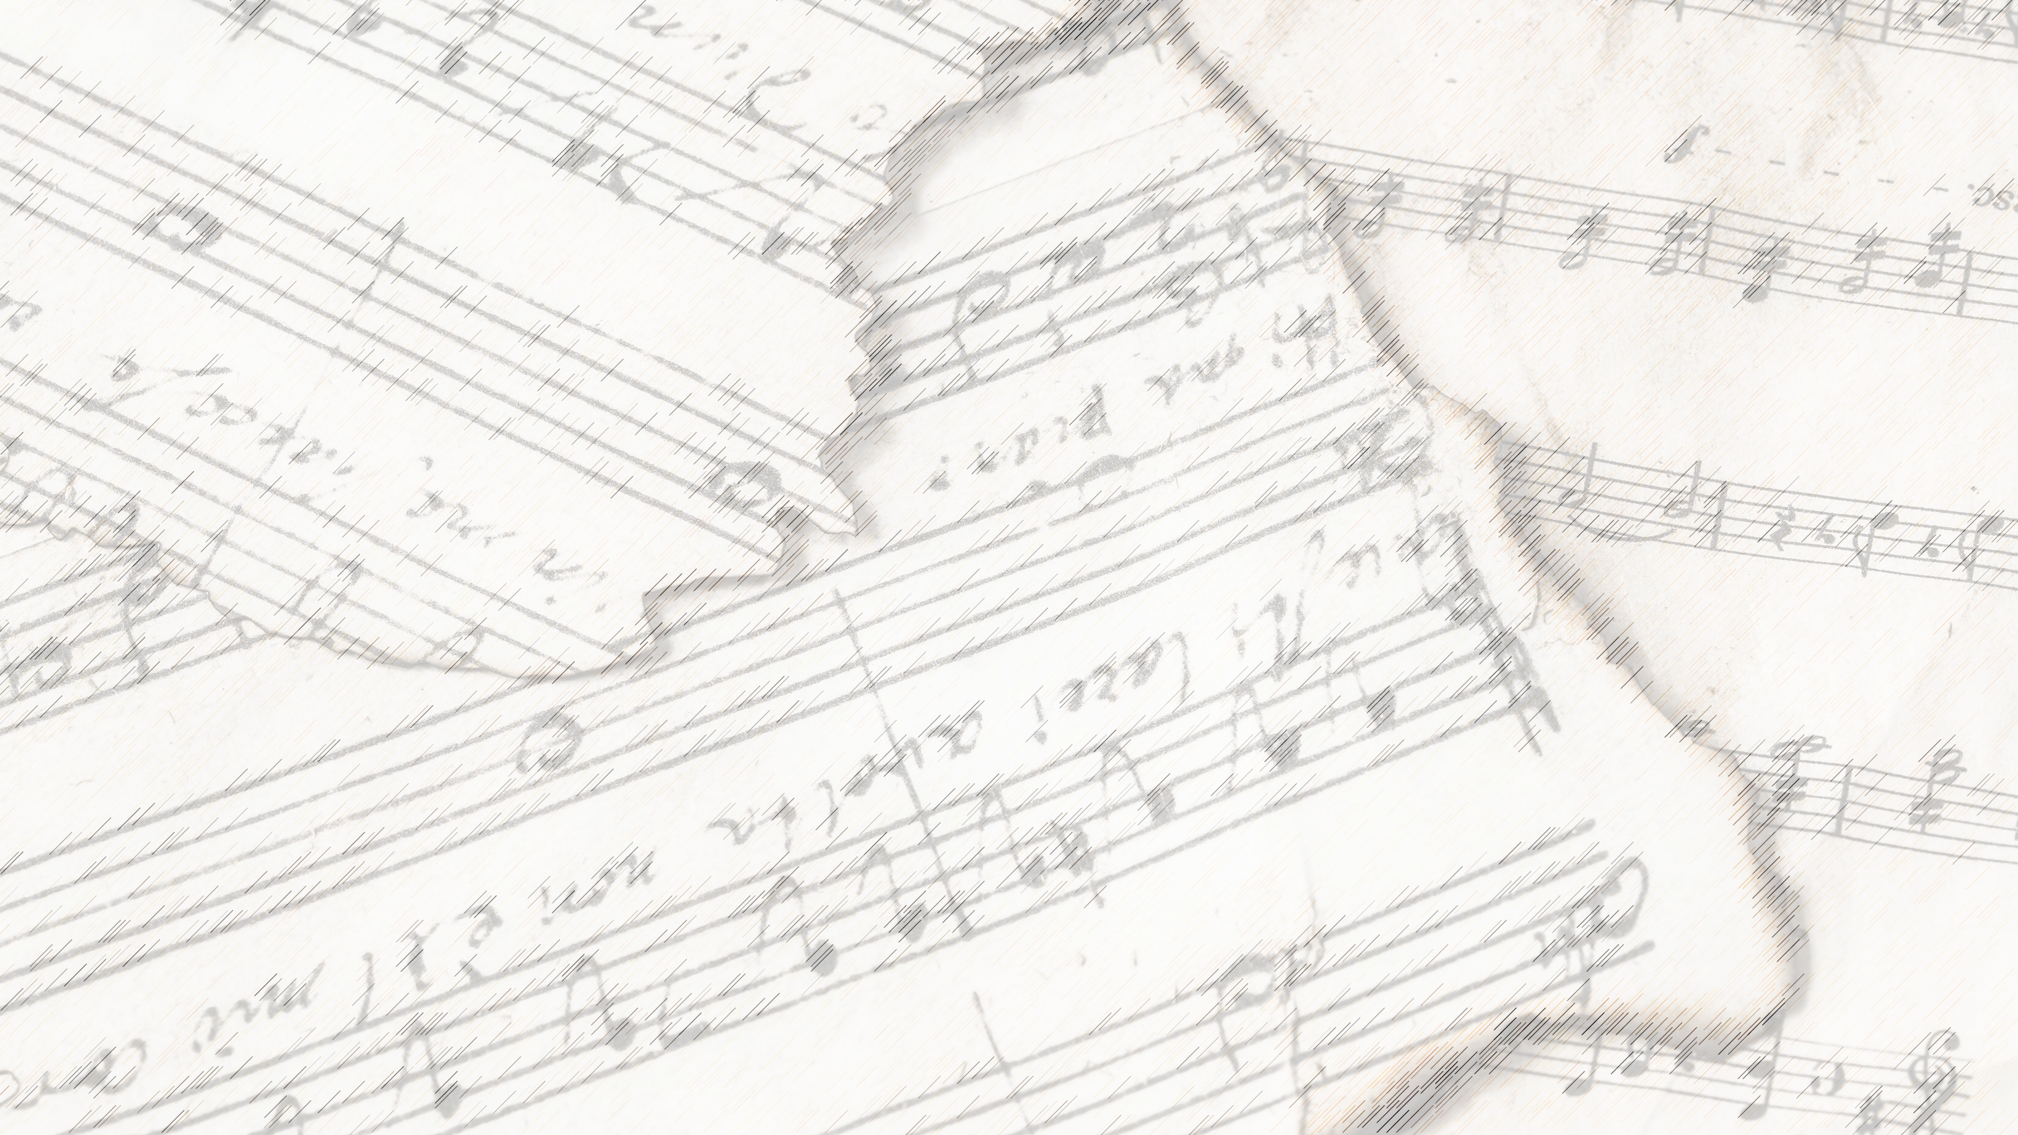
Welcome!
We Are Glad You Are Here

Slide 6
My Hope Is Built
#538

Slide 7
1-1 My Hope is Built
My Hope Is Built
538

Slide 8
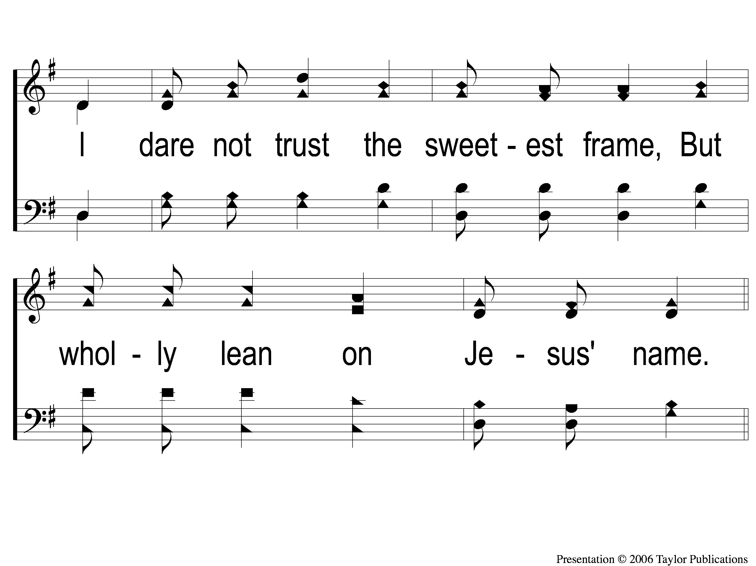
1-2 My Hope is Built
My Hope Is Built
538

Slide 9
c My Hope is Built
My Hope Is Built
538

Slide 10
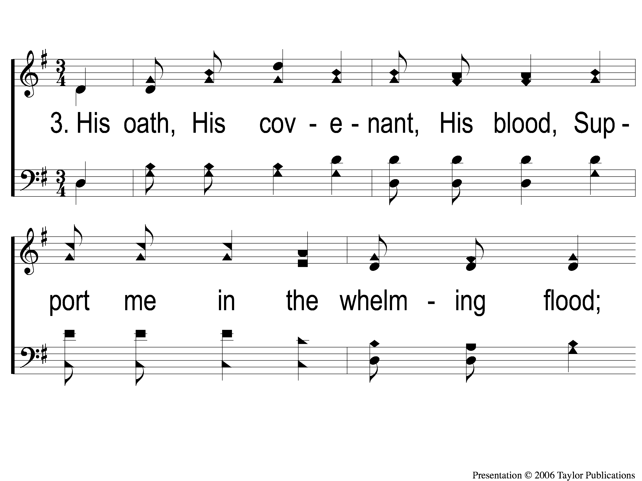
3-1 My Hope is Built
My Hope Is Built
538

Slide 11
3-2 My Hope is Built
My Hope Is Built
538

Slide 12
c My Hope is Built
My Hope Is Built
538

Slide 13
4-1 My Hope is Built
My Hope Is Built
538

Slide 14
4-2 My Hope is Built
My Hope Is Built
538

Slide 15
c My Hope is Built
My Hope Is Built
538

Slide 16
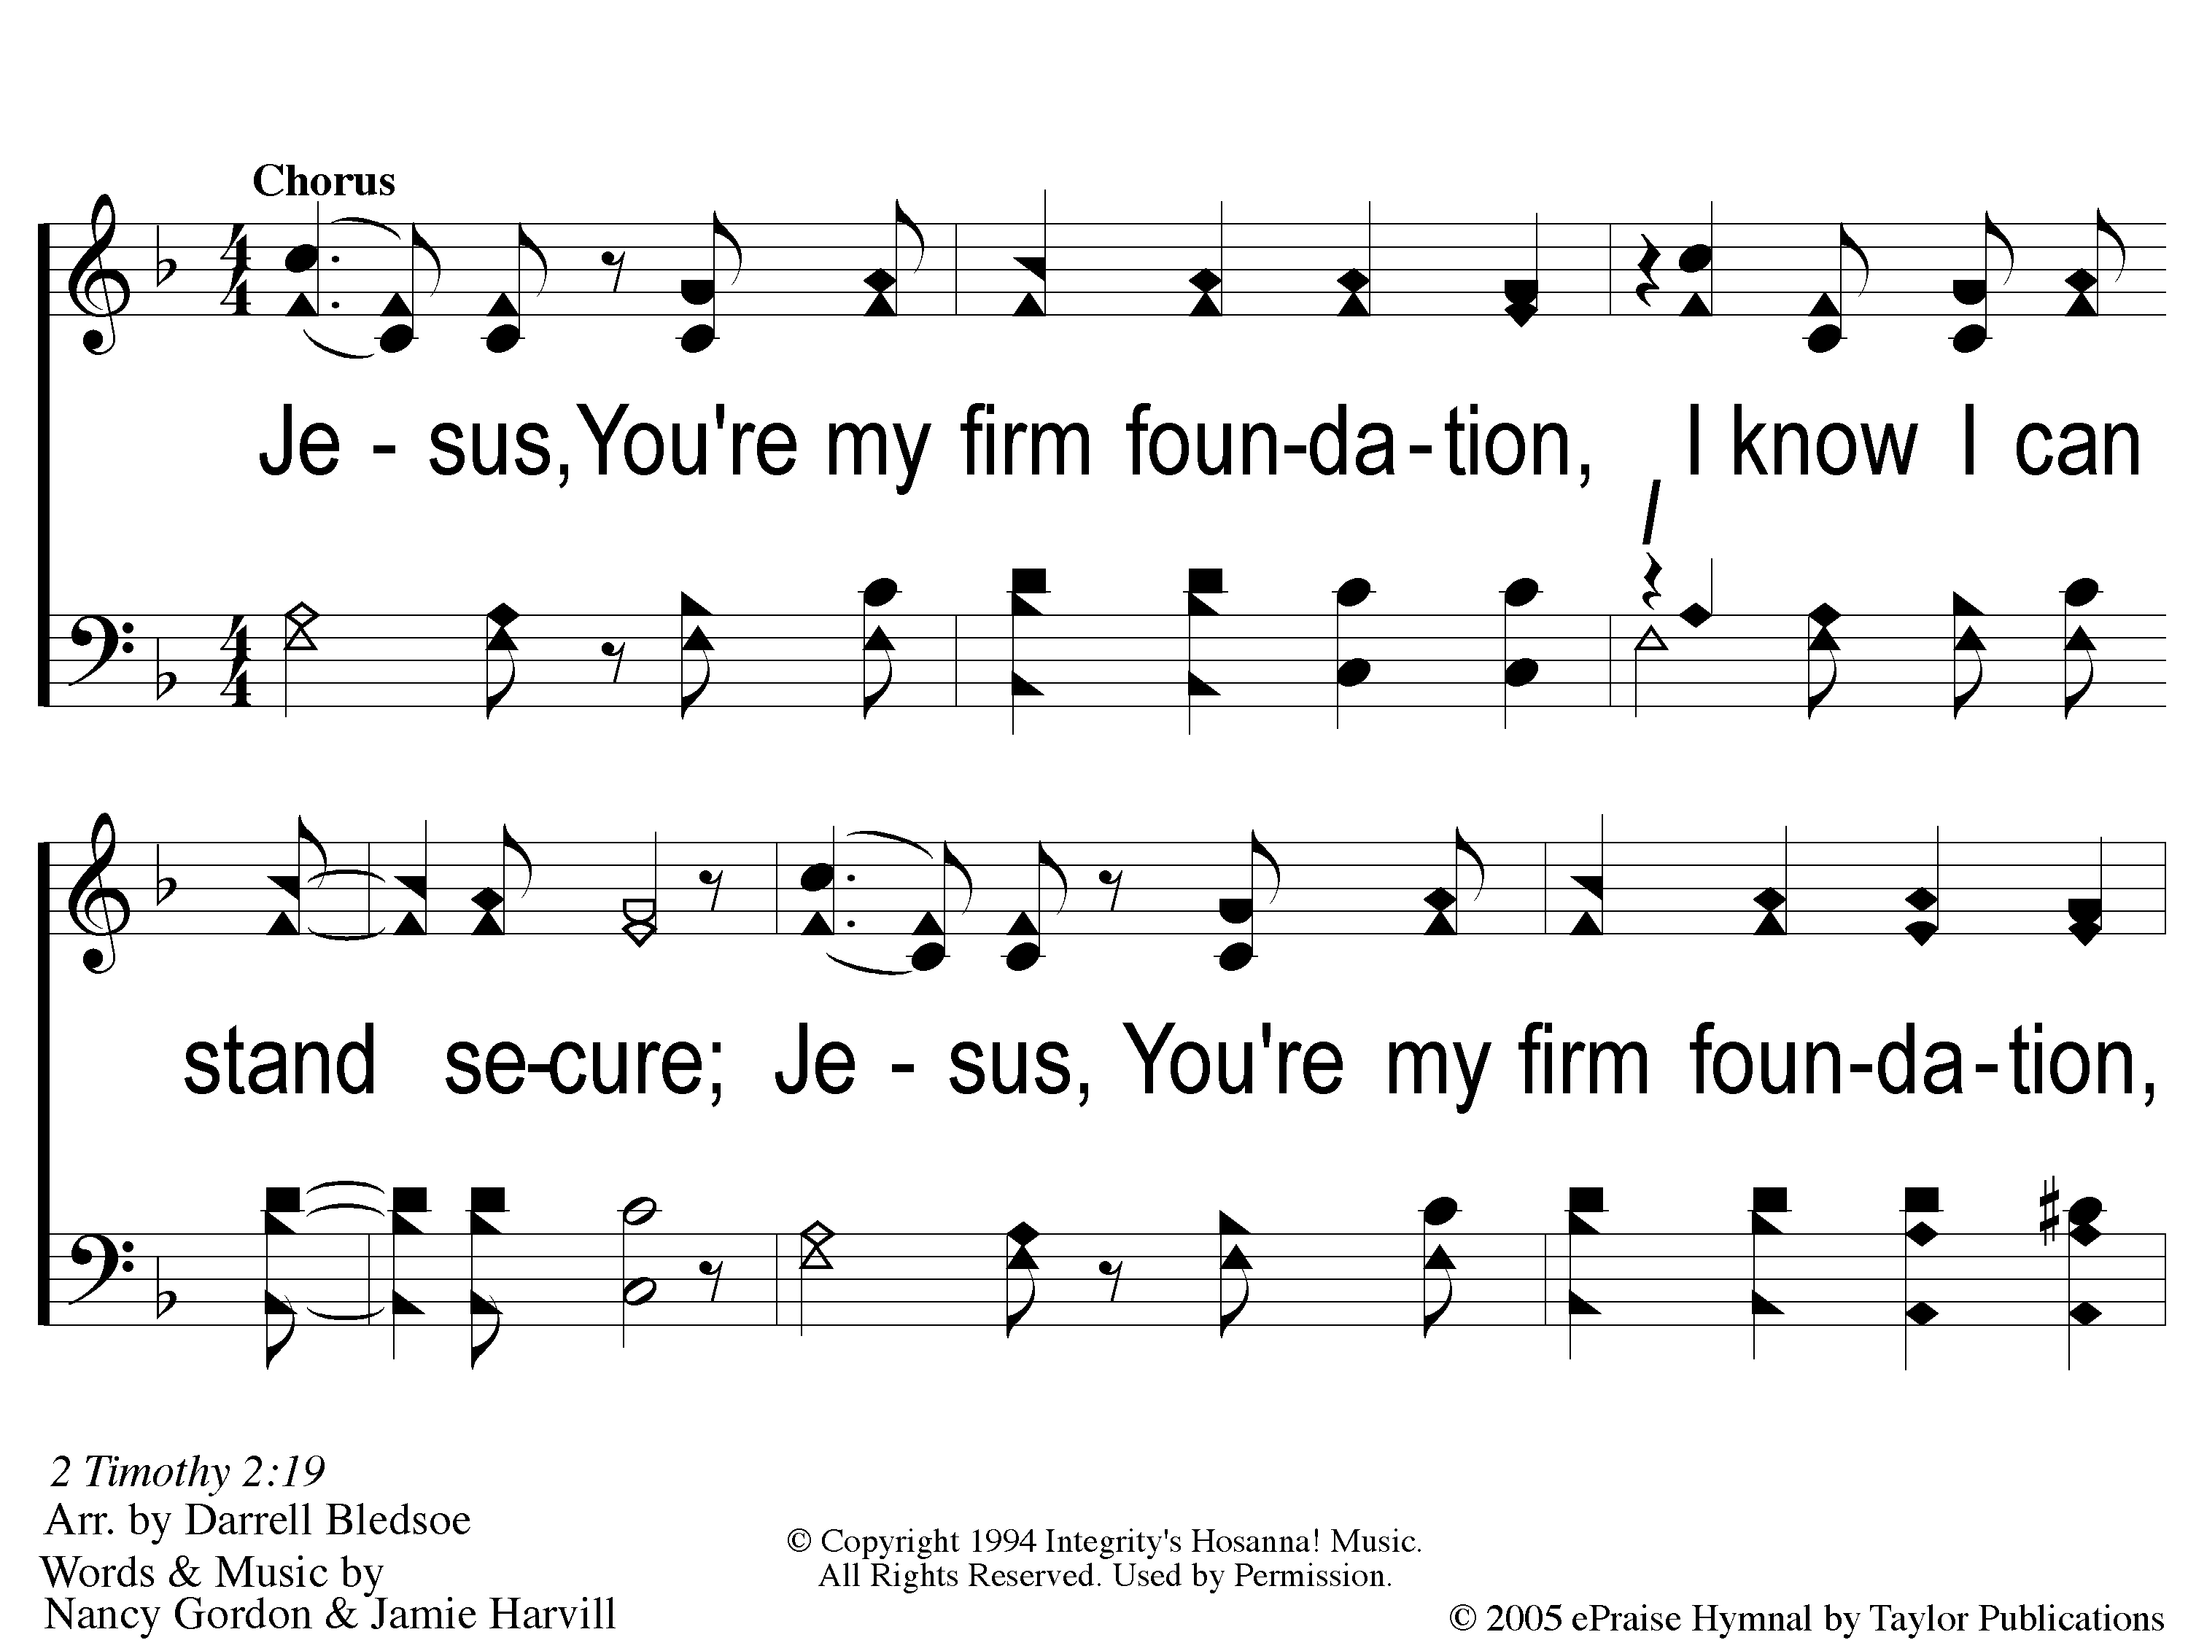
C-1 Firm Foundation
Firm Foundation

Slide 17
C-2 Firm Foundation
Firm Foundation

Slide 18
C-1 Firm Foundation
Firm Foundation

Slide 19
C-2 Firm Foundation
Firm Foundation

Slide 20
1-1 Firm Foundation
Firm Foundation

Slide 21
1-2 Firm Foundation
Firm Foundation

Slide 22
C-1 Firm Foundation
Firm Foundation

Slide 23
C-2 Firm Foundation
Firm Foundation

Slide 24
2-1 Firm Foundation
Firm Foundation

Slide 25
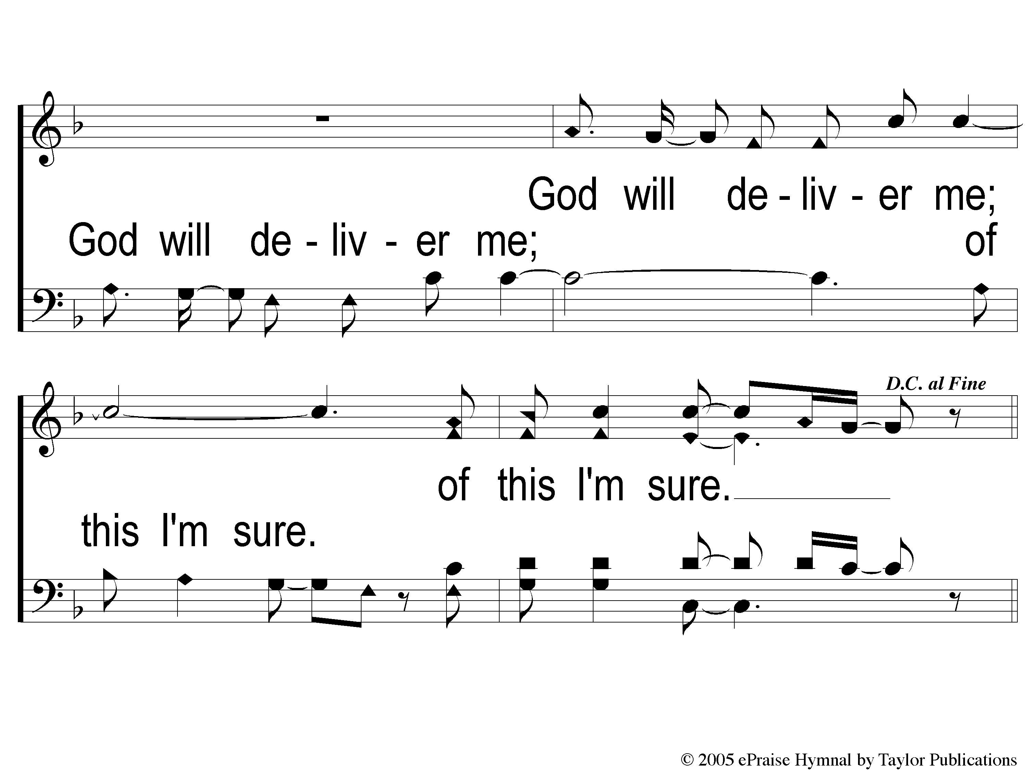
2-2 Firm Foundation
Firm Foundation

Slide 26
C-1 Firm Foundation
Firm Foundation

Slide 27
C-2 Firm Foundation
Firm Foundation

Slide 28
Ds-1 Firm Foundation
Firm Foundation

Slide 29
Ds-2 Firm Foundation
Firm Foundation

Slide 30
We Fall Down

Slide 31
1 We Fall Down
We Fall Down

Slide 32
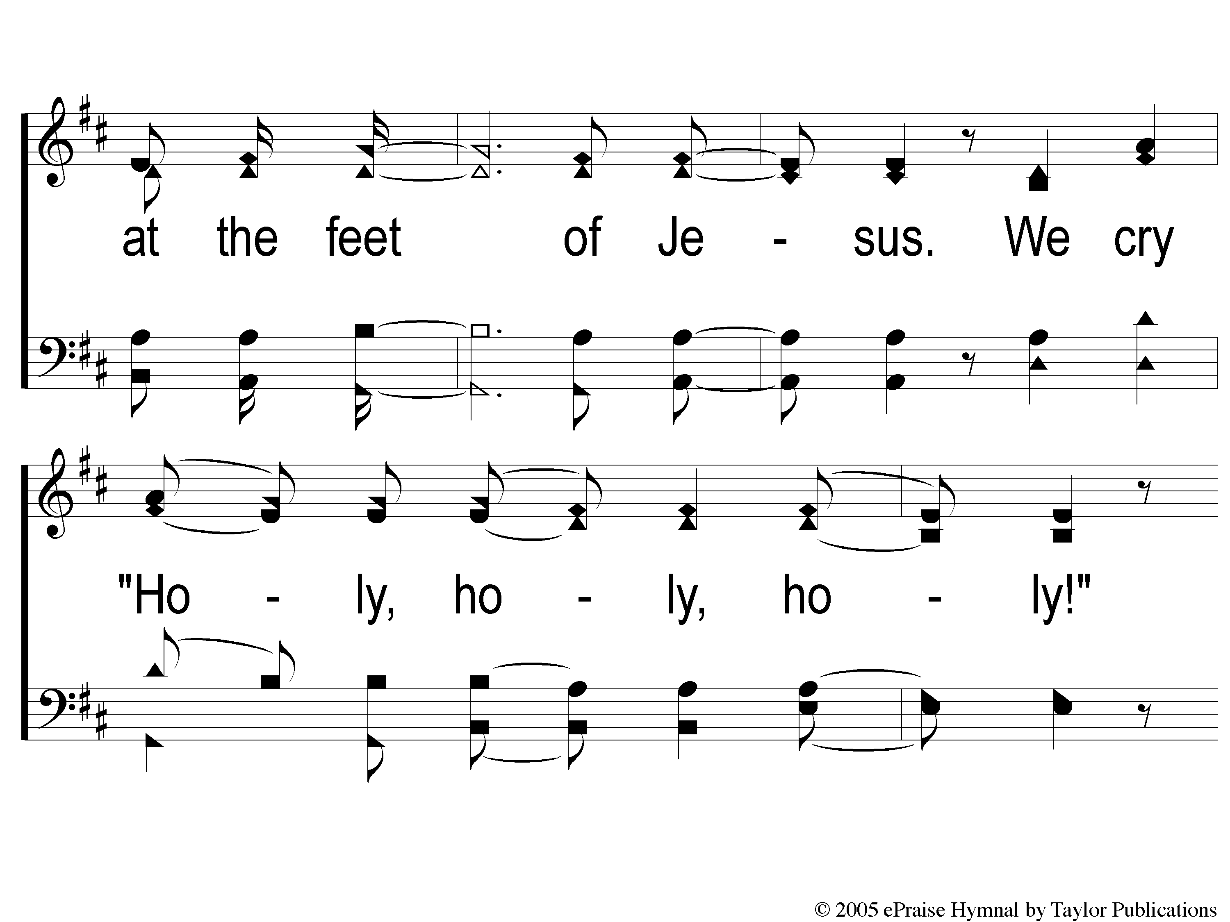
2 We Fall Down
We Fall Down

Slide 33
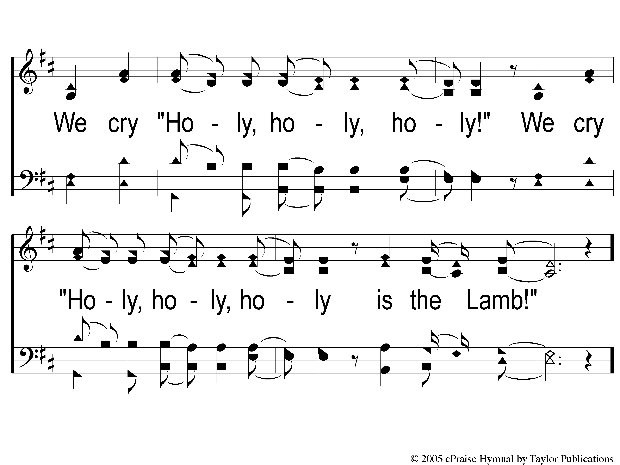
3 We Fall Down
We Fall Down

Slide 34
1 We Fall Down
We Fall Down

Slide 35
2 We Fall Down
We Fall Down

Slide 36
3 We Fall Down
We Fall Down

Slide 37
Opening Prayer

Slide 38
Rock of Ages
#454

Slide 39
1-1 Rock of Ages
Rock of Ages
454

Slide 40
1-2 Rock of Ages
Rock of Ages
454

Slide 41
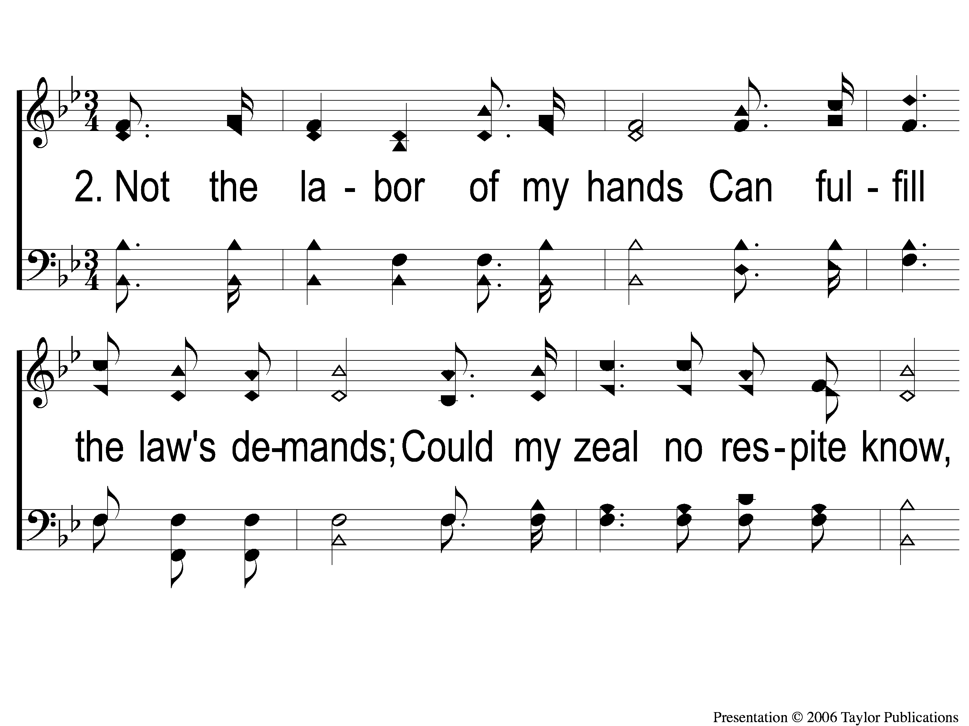
2-1 Rock of Ages
Rock of Ages
454

Slide 42
2-2 Rock of Ages
Rock of Ages
454

Slide 43
3-1 Rock of Ages
Rock of Ages
454

Slide 44
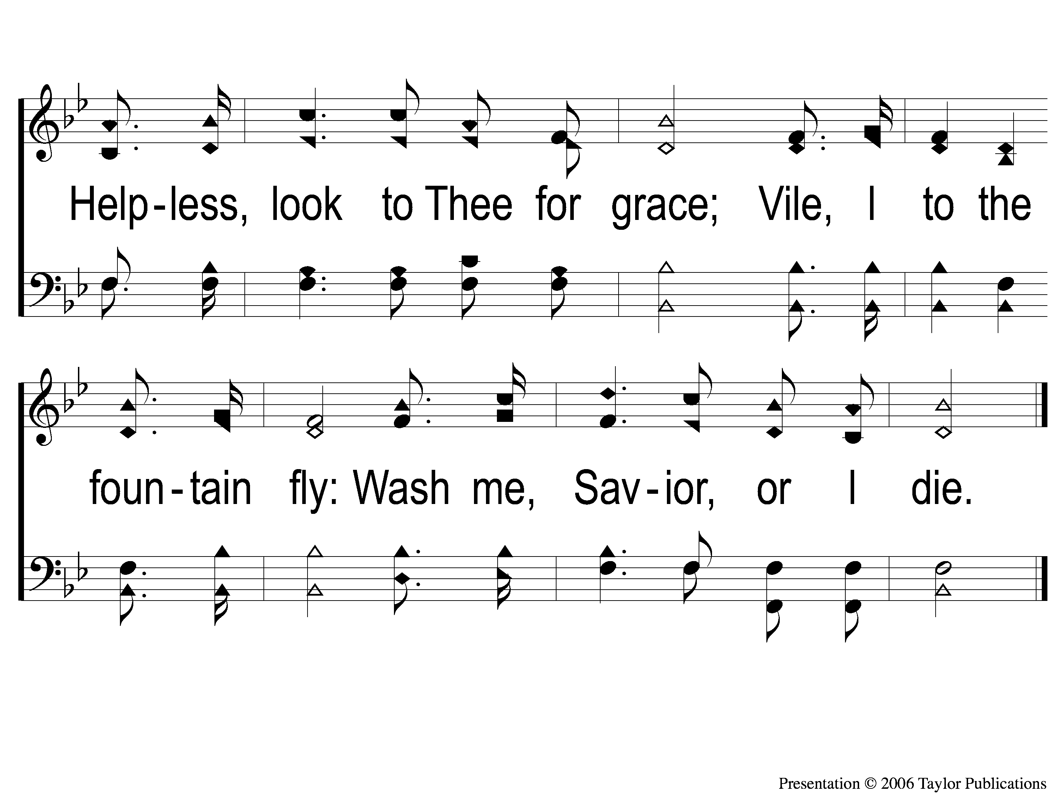
3-2 Rock of Ages
Rock of Ages
454

Slide 45
There Stands A Rock
#558

Slide 46
1-1 There Stands A Rock
There Stands A Rock
558

Slide 47
1-2 There’s Stands A Rock
There Stands A Rock
558

Slide 48
C-1 There’s Stands A Rock
There Stands A Rock
558

Slide 49
C-2 There’s Stands A Rock
There Stands A Rock
558

Slide 50
2-1 There’s Stands A Rock
There Stands A Rock
558

Slide 51
2-2 There’s Stands A Rock
There Stands A Rock
558

Slide 52
C-1 There’s Stands A Rock
There Stands A Rock
558

Slide 53
C-2 There’s Stands A Rock
There Stands A Rock
558

Slide 54
3-1 There’s Stands A Rock
There Stands A Rock
558

Slide 55
3-2 There’s Stands A Rock
There Stands A Rock
558

Slide 56
C-1 There’s Stands A Rock
There Stands A Rock
558

Slide 57
C-2 There’s Stands A Rock
There Stands A Rock
558

Slide 58
Scripture Reading:
Matthew 7: 24-27

Slide 59
Songs About
Standing Firm

Slide 60
There Stands A Rock

Slide 61
Writer & Composer
Writer: S. S. Journal

Slide 62
Writer & Composer
Writer: S. S. Journal
Composer: T. C. O’Kane

Slide 63
Chorus:
“Some build their hopes on the ever-drifting sand,
Some on their fame, or their treasure, or their land;
Mine’s on a rock that forever will stand,
Jesus, the Rock of Ages.”

Slide 64
Where Not To Build Your Hopes:
Your Fame

Slide 65
Where Not To Build Your Hopes:
Your Fame
Gen. 11: 1-4
Prov. 16: 18, 18: 10
Obadiah 3-4

Slide 66
Where Not To Build Your Hopes:
Your Fame
Your Treasure

Slide 67
Where Not To Build Your Hopes:
Your Treasures
Psa. 62: 10
Prov. 10: 2
Eccl. 2: 8, 11

Slide 68
Where Not To Build Your Hopes:
Your Treasures
Matt. 6: 19-21
Lk. 12: 34
Psa. 119: 162
Prov. 2: 4
Heb. 11: 26
Jms. 5: 3

Slide 69
Where Not To Build Your Hopes:
Your Fame
Your Treasure
Your Land

Slide 70
Where Not To Build Your Hopes:
Your Land
Jer. 48: 7
Matt. 7: 21-23
Lam. 3: 24

Slide 71
Where To Build Your Hopes:
Jesus, the Rock of Ages
Matt. 7:24-27
John 6:65-66

Slide 72
Where Are You
Building Your Hopes?

Slide 73
Invitation Song:
Just As I Am

Slide 74
1-1 Just as I am-I come broken
Just As I Am-I Come Broken

Slide 75
1-2 Just as I am-I come broken
Just As I Am-I Come Broken

Slide 76
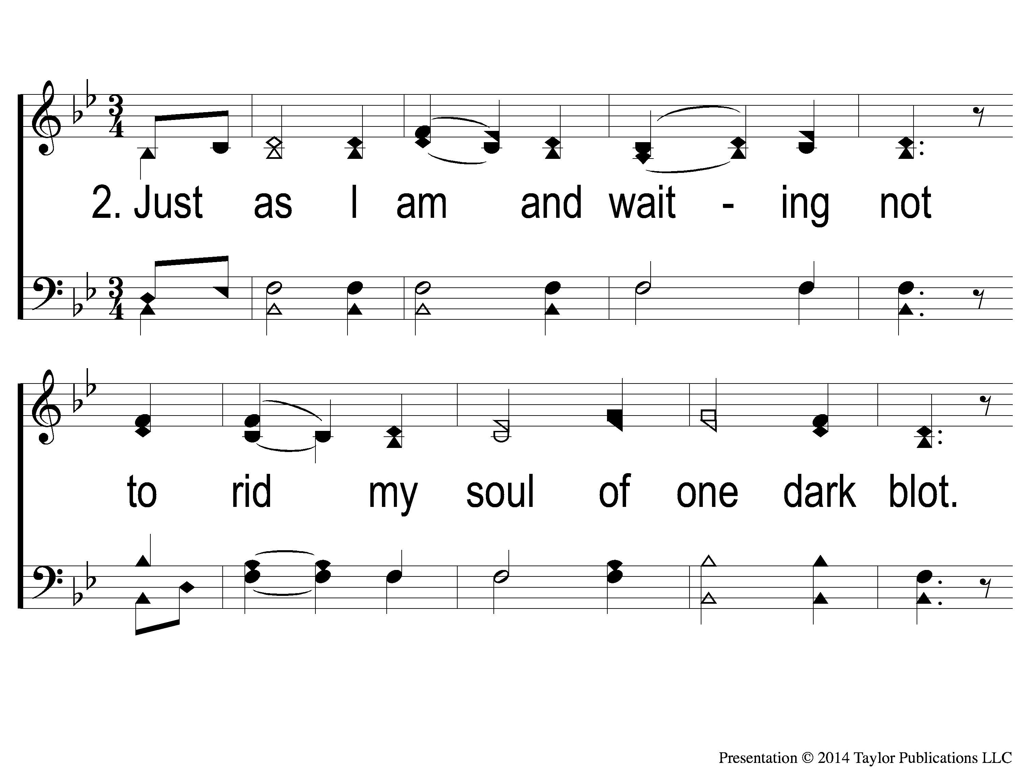
2-1 Just as I am-I come broken
Just As I Am-I Come Broken

Slide 77
2-2 Just as I am-I come broken
Just As I Am-I Come Broken

Slide 78
1c-1 Just as I am-I come broken
Just As I Am-I Come Broken

Slide 79
1c-2 Just as I am-I come broken
Just As I Am-I Come Broken

Slide 80
1c-3 Just as I am-I come broken
Just As I Am-I Come Broken

Slide 81
3-1 Just as I am-I come broken
Just As I Am-I Come Broken

Slide 82
3-2 Just as I am-I come broken
Just As I Am-I Come Broken

Slide 83
2c-1 Just as I am-I come broken
Just As I Am-I Come Broken

Slide 84
2c-2 Just as I am-I come broken
Just As I Am-I Come Broken

Slide 85
2c-3 Just as I am-I come broken
Just As I Am-I Come Broken

Slide 86
Ds-1 Just as I am-I come broken
Just As I Am-I Come Broken

Slide 87
Ds-2 Just as I am-I come broken
Just As I Am-I Come Broken

Slide 88
Ds-3 Just as I am-I come broken
Just As I Am-I Come Broken

Slide 89
He Bore It All
#351

Slide 90
1-1 He Bore It All
He Bore It All
351

Slide 91
1-2 He Bore It All
He Bore It All
351

Slide 92
C-1 He Bore It All
He Bore It All
351

Slide 93
C-2 He Bore It All
He Bore It All
351

Slide 94
C-3 He Bore It All
He Bore It All
351

Slide 95
2-1 He Bore It All
He Bore It All
351

Slide 96
2-2 He Bore It All
He Bore It All
351

Slide 97
C-1 He Bore It All
He Bore It All
351

Slide 98
C-2 He Bore It All
He Bore It All
351

Slide 99
C-3 He Bore It All
He Bore It All
351

Slide 100
3-1 He Bore It All
He Bore It All
351

Slide 101
3-2 He Bore It All
He Bore It All
351

Slide 102
C-1 He Bore It All
He Bore It All
351

Slide 103
C-2 He Bore It All
He Bore It All
351

Slide 104
C-3 He Bore It All
He Bore It All
351

Slide 105
The Lord’s Supper
Acts 20:7

Slide 106
The Unleavened Bread
“Who has believed our report? And to whom has the arm of the LORD been revealed? For He shall grow up before Him as a tender plant, And as a root out of dry ground. He has no form or comeliness; And when we see Him, There is no beauty that we should desire Him. He is despised and rejected by men, A Man of sorrows and acquainted with grief. And we hid, as it were, our faces from Him; He was despised, and we did not esteem Him.” – Isa. 53: 1-3

Slide 107
The Fruit of the Vine
“Surely He has borne our griefs And carried our sorrows; Yet we esteemed Him stricken, Smitten by God, and afflicted. But He was wounded for our transgressions, He was bruised for our iniquities; The chastisement for our peace was upon Him, And by His stripes we are healed.” – Isa. 53: 4-5

Slide 108
Our Offering
“For if there is first a willing mind, it is accepted according to what one has, and not according to what he does not have.”
– 2 Cor. 8:12

Slide 109
Closing Prayer

Slide 110
Sweet Beulah Land

Slide 111
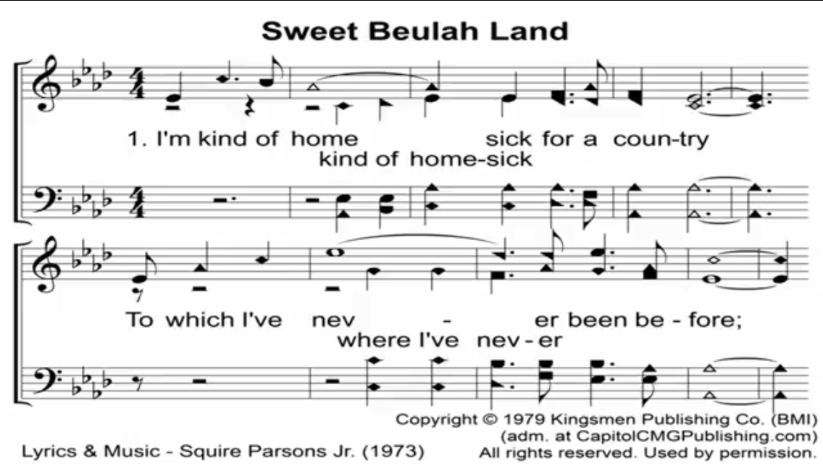

Slide 112
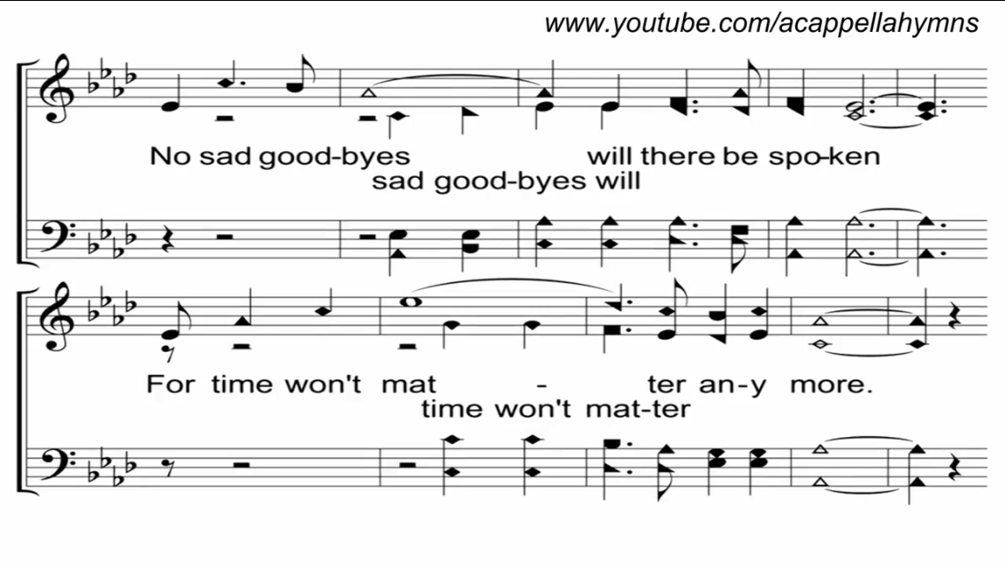

Slide 113
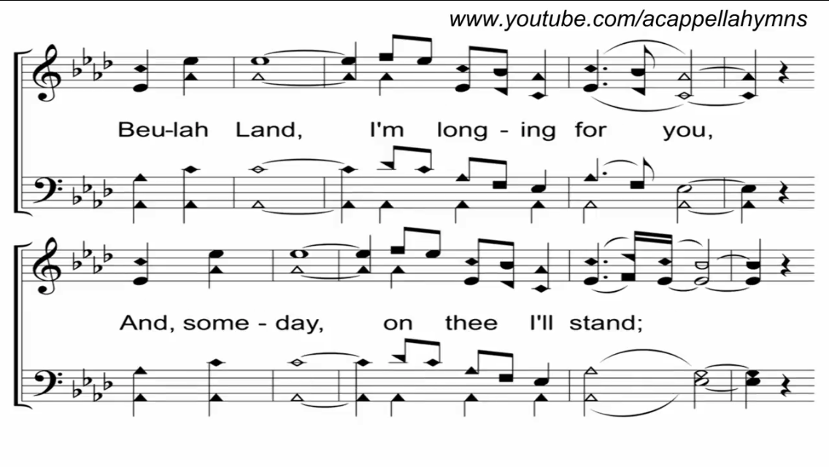

Slide 114
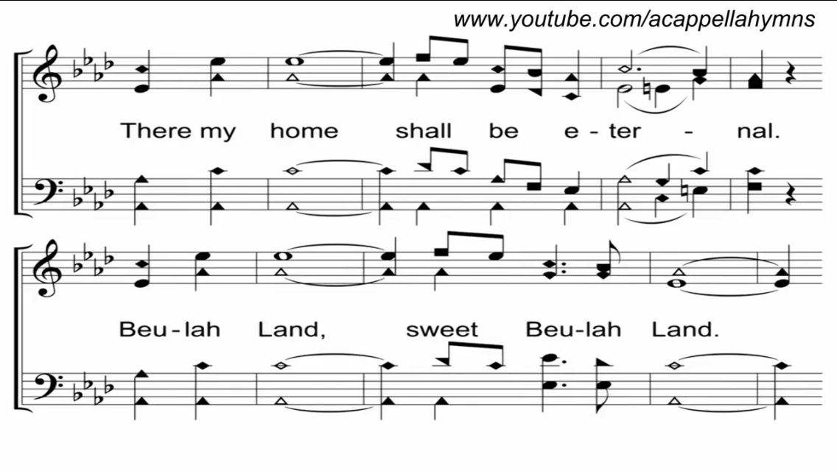

Slide 115
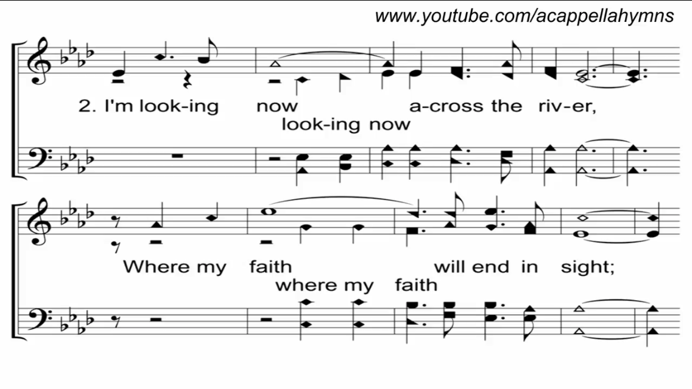

Slide 116
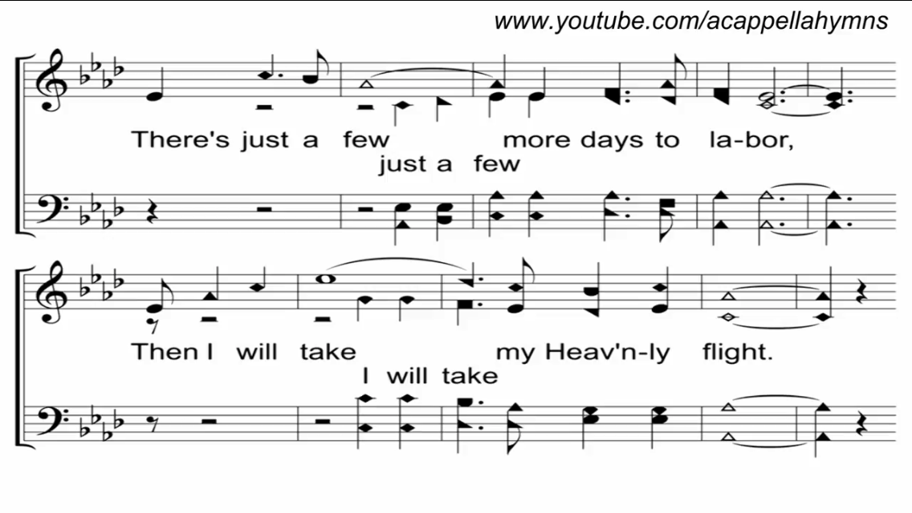

Slide 119
Join us for
Evening Worship
Tonight
@ 6:00pm!

