Slide 1
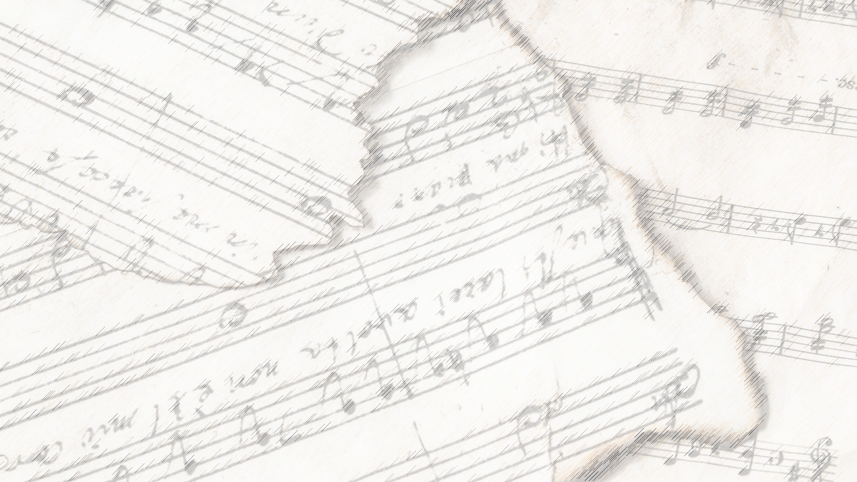
Welcome!
We Are Glad You Are Here

Slide 2
Have You Seen
Jesus My Lord?
#214

Slide 3
1-1 Have You Seen Jesus My Lord
Have You Seen Jesus My Lord
214

Slide 4
1-2 Have You Seen Jesus My Lord
Have You Seen Jesus My Lord
214

Slide 5
C-1 Have You Seen Jesus My Lord
Have You Seen Jesus My Lord
214

Slide 6
C-2 Have You Seen Jesus My Lord
Have You Seen Jesus My Lord
214

Slide 7
2-1 Have You Seen Jesus My Lord
Have You Seen Jesus My Lord
214

Slide 8
2-2 Have You Seen Jesus My Lord
Have You Seen Jesus My Lord
214

Slide 9
C-1 Have You Seen Jesus My Lord
Have You Seen Jesus My Lord
214

Slide 10
C-2 Have You Seen Jesus My Lord
Have You Seen Jesus My Lord
214

Slide 11
4-1 Have You Seen Jesus My Lord
Have You Seen Jesus My Lord
214

Slide 12
4-2 Have You Seen Jesus My Lord
Have You Seen Jesus My Lord
214

Slide 13
C-1 Have You Seen Jesus My Lord
Have You Seen Jesus My Lord
214

Slide 14
C-2 Have You Seen Jesus My Lord
Have You Seen Jesus My Lord
214

Slide 15
Master, The Tempest
Is Raging
#189

Slide 16
1-1 Master the Tempest
Master the Tempest is Raging
189

Slide 17
1-2 Master the Tempest
Master the Tempest is Raging
189

Slide 18
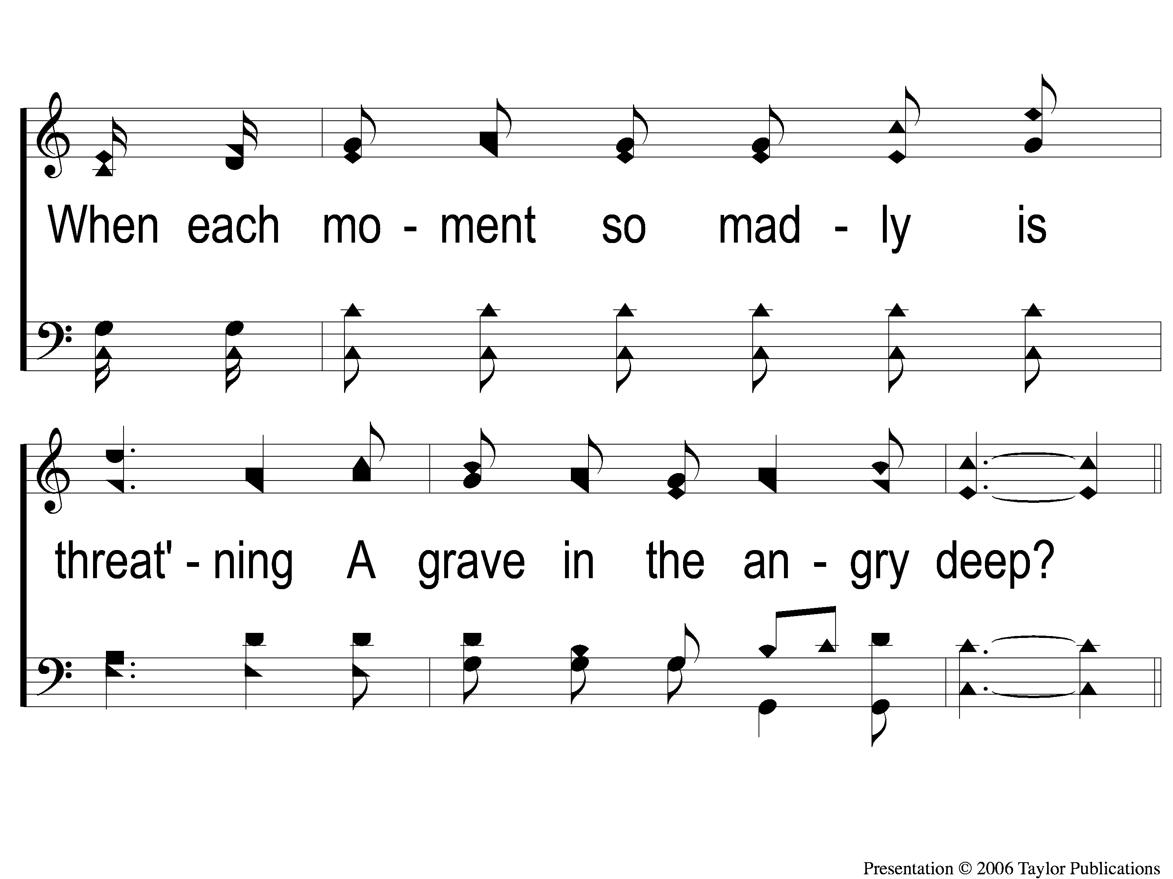
1-3 Master the Tempest
Master the Tempest is Raging
189

Slide 19
C-1 Master the Tempest
Master the Tempest is Raging
189

Slide 20
C-2 Master the Tempest
Master the Tempest is Raging
189

Slide 21
C-3 Master the Tempest
Master the Tempest is Raging
189

Slide 22
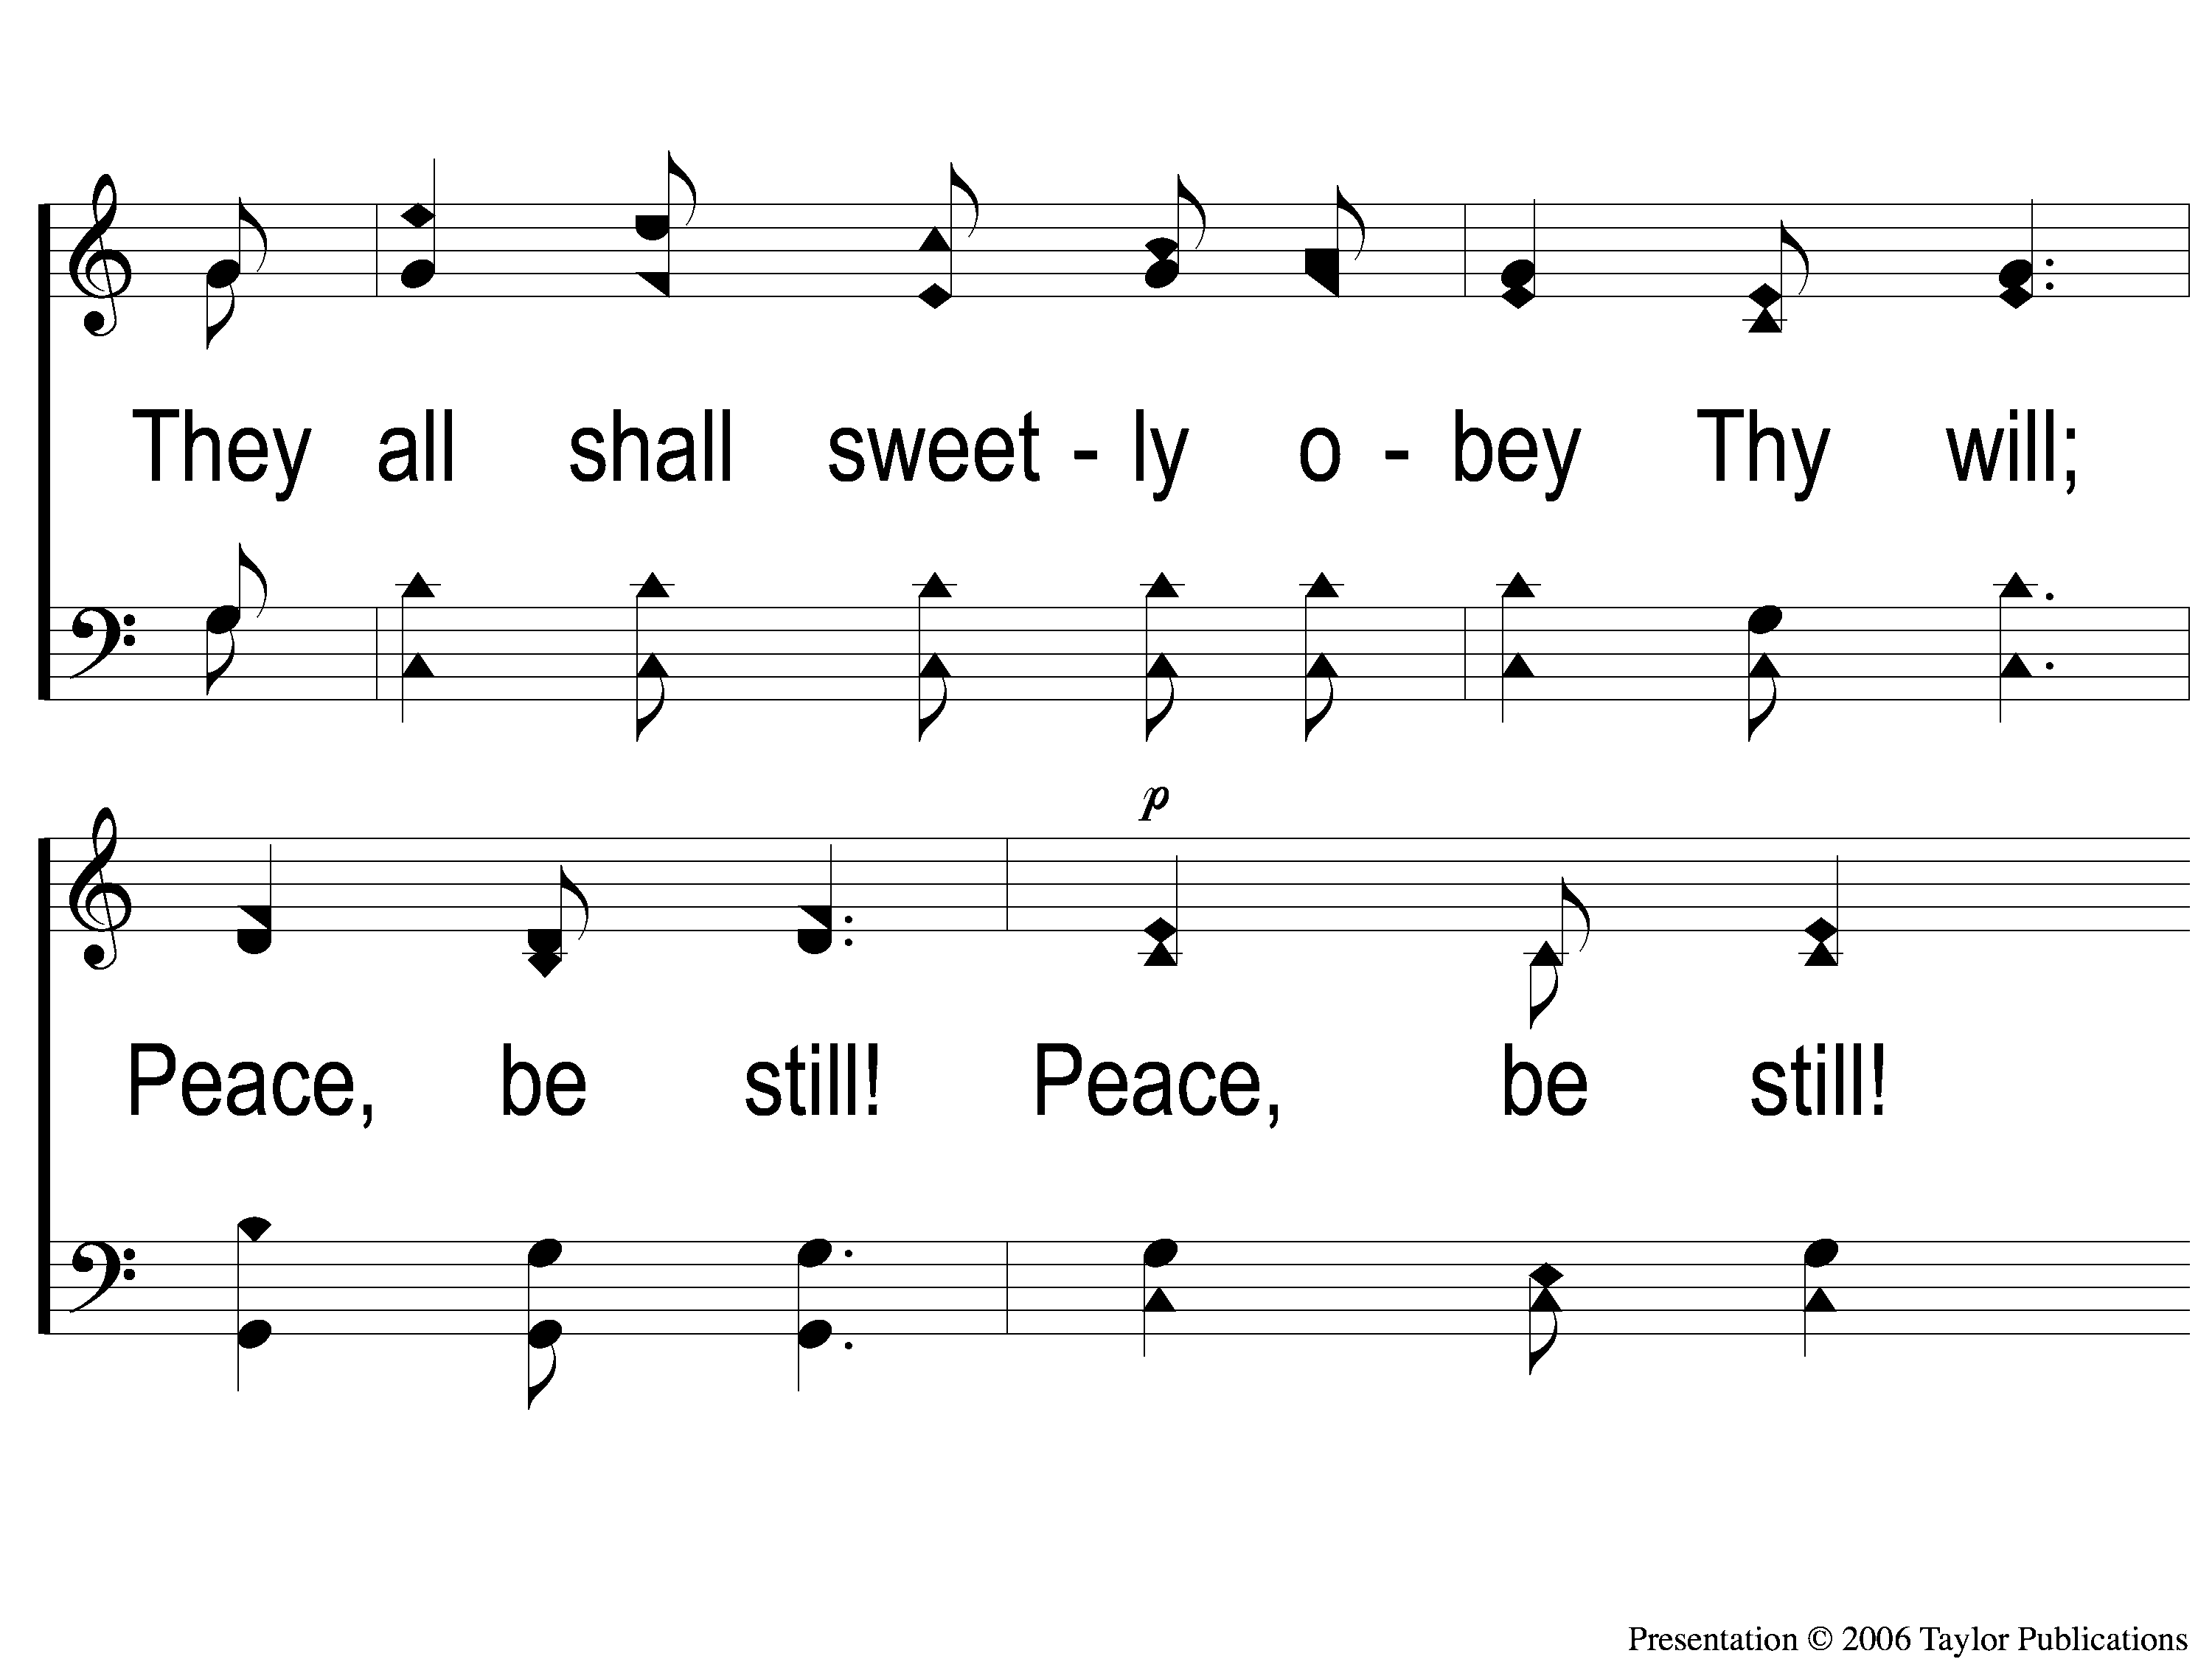
C-4 Master the Tempest
Master the Tempest is Raging
189

Slide 23
C-5 Master the Tempest
Master the Tempest is Raging
189

Slide 24
3-1 Master the Tempest
Master the Tempest is Raging
189

Slide 25
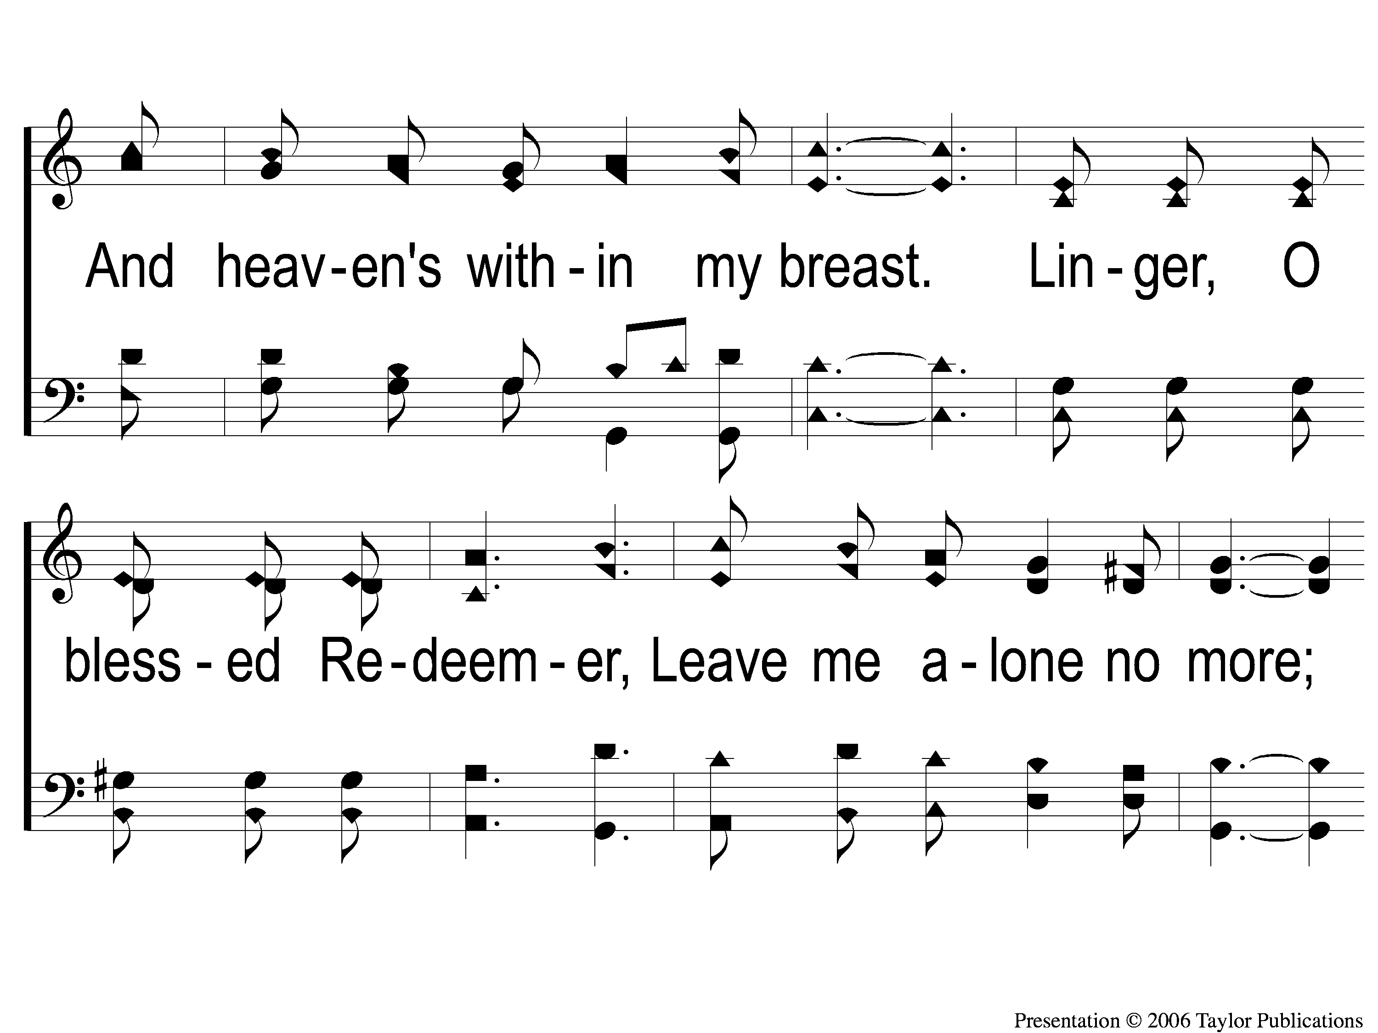
3-2 Master the Tempest
Master the Tempest is Raging
189

Slide 26
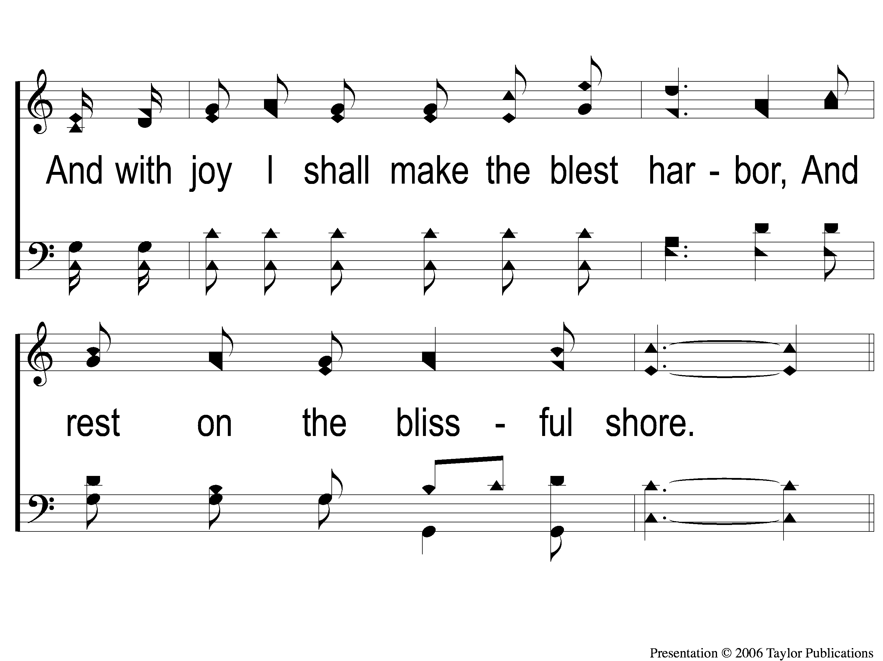
3-3 Master the Tempest
Master the Tempest is Raging
189

Slide 27
C-1 Master the Tempest
Master the Tempest is Raging
189

Slide 28
C-2 Master the Tempest
Master the Tempest is Raging
189

Slide 29
C-3 Master the Tempest
Master the Tempest is Raging
189

Slide 30
C-4 Master the Tempest
Master the Tempest is Raging
189

Slide 31
C-5 Master the Tempest
Master the Tempest is Raging
189

Slide 32
Opt Tag Master the Tempest
Master the Tempest is Raging
189
Tag

Slide 33
Opening Prayer

Slide 34
Because He Lives
#464

Slide 35
1-1 Because He Lives
Because He Lives
464

Slide 36
1-2 Because He Lives
Because He Lives
464

Slide 37
C-1 Because He Lives
Because He Lives
464

Slide 38
C-2 Because He Lives
Because He Lives
464

Slide 39
2-1 Because He Lives
Because He Lives
464

Slide 40
2-2 Because He Lives
Because He Lives
464

Slide 41
C-1 Because He Lives
Because He Lives
464

Slide 42
C-2 Because He Lives
Because He Lives
464

Slide 43
3-1 Because He Lives
Because He Lives
464

Slide 44
3-2 Because He Lives
Because He Lives
464

Slide 45
C-1 Because He Lives
Because He Lives
464

Slide 46
C-2 Because He Lives
Because He Lives
464

Slide 47
There Stands A Rock
#558

Slide 48
1-1 There Stands A Rock
There Stands A Rock
558

Slide 49
1-2 There’s Stands A Rock
There Stands A Rock
558

Slide 50
C-1 There’s Stands A Rock
There Stands A Rock
558

Slide 51
C-2 There’s Stands A Rock
There Stands A Rock
558

Slide 52
2-1 There’s Stands A Rock
There Stands A Rock
558

Slide 53
2-2 There’s Stands A Rock
There Stands A Rock
558

Slide 54
C-1 There’s Stands A Rock
There Stands A Rock
558

Slide 55
C-2 There’s Stands A Rock
There Stands A Rock
558

Slide 56
3-1 There’s Stands A Rock
There Stands A Rock
558

Slide 57
3-2 There’s Stands A Rock
There Stands A Rock
558

Slide 58
C-1 There’s Stands A Rock
There Stands A Rock
558

Slide 59
C-2 There’s Stands A Rock
There Stands A Rock
558

Slide 60
There Stands A Rock

Slide 61
Chorus:
“Some build their hopes on the ever-drifting sand,
Some on their fame, or their treasure, or their land;
Mine’s on a rock that forever will stand,
Jesus, the Rock of Ages.”

Slide 62
Verse 1:
“There stands a rock on shores of time
That rears to Heaven its head sublime.

Slide 63
A Place Of Rest
An Exalted Place
Acts 5: 31
1 Pet. 3: 22

Slide 64
Verse 1:
“There stands a rock on shores of time
That rears to Heaven its head sublime.
That rock is cleft, and they are blest
Who find within this cleft a rest.”

Slide 65
A Place Of Rest
An Resting Place
Ex. 33: 14
Matt. 11: 28-30, 6: 25-34
Heb. 4: 9, 11

Slide 66
Verse 2:
“That rock’s a cross, its arms outspread,
Celestial glory bathes its head;

Slide 67
A Place Of Salvation
Jesus & The Cross
Jn. 3: 14, 8: 28
Lk. 18: 31-33, 22: 39-44

Slide 68
Verse 2:
“That rock’s a cross, its arms outspread,
Celestial glory bathes its head;
To its firm base my all I bring,
And to the Rock of Ages cling.”

Slide 69
A Place Of Salvation
Christians & The Cross
Lk. 9: 23
1 Cor. 15: 31, Gal. 2: 20
Matt. 22: 34-37

Slide 70
Verse 3:
“That rock’s a tower, whose lofty height,
Illumed with Heaven’s unclouded light,

Slide 71
A Place Of Protection
Protection From Evil
Job 1: 9-10 Gen. 39: 2-3, 21, 23
Psa. 9: 9 2 Thess. 3: 3
1 Cor. 10: 13

Slide 72
Verse 3:
“That rock’s a tower, whose lofty height,
Illumed with Heaven’s unclouded light,
Opes wide its gate beneath the dome
Where saints find rest with Christ at home.”

Slide 73
A Place Of Protection
Eternal Protection
Deut. 33: 27 Isa. 26: 2
Jn. 14: 2-3 Heb. 6: 18
Col. 1: 5

Slide 74
Are you Clinging to
the Rock of Ages?

Slide 75
Invitation Song:
Light The Fire

Slide 76
1 Light The Fire
Light The Fire

Slide 77
C-1 Light The Fire
Light The Fire

Slide 78
C-2 Light The Fire
Light The Fire

Slide 79
2-1 Light The Fire
Light The Fire

Slide 80
2-2 Light The Fire
Light The Fire

Slide 81
C-1 Light The Fire
Light The Fire

Slide 82
C-2 Light The Fire
Light The Fire

Slide 83
The Lord’s Supper
Acts 20:7

Slide 84
Closing Prayer

Slide 85
When All Of God’s Singers Get Home
#859

Slide 86
1-1 When all of God’s Singers get Home
When All Of God’s Singers Get Home
859

Slide 87
1-2 When all of God’s Singers get Home
When All Of God’s Singers Get Home
859

Slide 88
C-1 When all of God’s Singers get Home
When All Of God’s Singers Get Home
859

Slide 89
C-2 When all of God’s Singers get Home
When All Of God’s Singers Get Home
859

Slide 90
2-1 When all of God’s Singers get Home
When All Of God’s Singers Get Home
859

Slide 91
2-2 When all of God’s Singers get Home
When All Of God’s Singers Get Home
859

Slide 92
C-1 When all of God’s Singers get Home
When All Of God’s Singers Get Home
859

Slide 93
C-2 When all of God’s Singers get Home
When All Of God’s Singers Get Home
859

Slide 94
3-1 When all of God’s Singers get Home
When All Of God’s Singers Get Home
859

Slide 95
3-2 When all of God’s Singers get Home
When All Of God’s Singers Get Home
859

Slide 96
C-1 When all of God’s Singers get Home
When All Of God’s Singers Get Home
859

Slide 97
C-2 When all of God’s Singers get Home
When All Of God’s Singers Get Home
859

Slide 98
Join us for
Worship & Bible Classes
Wednesday
@ 6:30pm!

