Slide 1
s
The Old Rugged Cross
313

Slide 2
1-2 The Old Rugged Cross
The Old Rugged Cross
313

Slide 3
C-1 The Old Rugged Cross
The Old Rugged Cross
313

Slide 4
C-2 The Old Rugged Cross
The Old Rugged Cross
313

Slide 5
RESTORE REBUILD RENEW
welcome
we are glad to
Have you with us
IN 2022
WHEELER
CHURCH
OF
CHRIST

Slide 6
Song:
When I Survey
The Wondrous Cross
#315

Slide 7
1-1 When I Survey the Wondrous Cross
When I Survey the Wondrous Cross
315

Slide 8
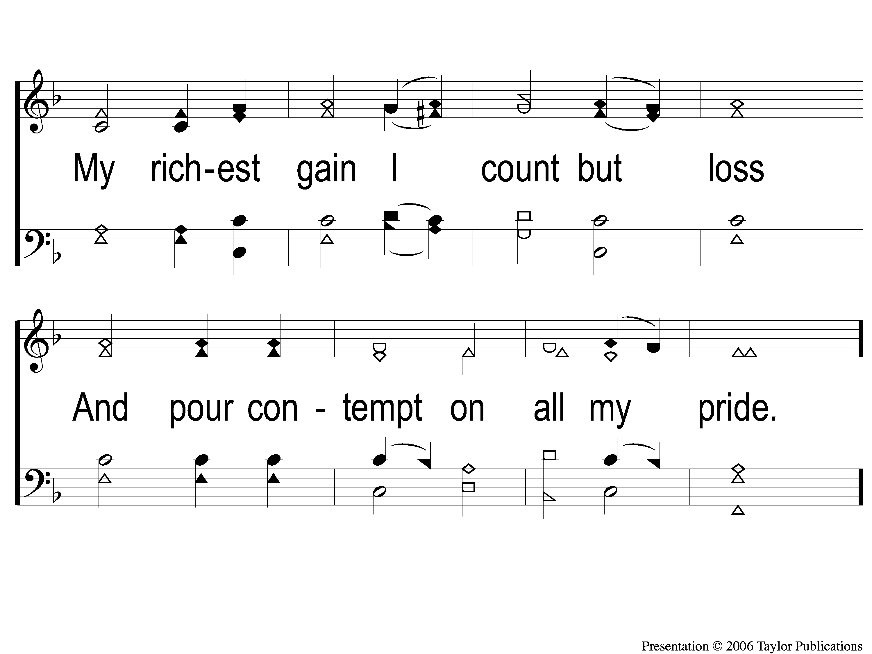
1-2 When I Survey the Wondrous Cross
When I Survey the Wondrous Cross
315

Slide 9
2-1 When I Survey the Wondrous Cross
When I Survey the Wondrous Cross
315

Slide 10
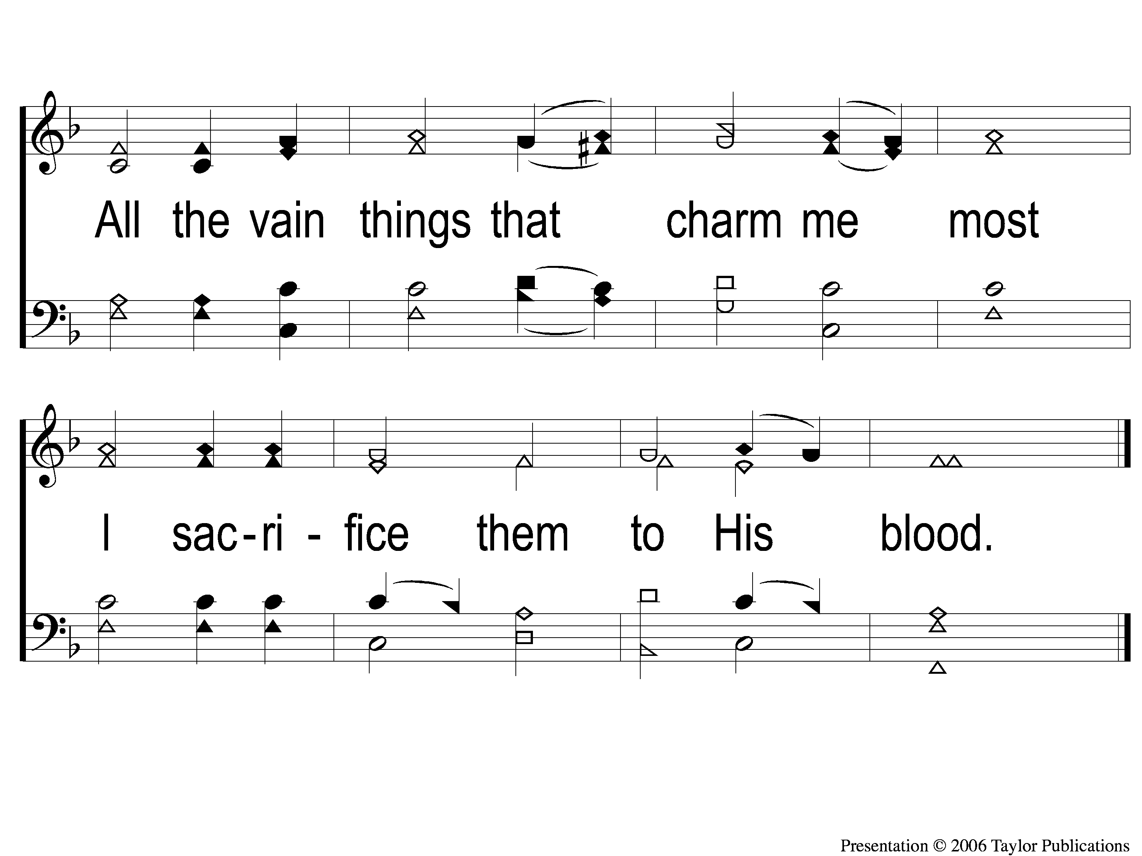
2-2 When I Survey the Wondrous Cross
When I Survey the Wondrous Cross
315

Slide 11
3-1 When I Survey the Wondrous Cross
When I Survey the Wondrous Cross
315

Slide 12
3-2 When I Survey the Wondrous Cross
When I Survey the Wondrous Cross
315

Slide 13
4-1 When I Survey the Wondrous Cross
When I Survey the Wondrous Cross
315

Slide 14
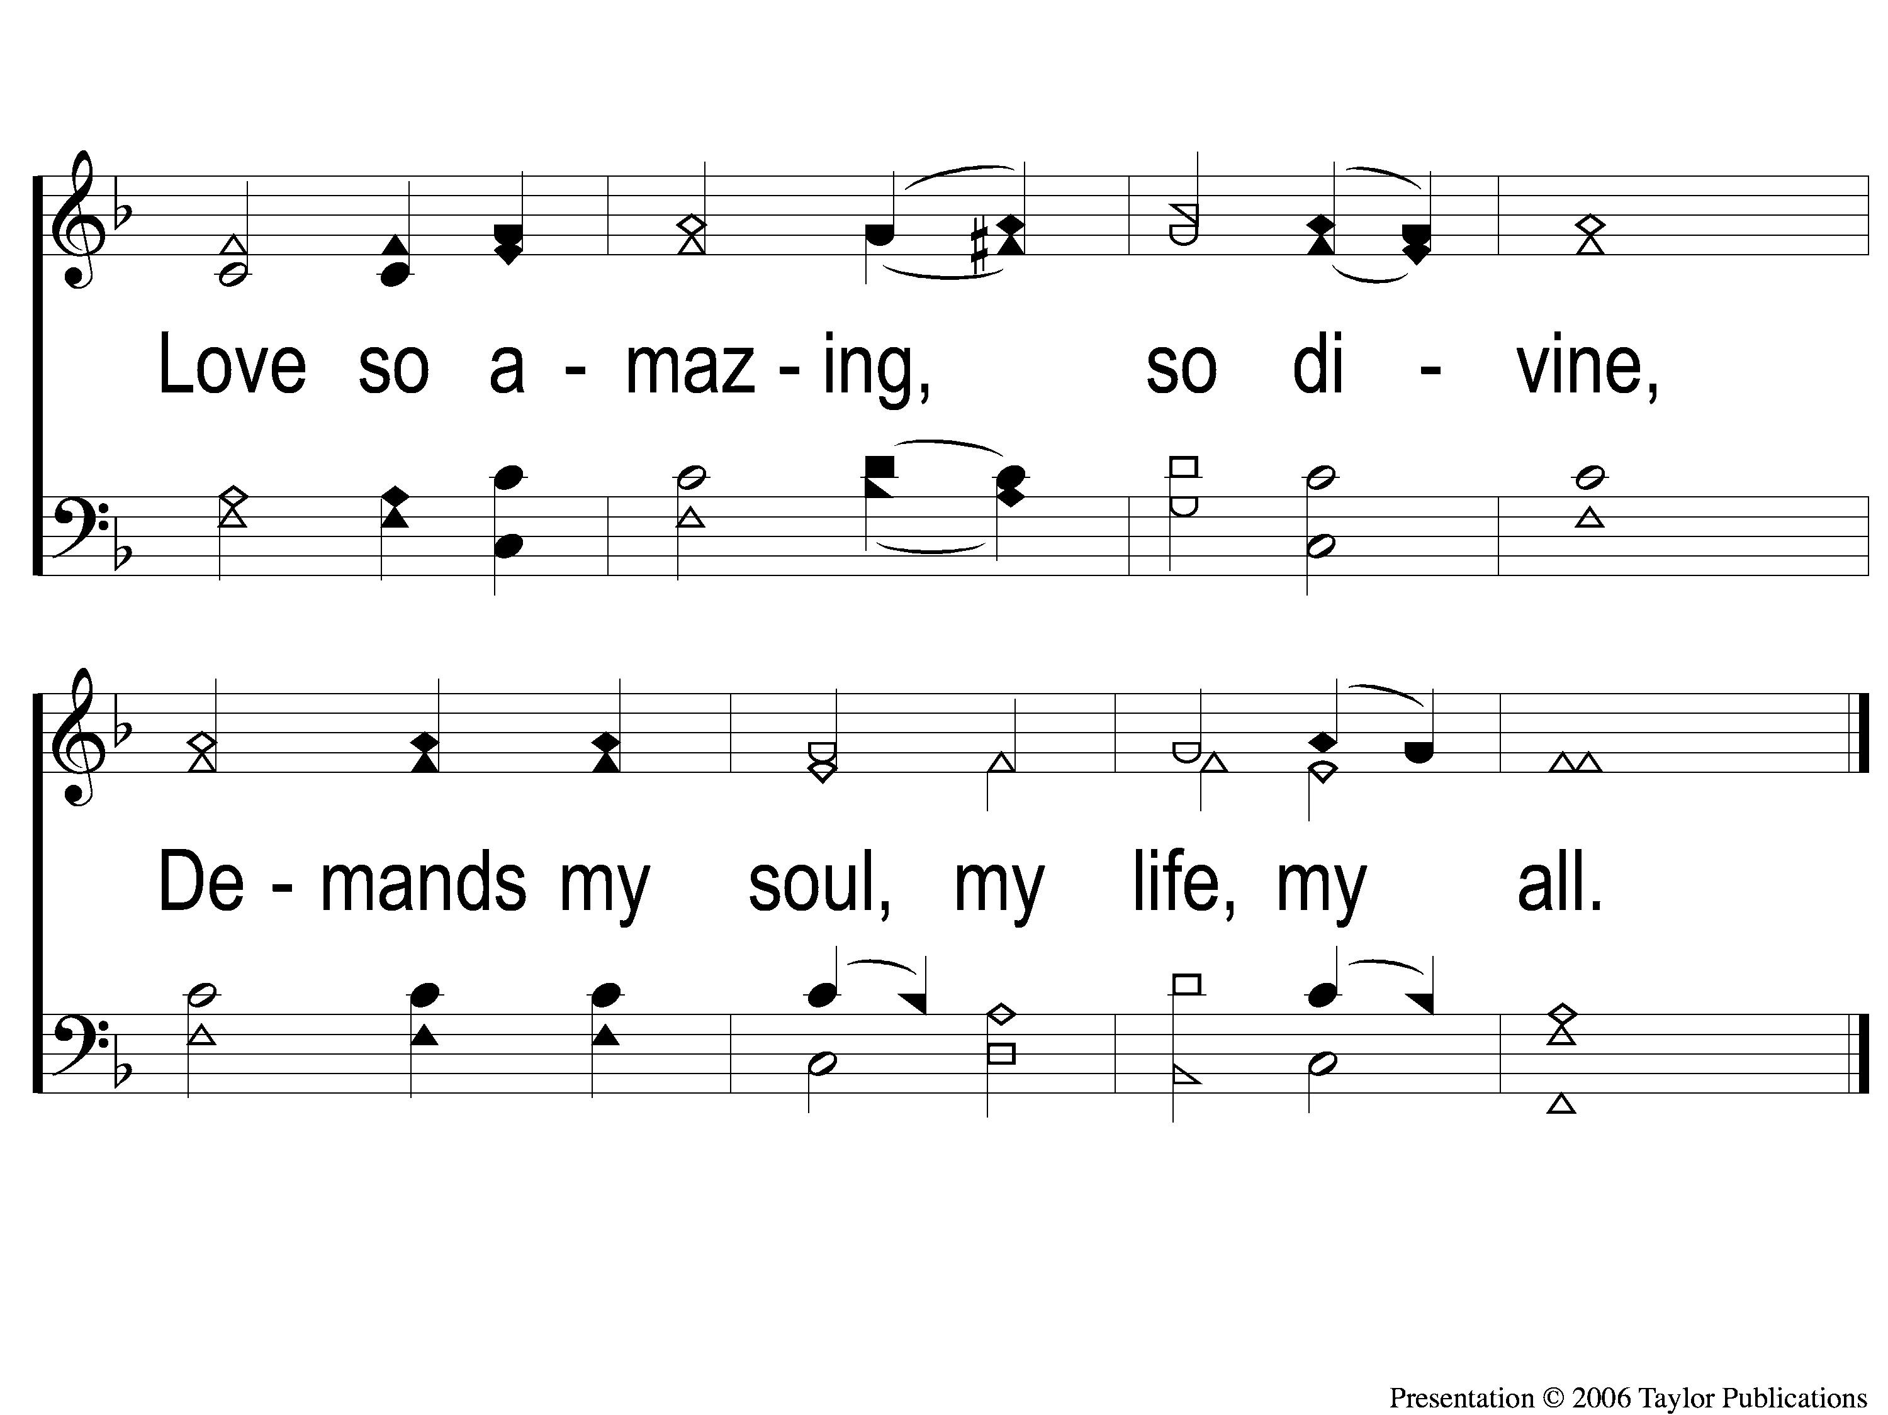
4-2 When I Survey the Wondrous Cross
When I Survey the Wondrous Cross
315

Slide 15
Song:
Alas! And Did
My Savior Bleed?
#324

Slide 16
1-1 Alas and Did My Savior Bleed
Alas! And Did My Savior Bleed?
324

Slide 17
1-2 Alas and Did My Savior Bleed
Alas! And Did My Savior Bleed?
324

Slide 18
C-1 Alas and Did My Savior Bleed
Alas! And Did My Savior Bleed?
324

Slide 19
C-2 Alas and Did My Savior Bleed
Alas! And Did My Savior Bleed?
324

Slide 20
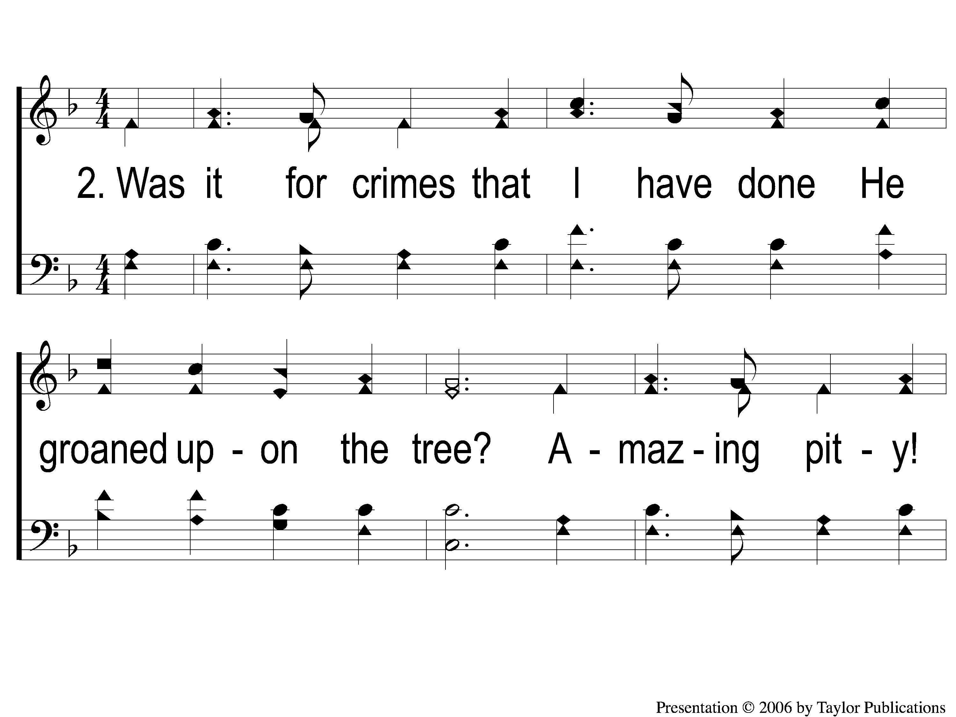
2-1 Alas and Did My Savior Bleed
Alas! And Did My Savior Bleed?
324

Slide 21
2-2 Alas and Did My Savior Bleed
Alas! And Did My Savior Bleed?
324

Slide 22
C-1 Alas and Did My Savior Bleed
Alas! And Did My Savior Bleed?
324

Slide 23
C-2 Alas and Did My Savior Bleed
Alas! And Did My Savior Bleed?
324

Slide 24
3-1 Alas and Did My Savior Bleed
Alas! And Did My Savior Bleed?
324

Slide 25
3-2 Alas and Did My Savior Bleed
Alas! And Did My Savior Bleed?
324

Slide 26
C-1 Alas and Did My Savior Bleed
Alas! And Did My Savior Bleed?
324

Slide 27
C-2 Alas and Did My Savior Bleed
Alas! And Did My Savior Bleed?
324

Slide 28
4-1 Alas and Did My Savior Bleed
Alas! And Did My Savior Bleed?
324

Slide 29
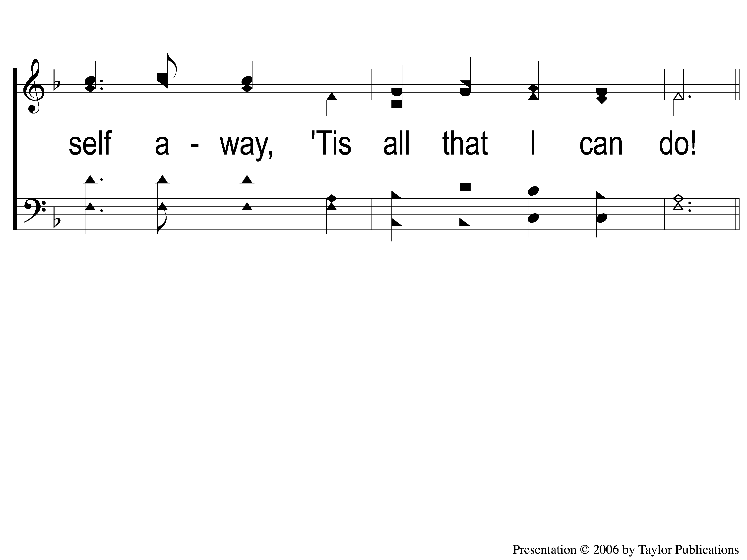
4-2 Alas and Did My Savior Bleed
Alas! And Did My Savior Bleed?
324

Slide 30
C-1 Alas and Did My Savior Bleed
Alas! And Did My Savior Bleed?
324

Slide 31
C-2 Alas and Did My Savior Bleed
Alas! And Did My Savior Bleed?
324

Slide 32
Opening Prayer

Slide 33
Song:
‘Tis Midnight and
On Olive’s Brow
#334

Slide 34
1-1 Tis Midnight and On Olive’s Brow
‘Tis Midnight and On Olive’s Brow
334

Slide 35
1-2 Tis Midnight and On Olive’s Brow
‘Tis Midnight and On Olive’s Brow
334

Slide 36
2-1 Tis Midnight and On Olive’s Brow
‘Tis Midnight and On Olive’s Brow
334

Slide 37
2-2 Tis Midnight and On Olive’s Brow
‘Tis Midnight and On Olive’s Brow
334

Slide 38
3-1 Tis Midnight and On Olive’s Brow
‘Tis Midnight and On Olive’s Brow
334

Slide 39
3-2 Tis Midnight and On Olive’s Brow
‘Tis Midnight and On Olive’s Brow
334

Slide 40
4-1 Tis Midnight and On Olive’s Brow
‘Tis Midnight and On Olive’s Brow
334

Slide 41
4-2 Tis Midnight and On Olive’s Brow
‘Tis Midnight and On Olive’s Brow
334

Slide 42
Song:
Our God, He Is Alive
#23

Slide 43
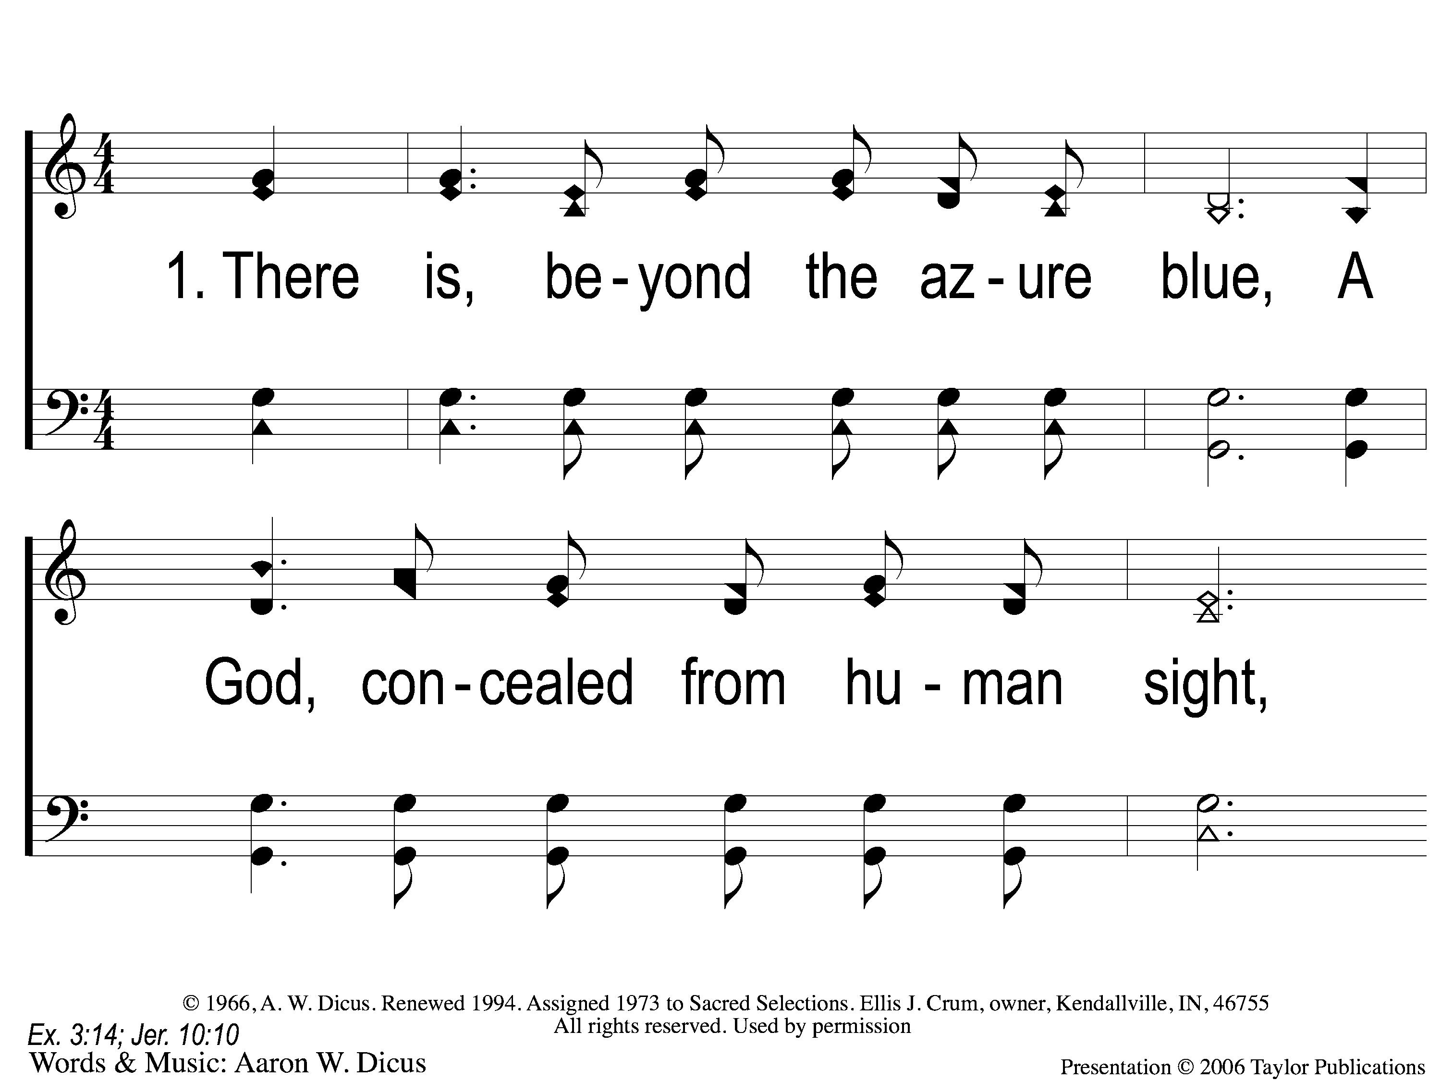
1-1 Our God He Is Alive
Our God, He Is Alive
23

Slide 44
1-2 Our God He Is Alive
Our God, He Is Alive
23

Slide 45
C-1 Our God He Is Alive
Our God, He Is Alive
23

Slide 46
C-2 Our God He Is Alive
Our God, He Is Alive
23

Slide 47
2-1 Our God He Is Alive
Our God, He Is Alive
23

Slide 48
2-2 Our God He Is Alive
Our God, He Is Alive
23

Slide 49
C-1 Our God He Is Alive
Our God, He Is Alive
23

Slide 50
C-2 Our God He Is Alive
Our God, He Is Alive
23

Slide 51
3-1 Our God He Is Alive
Our God, He Is Alive
23

Slide 52
3-2 Our God He Is Alive
Our God, He Is Alive
23

Slide 53
C-1 Our God He Is Alive
Our God, He Is Alive
23

Slide 54
C-2 Our God He Is Alive
Our God, He Is Alive
23

Slide 55
4-1 Our God He Is Alive
Our God, He Is Alive
23

Slide 56
4-2 Our God He Is Alive
Our God, He Is Alive
23

Slide 57
C-1 Our God He Is Alive
Our God, He Is Alive
23

Slide 58
C-2 Our God He Is Alive
Our God, He Is Alive
23

Slide 59
Scripture Reading:
Psalm 19:1-4

Slide 60
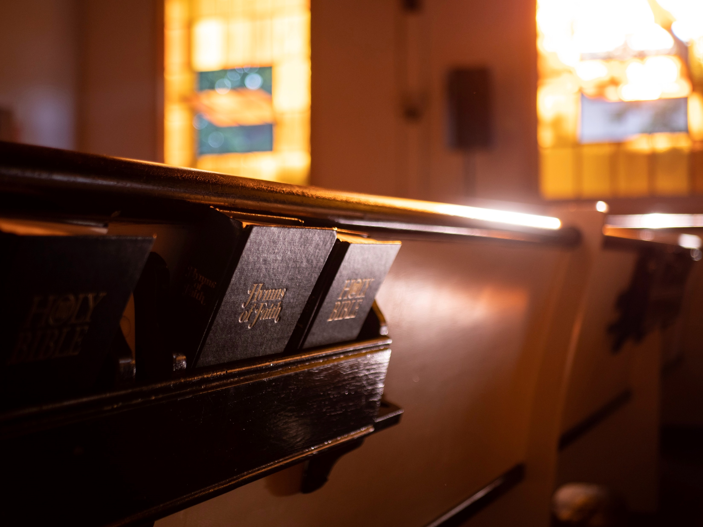
Renewed
by
Hymns

Slide 61
Tonight’s
Lesson:
Pierce
My Ear

Slide 62
Our God,
He Is Alive

Slide 63
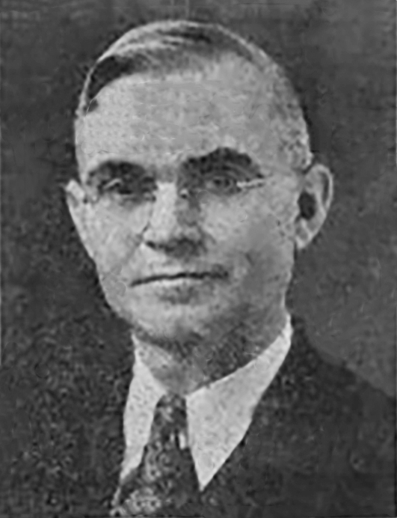
Hymn History
Words & Music: Aaron Wesley Dicus (1888-1978)
Published: 1966
Occasion: Unknown

Slide 64
Lessons
God’s Power is Unmatchable

Slide 65
Stanza 1
"There is, beyond the azure blue, A God concealed from human sight; He tinted skies with heavenly hue, And framed the worlds with His great might."

Slide 66
Lessons
God’s Power is Unmatchable
Matt. 6:9, Gen. 1:1, Heb. 11:3, Psa. 29

Slide 67
Lessons
God’s Power is Unmatchable
Matt. 6:9, Gen. 1:1, Heb. 11:3, Psa. 29
God’s Wisdom is Unfathomable

Slide 68
Stanza 3
"Secure is life from mortal mind;
God holds the germ within His hand.
Though men may search they cannot find, For God alone does understand.“

Slide 69
Lessons
God’s Power is Unmatchable
Matt. 6:9, Gen. 1:1, Heb. 11:3, Psa. 29
God’s Wisdom is Unfathomable
Gen. 1:26-28, 2:7, Job 36:24-33, 38:4-7

Slide 70
Lessons
God Desires to Speak to Us

Slide 71
Stanza 2
"There was, a long, long time ago, A God whose voice the prophets heard;
He is the God that we should know, Who speaks from His inspired word.”

Slide 72
Lessons
God Desires to Speak to Us
1 Pet. 1:10-12, 2 Pet. 1:19-21, Jn. 17:1-3

Slide 73
Lessons
God Desires to Speak to Us
1 Pet. 1:10-12, 2 Pet. 1:19-21, Jn. 17:1-3
Heb. 1:1-4, 2 Tim. 3:16-17

Slide 74
Lessons
God Desires to Speak to Us
1 Pet. 1:10-12, 2 Pet. 1:19-21, Jn. 17:1-3
Heb. 1:1-4, 2 Tim. 3:16-17
God Gave His Only Son for Us

Slide 75
Stanza 4
"Our God–whose Son upon a tree
A life was willing there to give,
That He from sin might set man free,
And evermore with Him could live.”

Slide 76
Lessons
God Desires to Speak to Us
1 Pet. 1:10-12, 2 Pet. 1:19-21, Jn. 17:1-3
Heb. 1:1-4, 2 Tim. 3:16-17
God Gave His Only Son for Us
Jn. 3:16, Rom. 5:6-8, Matt. 25:35, 26:28

Slide 77
Chorus
"There is a God, He is alive,
In Him we live, and we survive.
From dust our God created man;
He is our God, the great I AM."

Slide 78
Respond
To God’s Grace

Slide 79
I Gave My Life For Thee
#354
Invitation
Song:

Slide 80
1-1 I Gave My Life For Thee
I Gave My Life for Thee
354

Slide 81
1-2 I Gave My Life For Thee
I Gave My Life for Thee
354

Slide 82
2-1 I Gave My Life For Thee
I Gave My Life for Thee
354

Slide 83
2-2 I Gave My Life For Thee
I Gave My Life for Thee
354

Slide 84
3-1 I Gave My Life For Thee
I Gave My Life for Thee
354

Slide 85
3-2 I Gave My Life For Thee
I Gave My Life for Thee
354

Slide 86
4-1 I Gave My Life For Thee
I Gave My Life for Thee
354

Slide 87
4-2 I Gave My Life For Thee
I Gave My Life for Thee
354

Slide 88
The Contribution:
Hebrews 13:15-16
“Therefore by Him let us continually offer the sacrifice of praise to God, that is, the fruit of our lips, giving thanks to His name. But do not forget to do good and to share, for with such sacrifices God is well pleased.”

Slide 89
Song:
When My Love
To Christ Grows Weak
#350

Slide 90
1-1 When My Love To Christ Grows Weak
When My Love to Christ Grows Weak
350

Slide 91
1-2 When My Love To Christ Grows Weak
When My Love to Christ Grows Weak
350

Slide 92
2-1 When My Love To Christ Grows Weak
When My Love to Christ Grows Weak
350

Slide 93
2-2 When My Love To Christ Grows Weak
When My Love to Christ Grows Weak
350

Slide 94
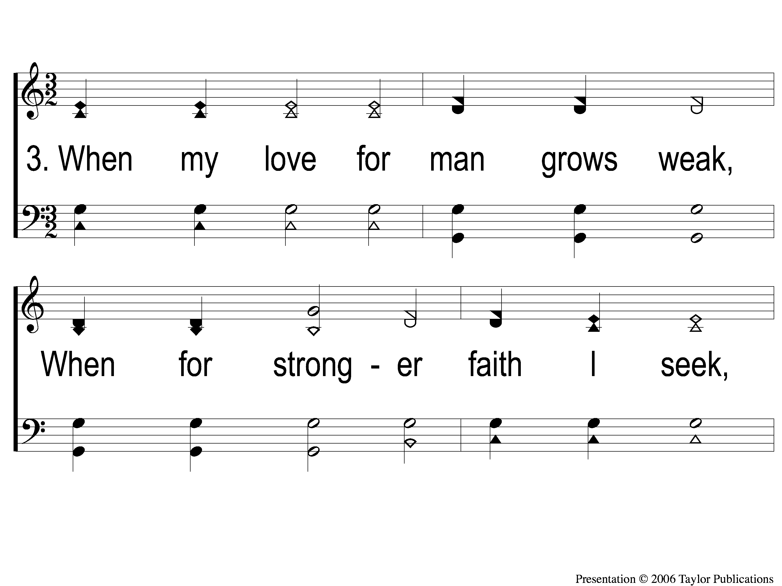
3-1 When My Love To Christ Grows Weak
When My Love to Christ Grows Weak
350

Slide 95
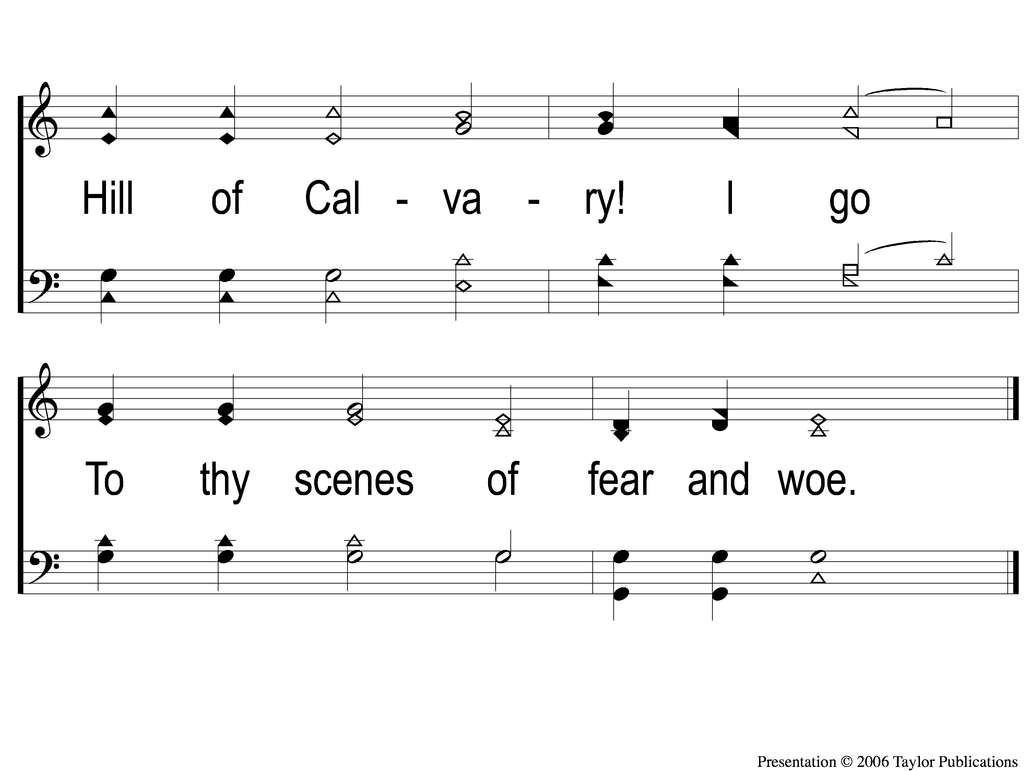
3-2 When My Love To Christ Grows Weak
When My Love to Christ Grows Weak
350

Slide 96
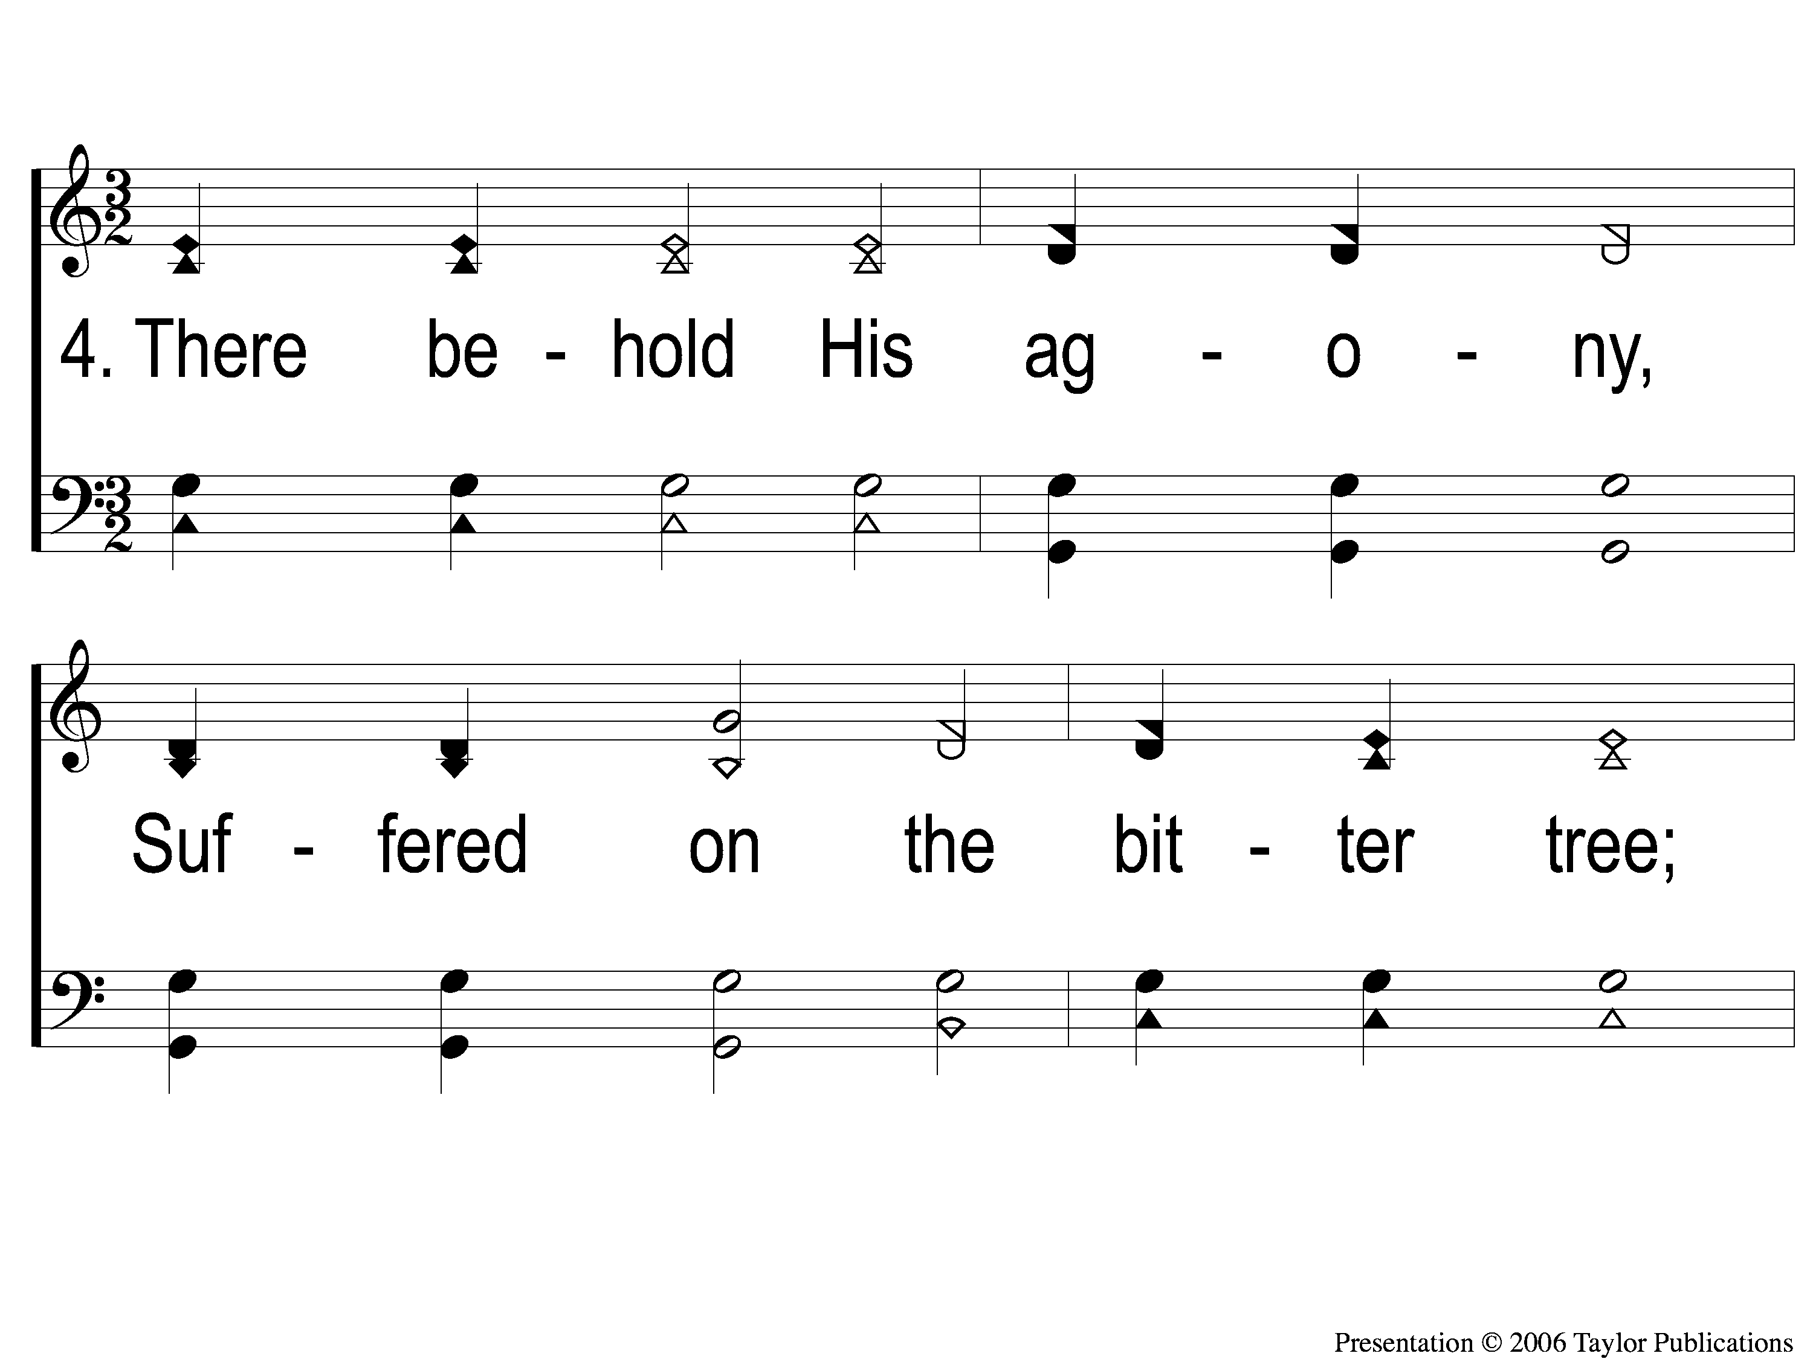
4-1 When My Love To Christ Grows Weak
When My Love to Christ Grows Weak
350

Slide 97
4-2 When My Love To Christ Grows Weak
When My Love to Christ Grows Weak
350

Slide 98
5-1 When My Love To Christ Grows Weak
When My Love to Christ Grows Weak
350

Slide 99
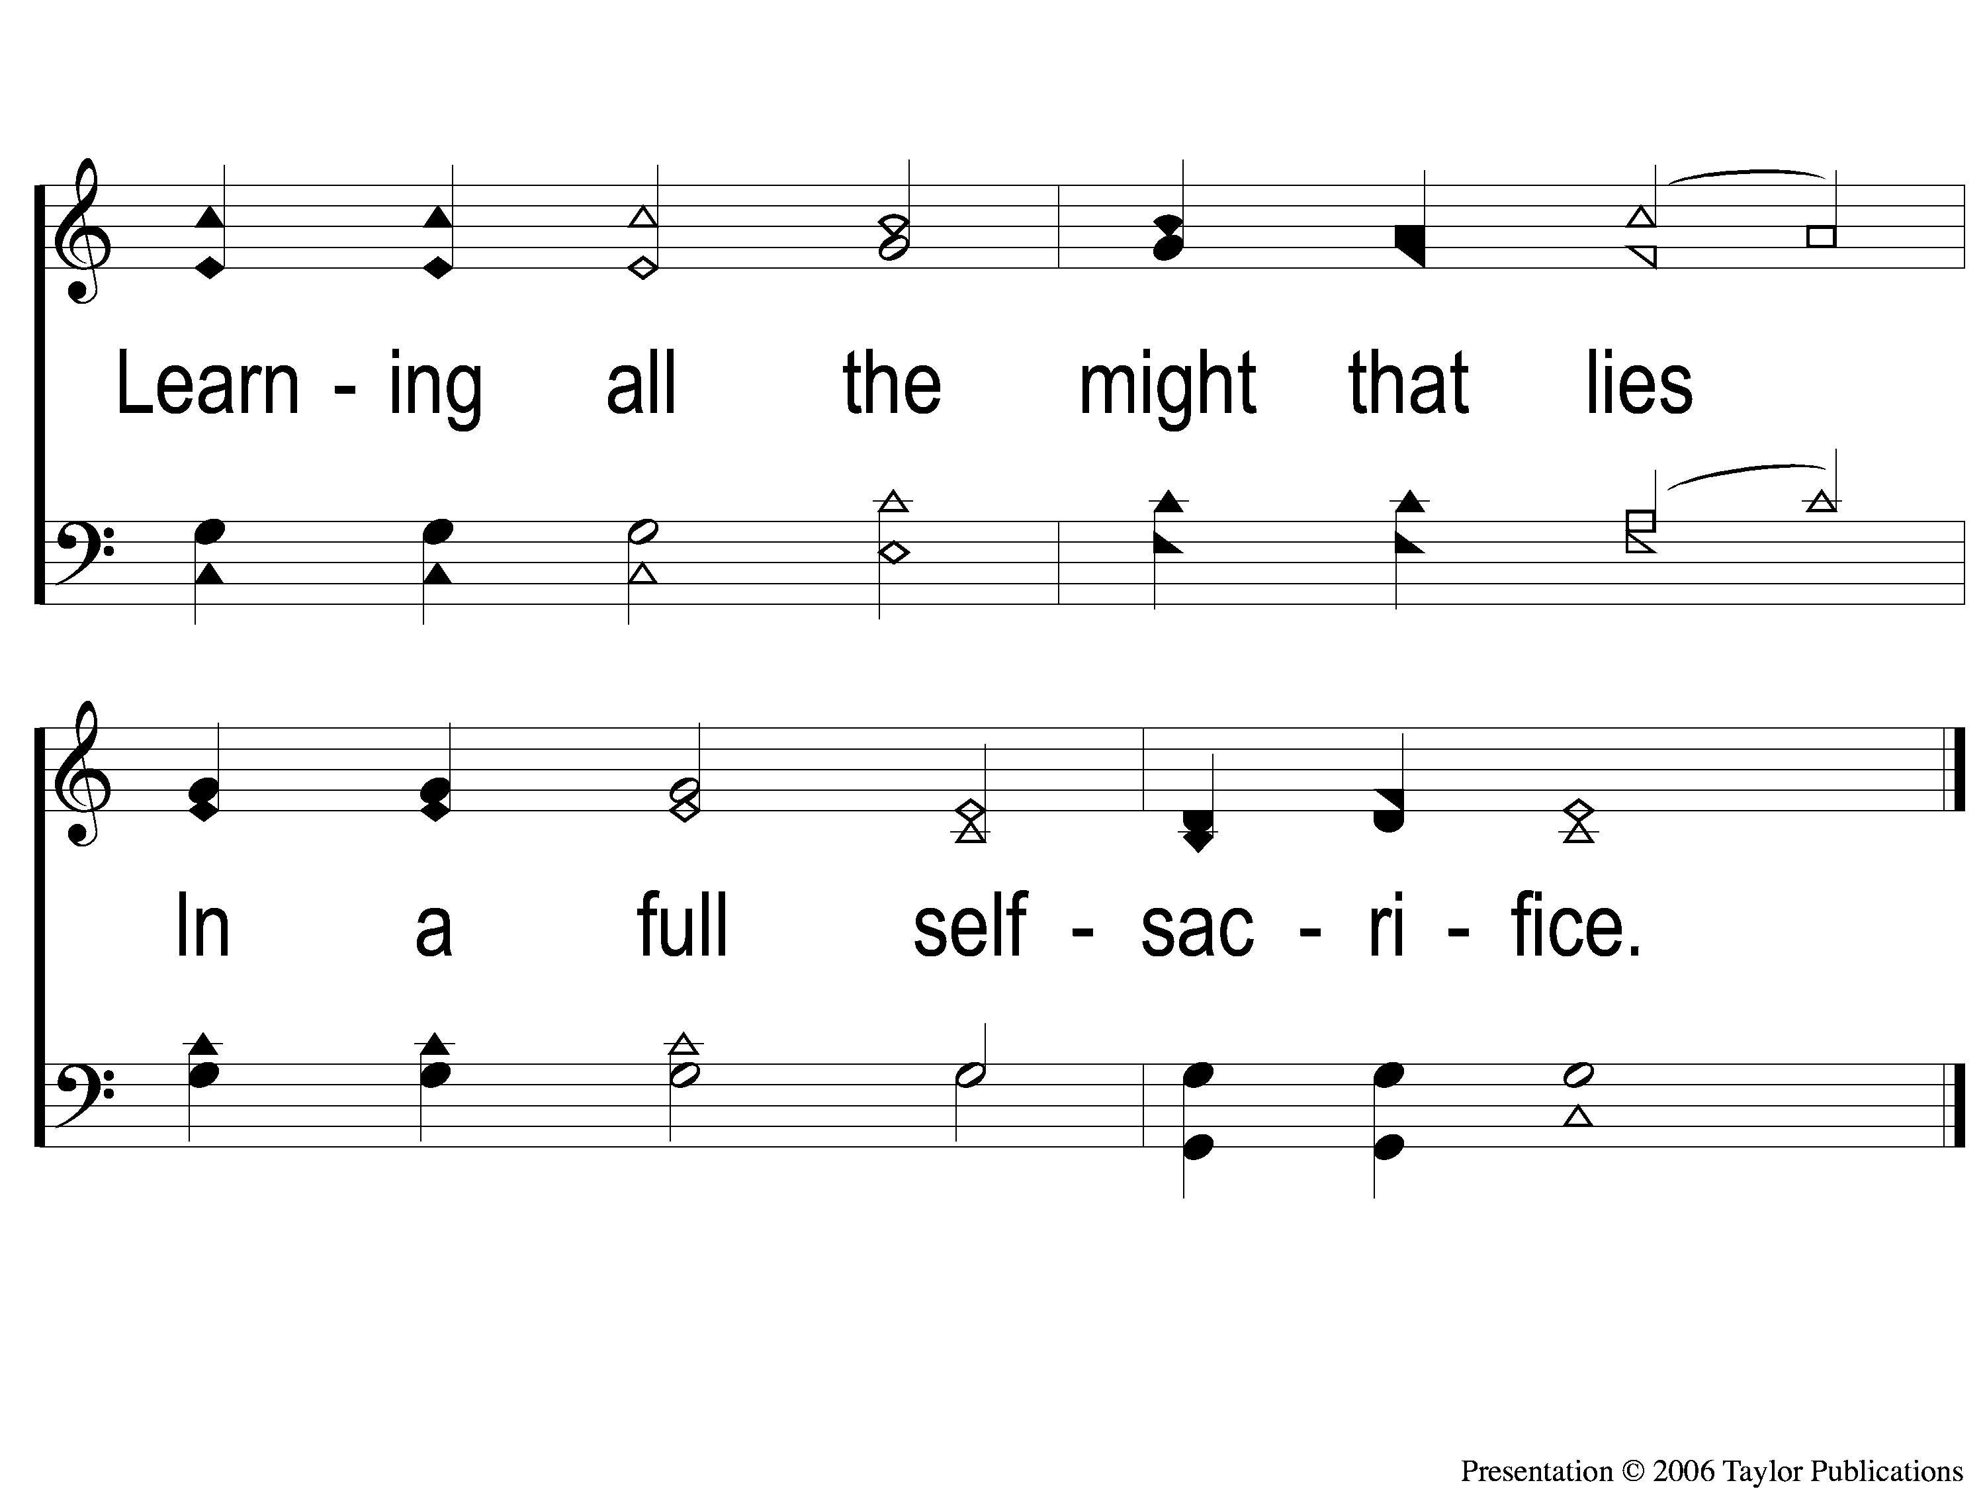
5-2 When My Love To Christ Grows Weak
When My Love to Christ Grows Weak
350

Slide 100
The Unleavened Bread
Hebrews 4:14-16
“Seeing then that we have a great High Priest who has passed through the heavens, Jesus the Son of God, olet us hold fast our confession. For we do not have a High Priest who cannot sympathize with our weaknesses, but was in all points tempted as we are, yet without sin. Let us therefore come boldly to the throne of grace, that we may obtain mercy and find grace to help in time of need.”

Slide 101
The Fruit
of the Vine
Hebrews 9:11-14
“But Christ came as High Priest of the good things to come, with the greater and more perfect tabernacle not made with hands, that is, not of this creation. Not with the blood of goats and calves, but with His own blood…For if the blood of bulls and goats and the ashes of a heifer, sprinkling the unclean, sanctifies for the purifying of the flesh, how much more shall the blood of Christ, who through the eternal Spirit offered Himself without spot to God, cleanse your conscience from dead works to serve the living God?”

Slide 102
Closing Prayer

Slide 103
Song:
Nailed To The Cross
#361

Slide 104
1-1 Nailed to the Cross
Nailed To the Cross
361

Slide 105
1-2 Nailed to the Cross
Nailed To the Cross
361

Slide 106
C-1 Nailed to the Cross
Nailed To the Cross
361

Slide 107
C-2 Nailed to the Cross
Nailed To the Cross
361

Slide 108
2-1 Nailed to the Cross
Nailed To the Cross
361

Slide 109
2-2 Nailed to the Cross
Nailed To the Cross
361

Slide 110
C-1 Nailed to the Cross
Nailed To the Cross
361

Slide 111
C-2 Nailed to the Cross
Nailed To the Cross
361

Slide 112
3-1 Nailed to the Cross
Nailed To the Cross
361

Slide 113
3-2 Nailed to the Cross
Nailed To the Cross
361

Slide 114
C-1 Nailed to the Cross
Nailed To the Cross
361

Slide 115
C-2 Nailed to the Cross
Nailed To the Cross
361

Slide 116
RESTORE REBUILD RENEW
tonight
Worship @ 6:00 PM
Wednesday
Worship & Classes & 6:30 PM
IN 2022
WHEELER
CHURCH
OF
CHRIST

Slide 117
Today
Join us in the MPB for
A Fellowship Meal & Devo
Wednesday
Worship & Classes & 6:30 PM
RESTORE REBUILD RENEW
IN 2022
WHEELER
CHURCH
OF
CHRIST

