Slide 1
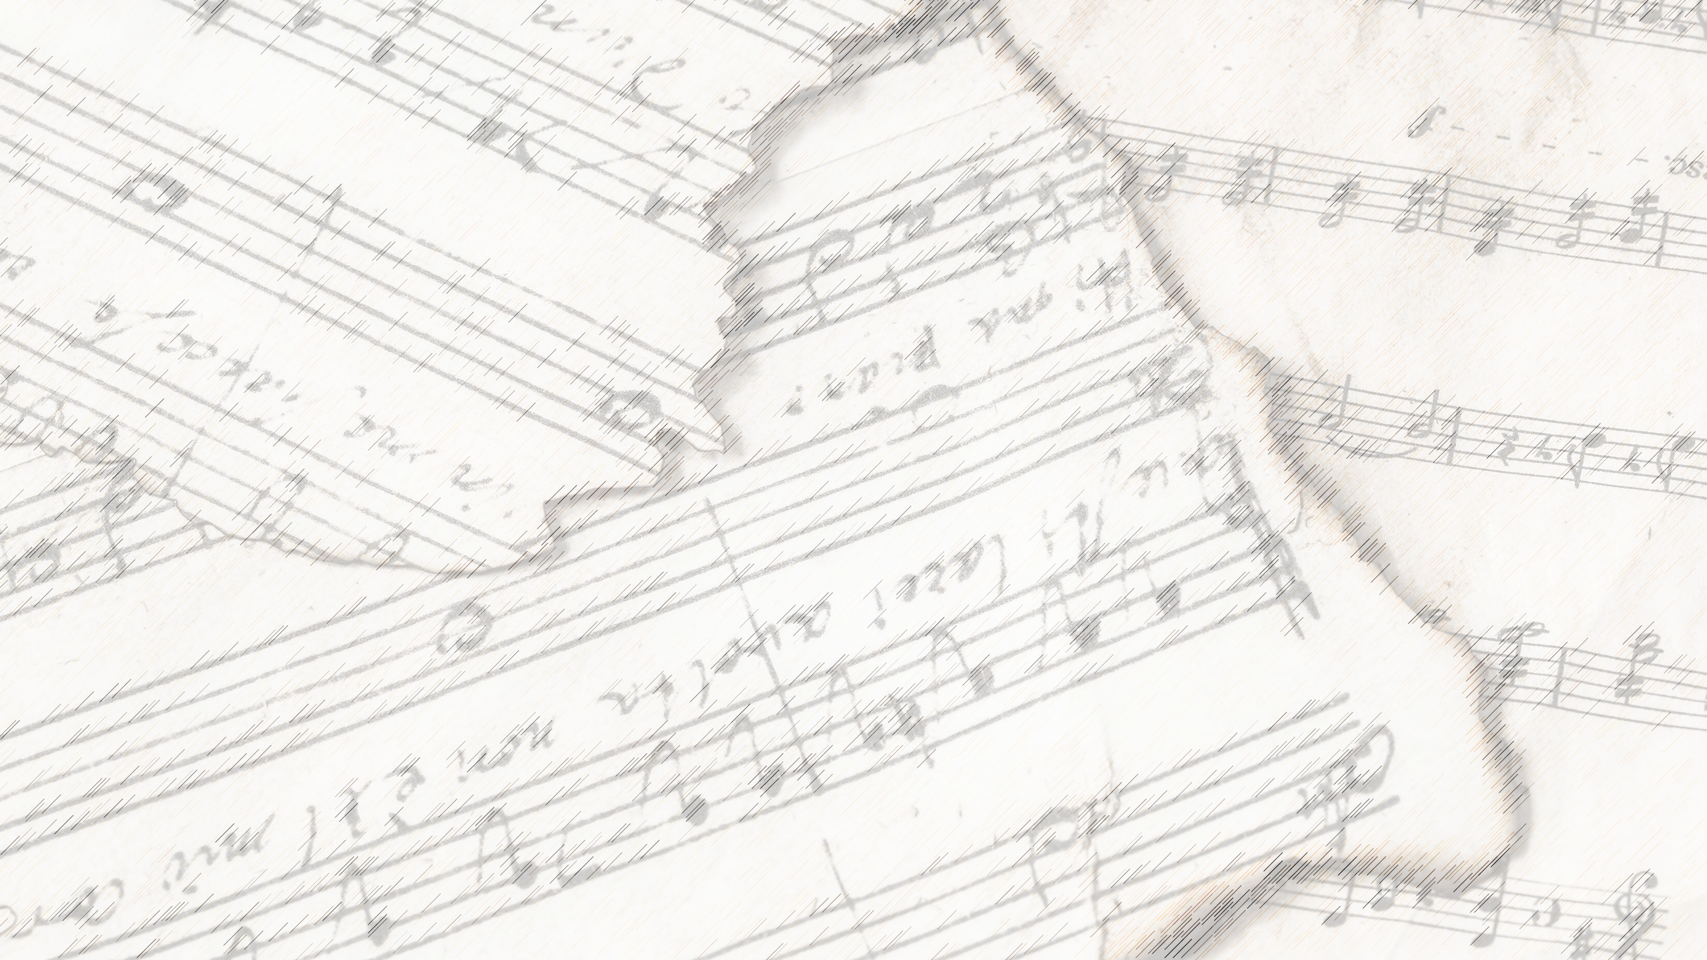
Welcome!
We Are Glad You Are Here

Slide 2
A Shelter In
Time of Storm
#472

Slide 3
1-1 A Shelter in Time of Storm
A Shelter in Time of Storm
472

Slide 4
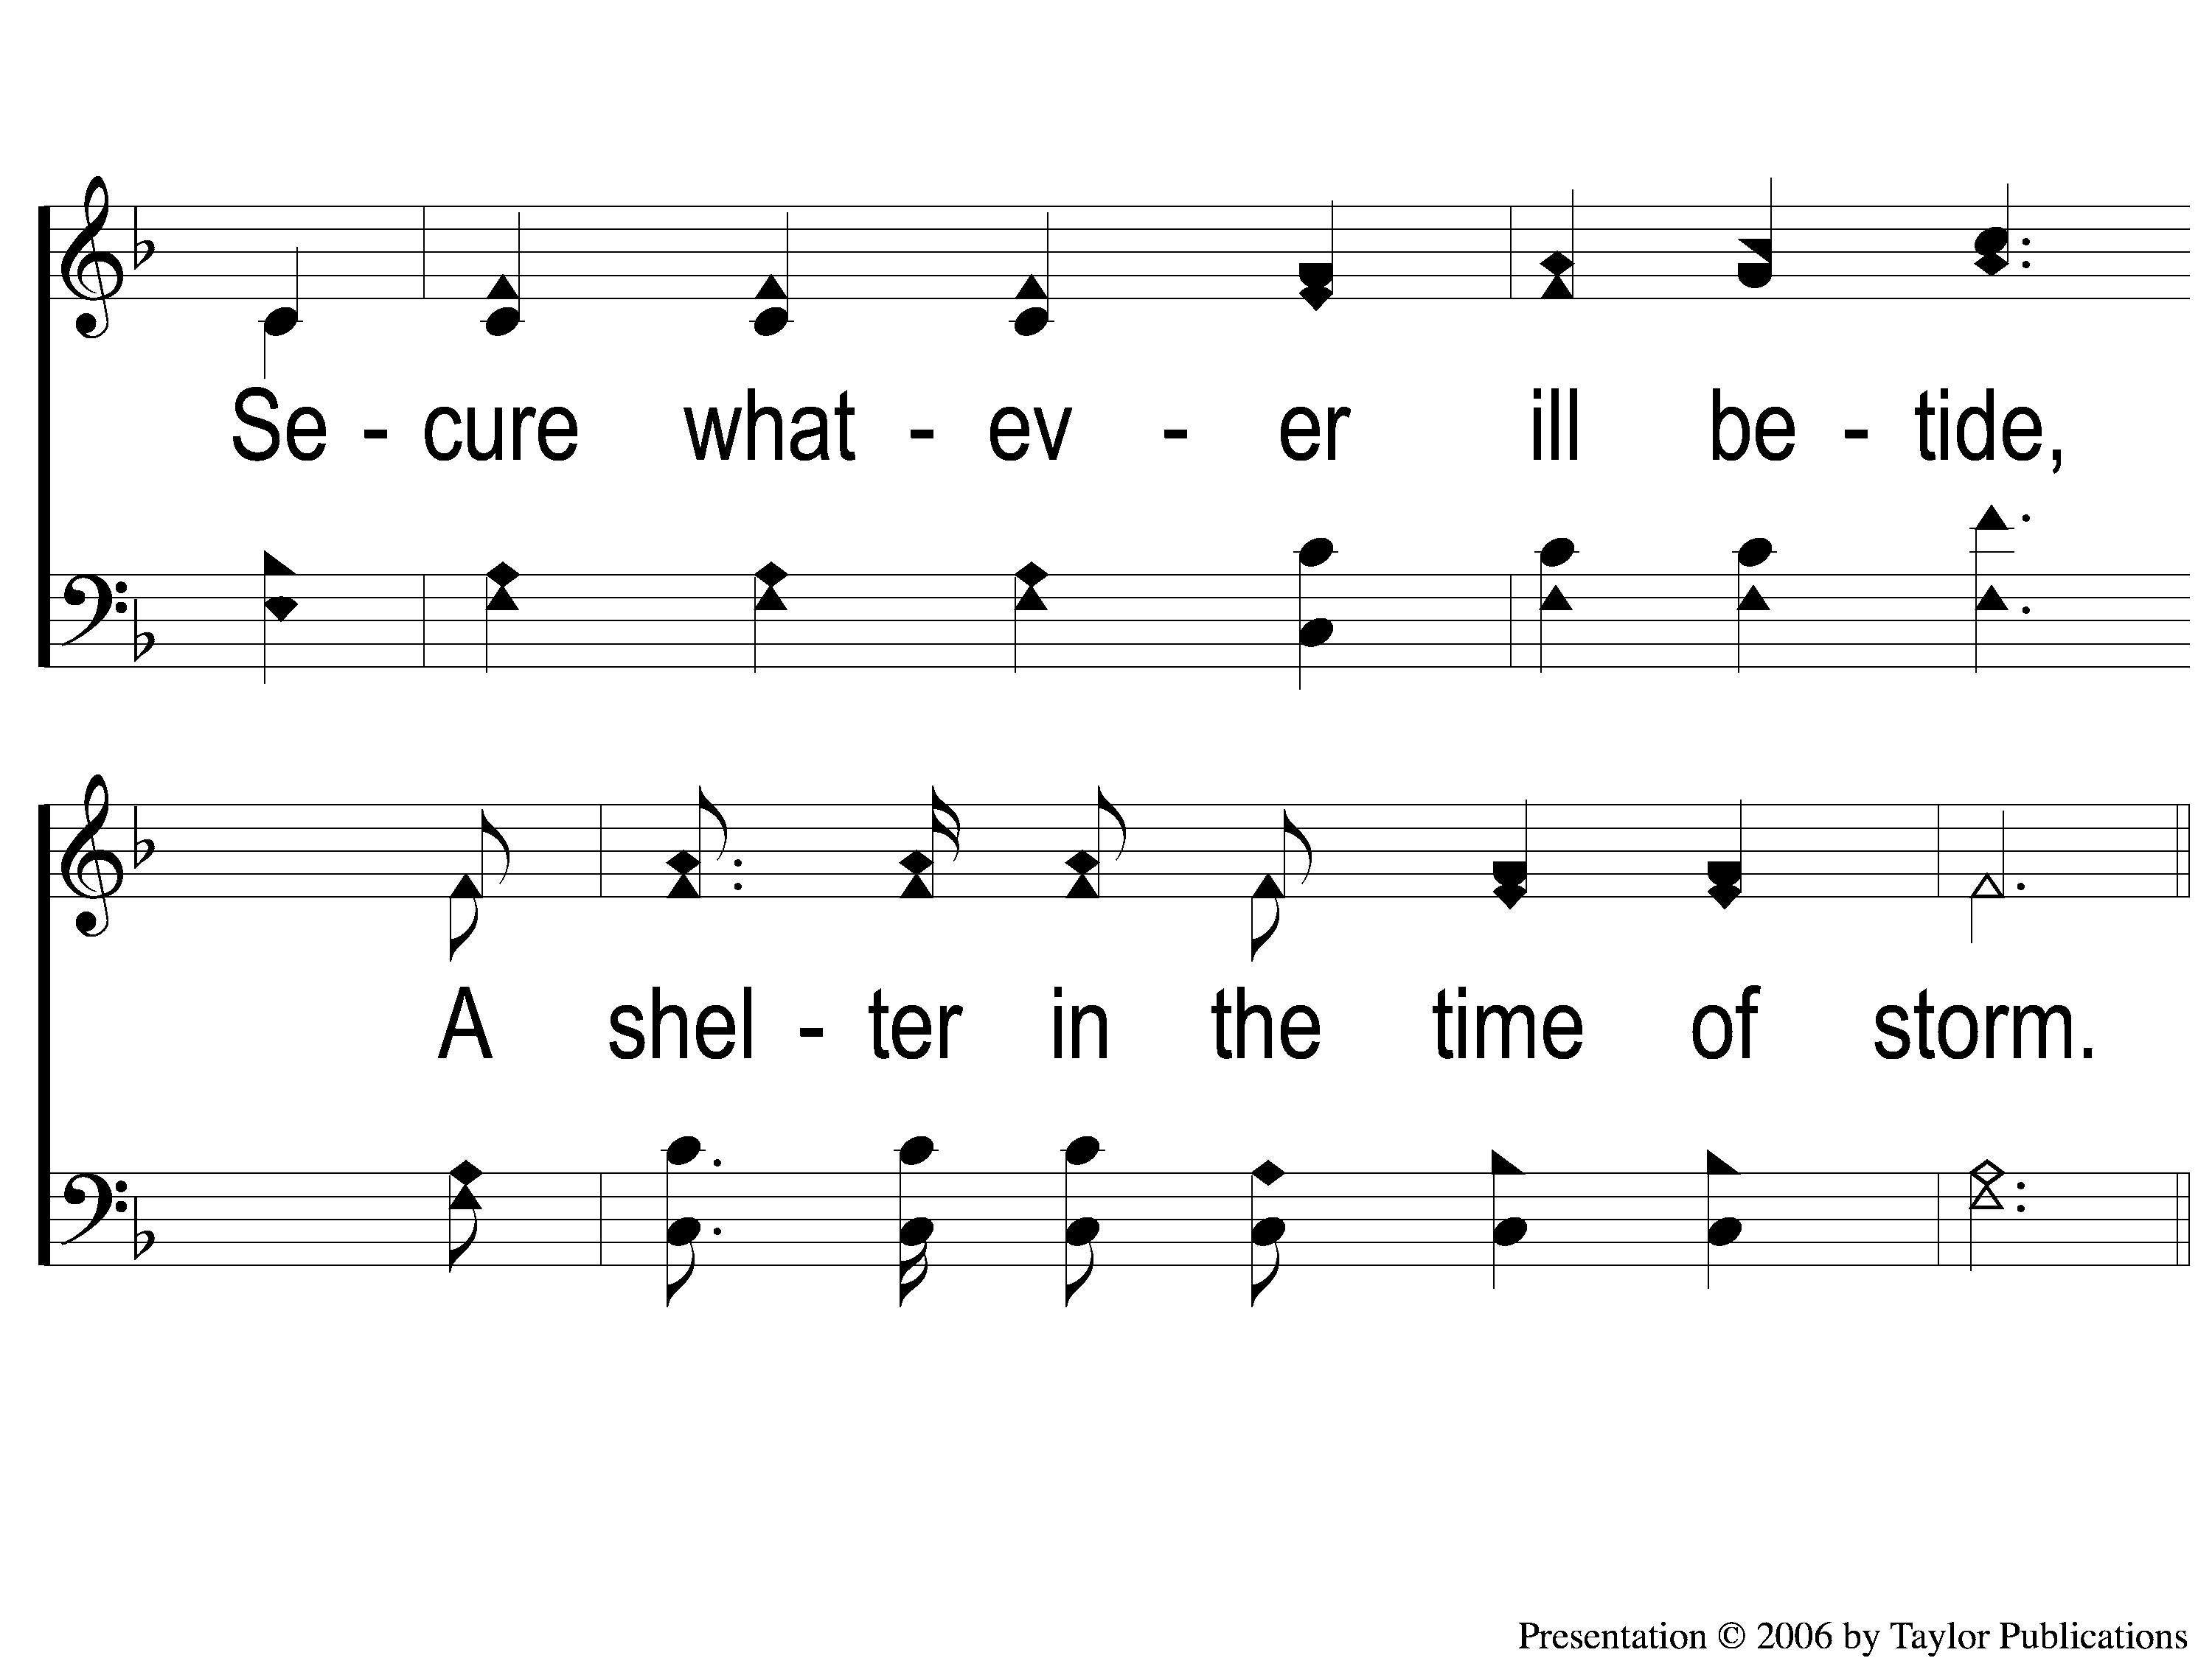
1-2 A Shelter in Time of Storm
A Shelter in Time of Storm
472

Slide 5
C-1 A Shelter in Time of Storm
472
A Shelter in Time of Storm

Slide 6
C-2 A Shelter in Time of Storm
A Shelter in Time of Storm
472

Slide 7
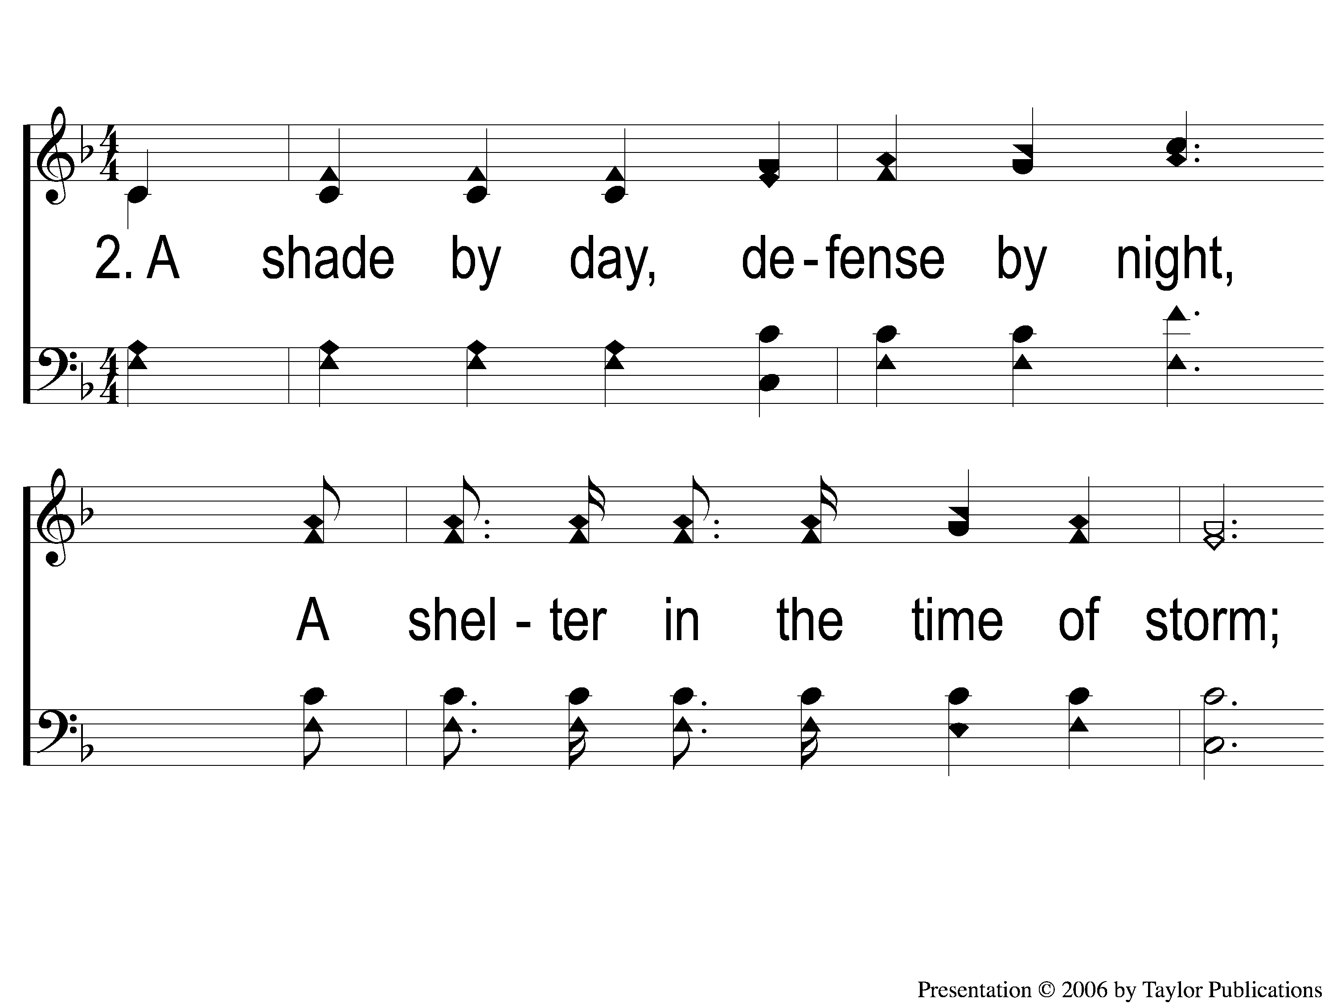
2-1 A Shelter in Time of Storm
A Shelter in Time of Storm
472

Slide 8
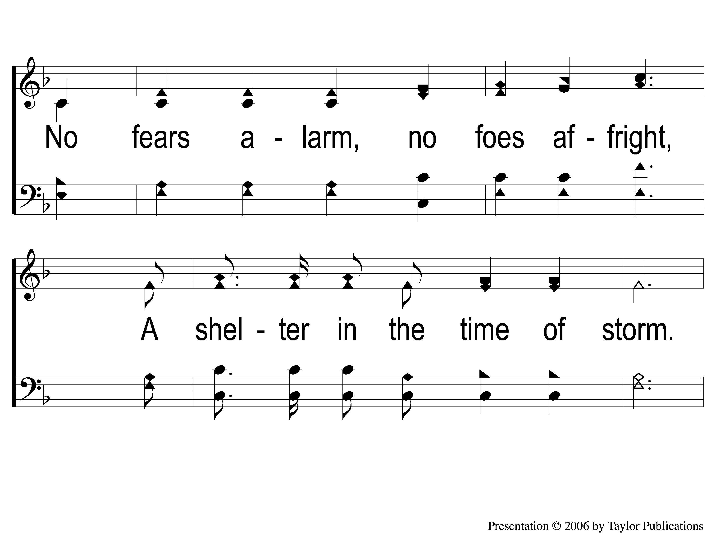
2-2 A Shelter in Time of Storm
A Shelter in Time of Storm
472

Slide 9
C-1 A Shelter in Time of Storm
472
A Shelter in Time of Storm

Slide 10
C-2 A Shelter in Time of Storm
A Shelter in Time of Storm
472

Slide 11
4-1 A Shelter in Time of Storm
A Shelter in Time of Storm
472

Slide 12
4-2 A Shelter in Time of Storm
A Shelter in Time of Storm
472

Slide 13
C-1 A Shelter in Time of Storm
472
A Shelter in Time of Storm

Slide 14
C-2 A Shelter in Time of Storm
A Shelter in Time of Storm
472

Slide 15
When I Survey
The Wondrous Cross
#315

Slide 16
1-1 When I Survey the Wondrous Cross
When I Survey the Wondrous Cross
315

Slide 17
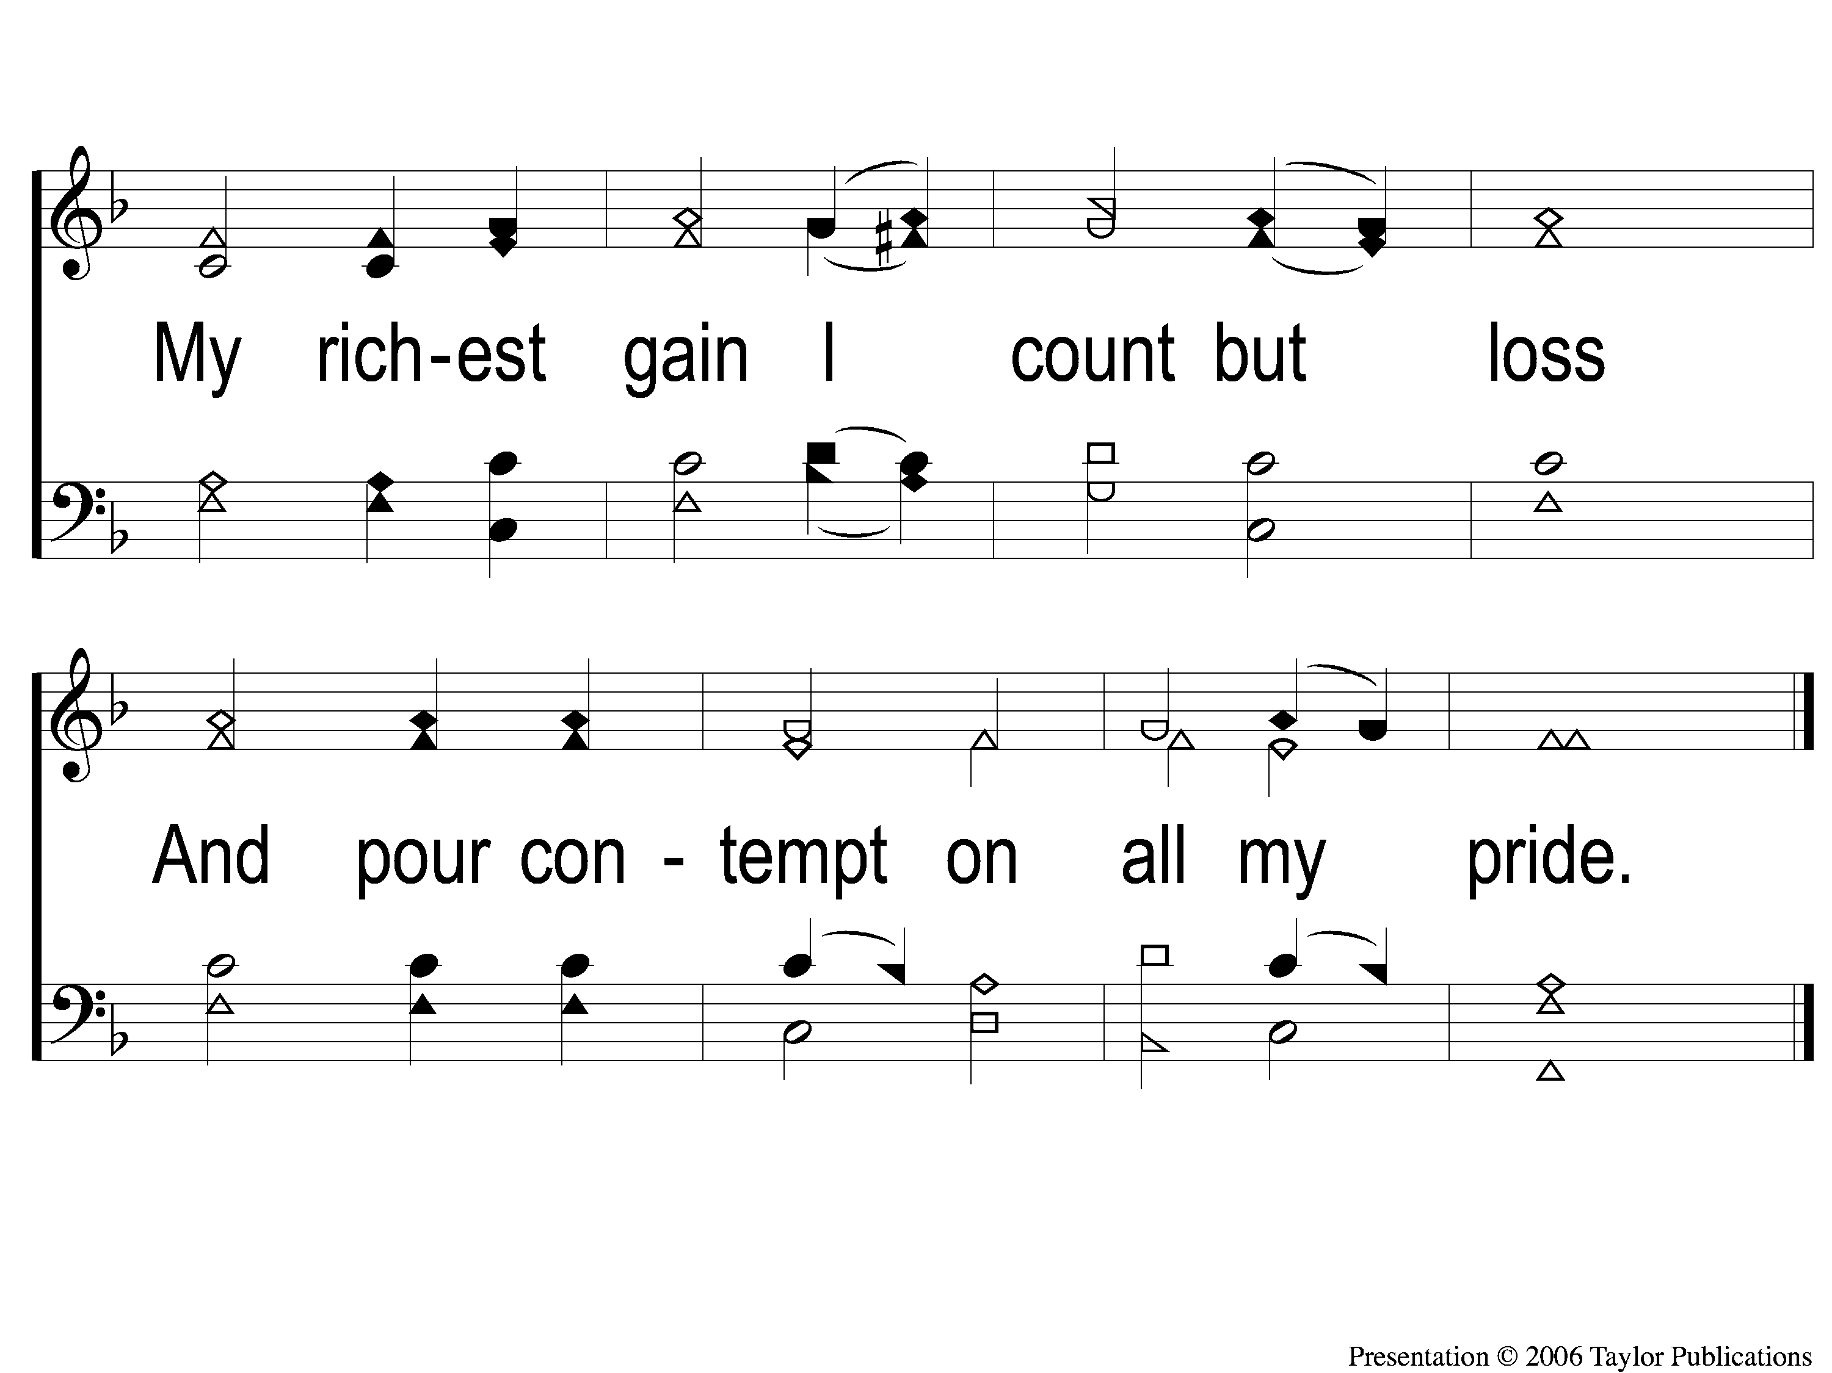
1-2 When I Survey the Wondrous Cross
When I Survey the Wondrous Cross
315

Slide 18
2-1 When I Survey the Wondrous Cross
When I Survey the Wondrous Cross
315

Slide 19
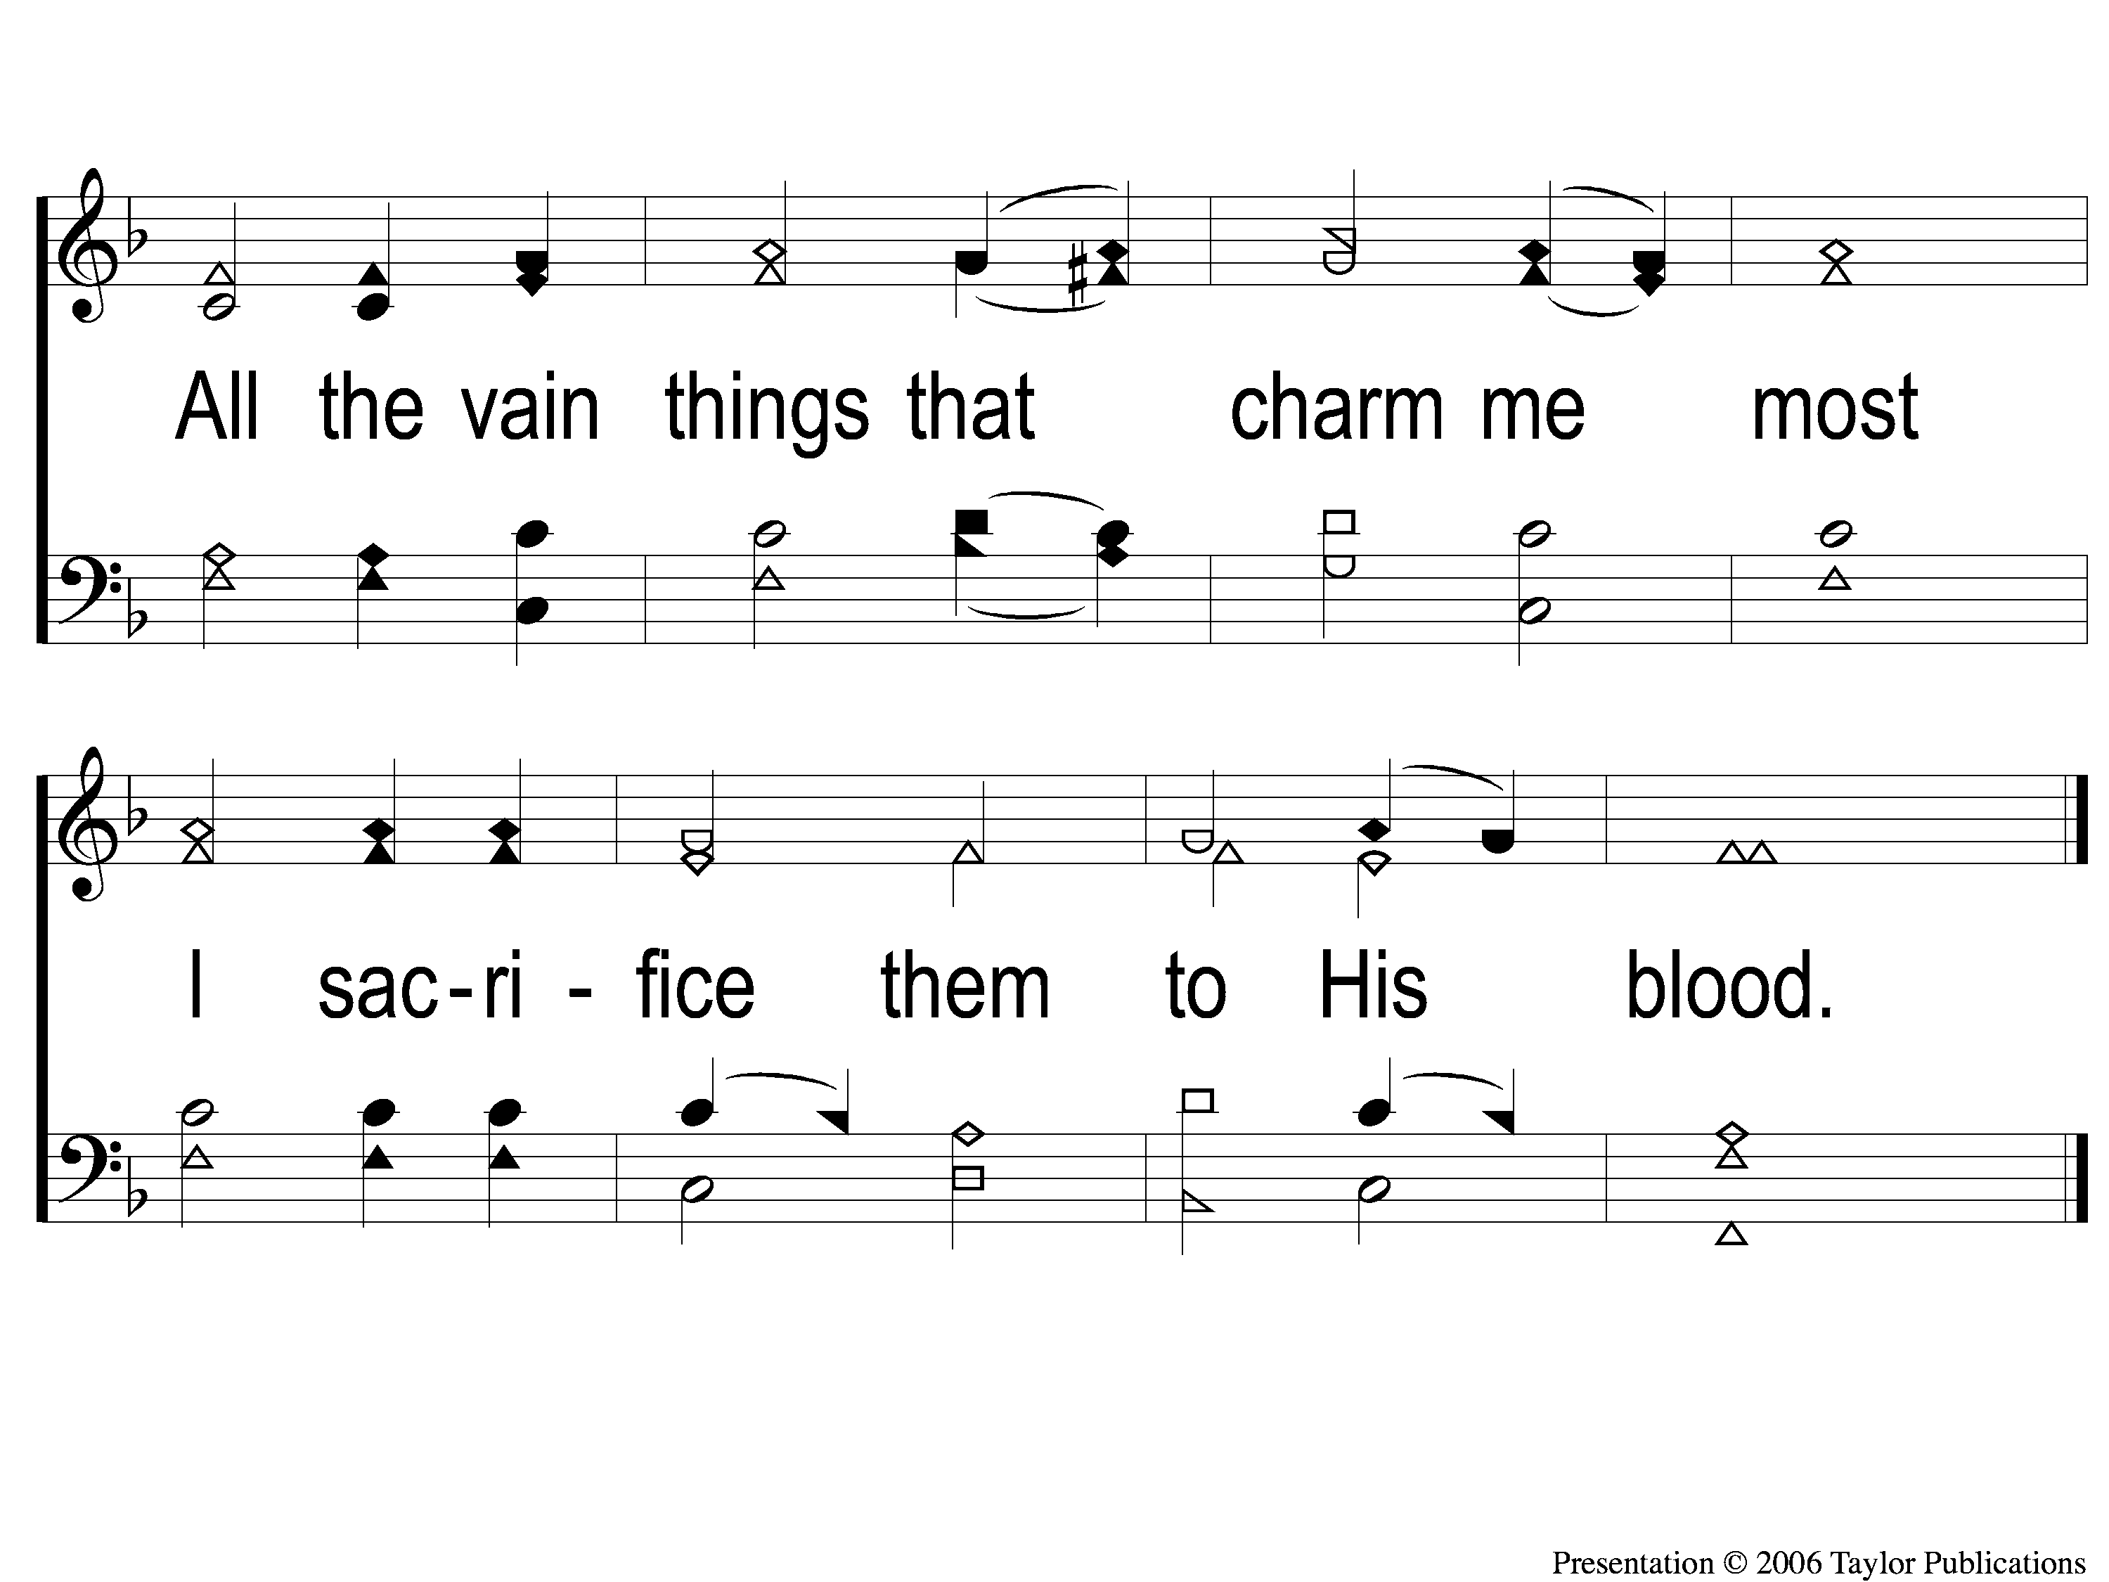
2-2 When I Survey the Wondrous Cross
When I Survey the Wondrous Cross
315

Slide 20
3-1 When I Survey the Wondrous Cross
When I Survey the Wondrous Cross
315

Slide 21
3-2 When I Survey the Wondrous Cross
When I Survey the Wondrous Cross
315

Slide 22
4-1 When I Survey the Wondrous Cross
When I Survey the Wondrous Cross
315

Slide 23
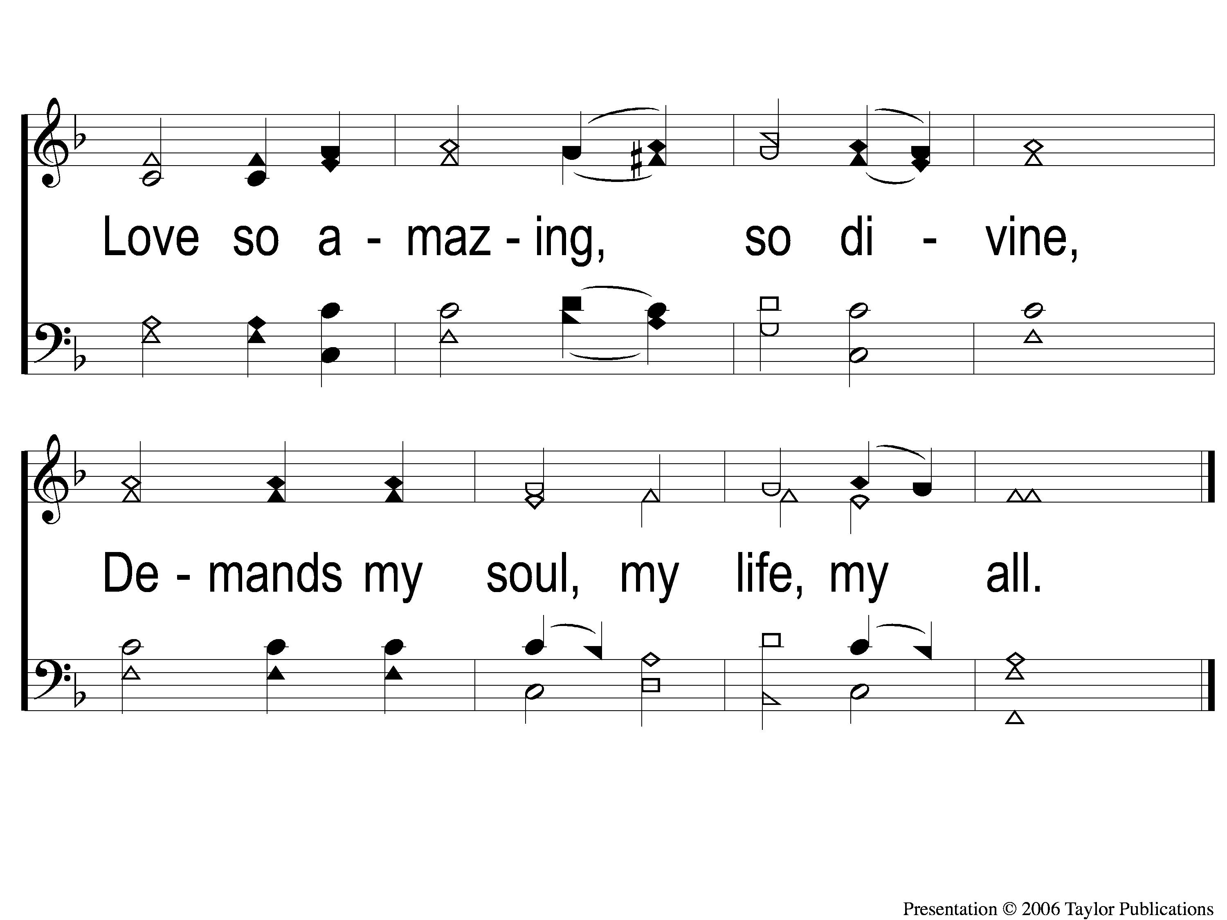
4-2 When I Survey the Wondrous Cross
When I Survey the Wondrous Cross
315

Slide 24
Opening Prayer

Slide 25
A Wonderful Savior
#508

Slide 26
1-1 A Wonderful Savior(Crosby)
A Wonderful Savior
508

Slide 27
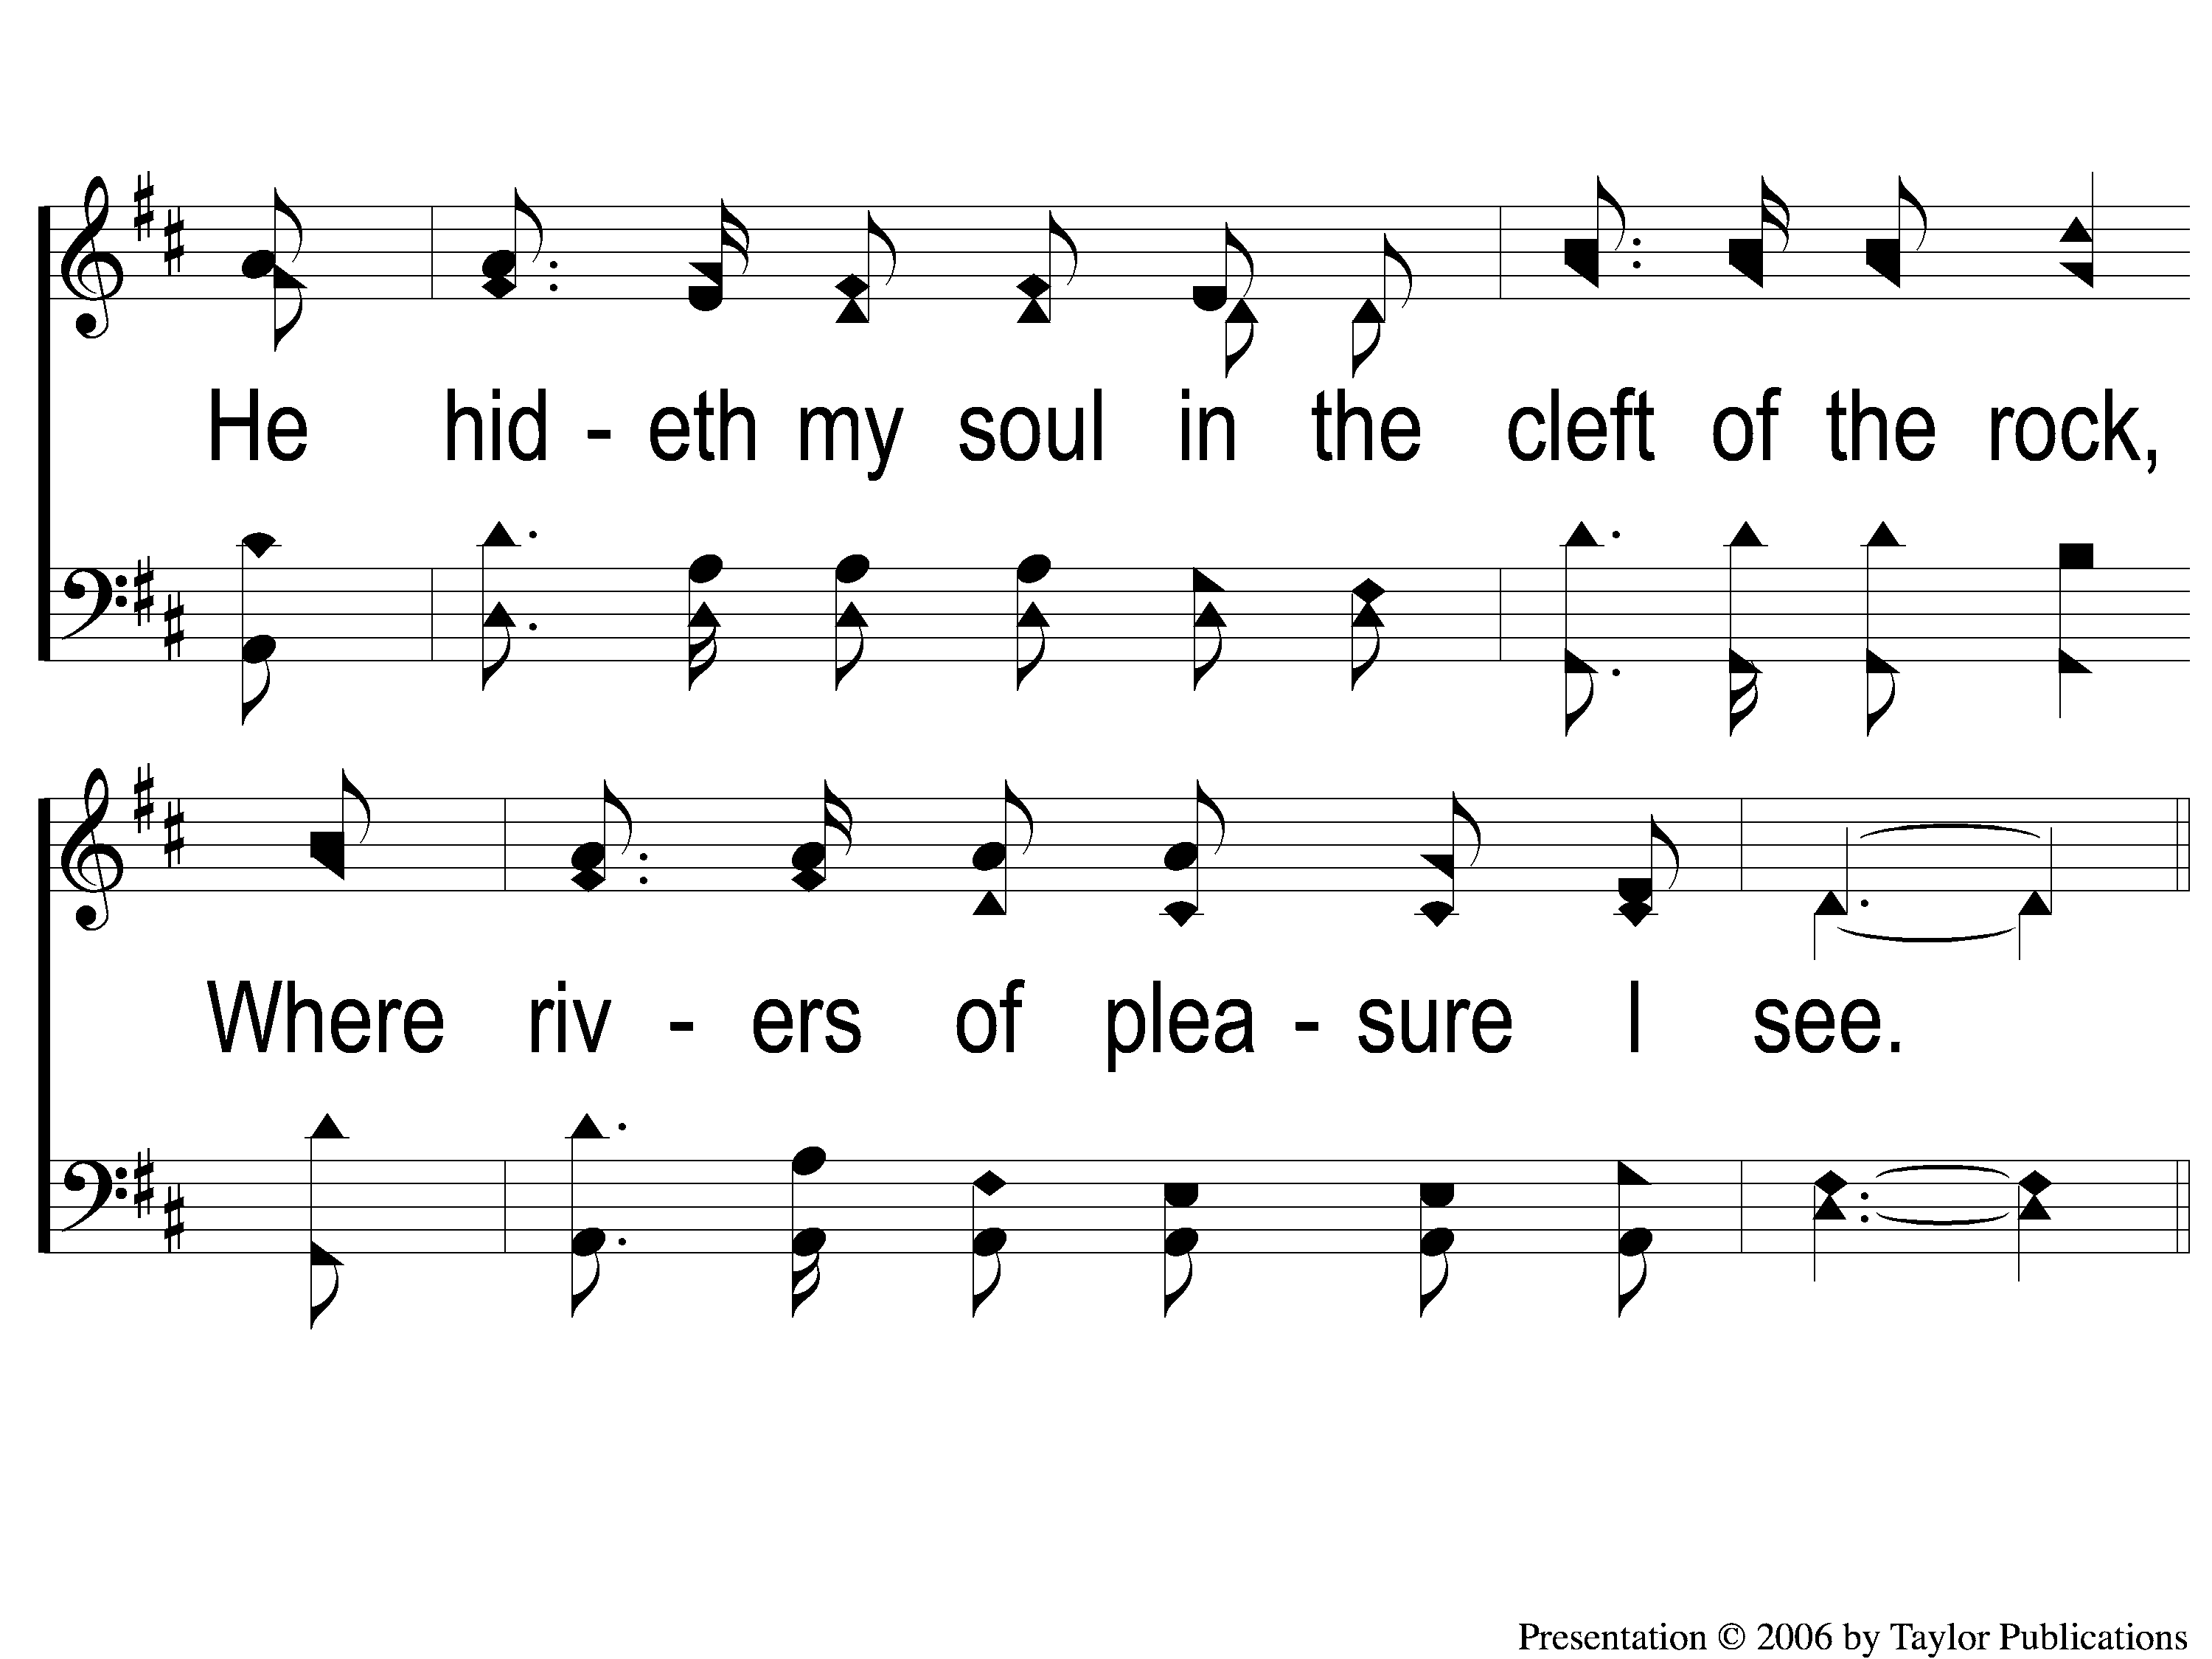
1-2 A Wonderful Savior(Crosby)
A Wonderful Savior
508

Slide 28
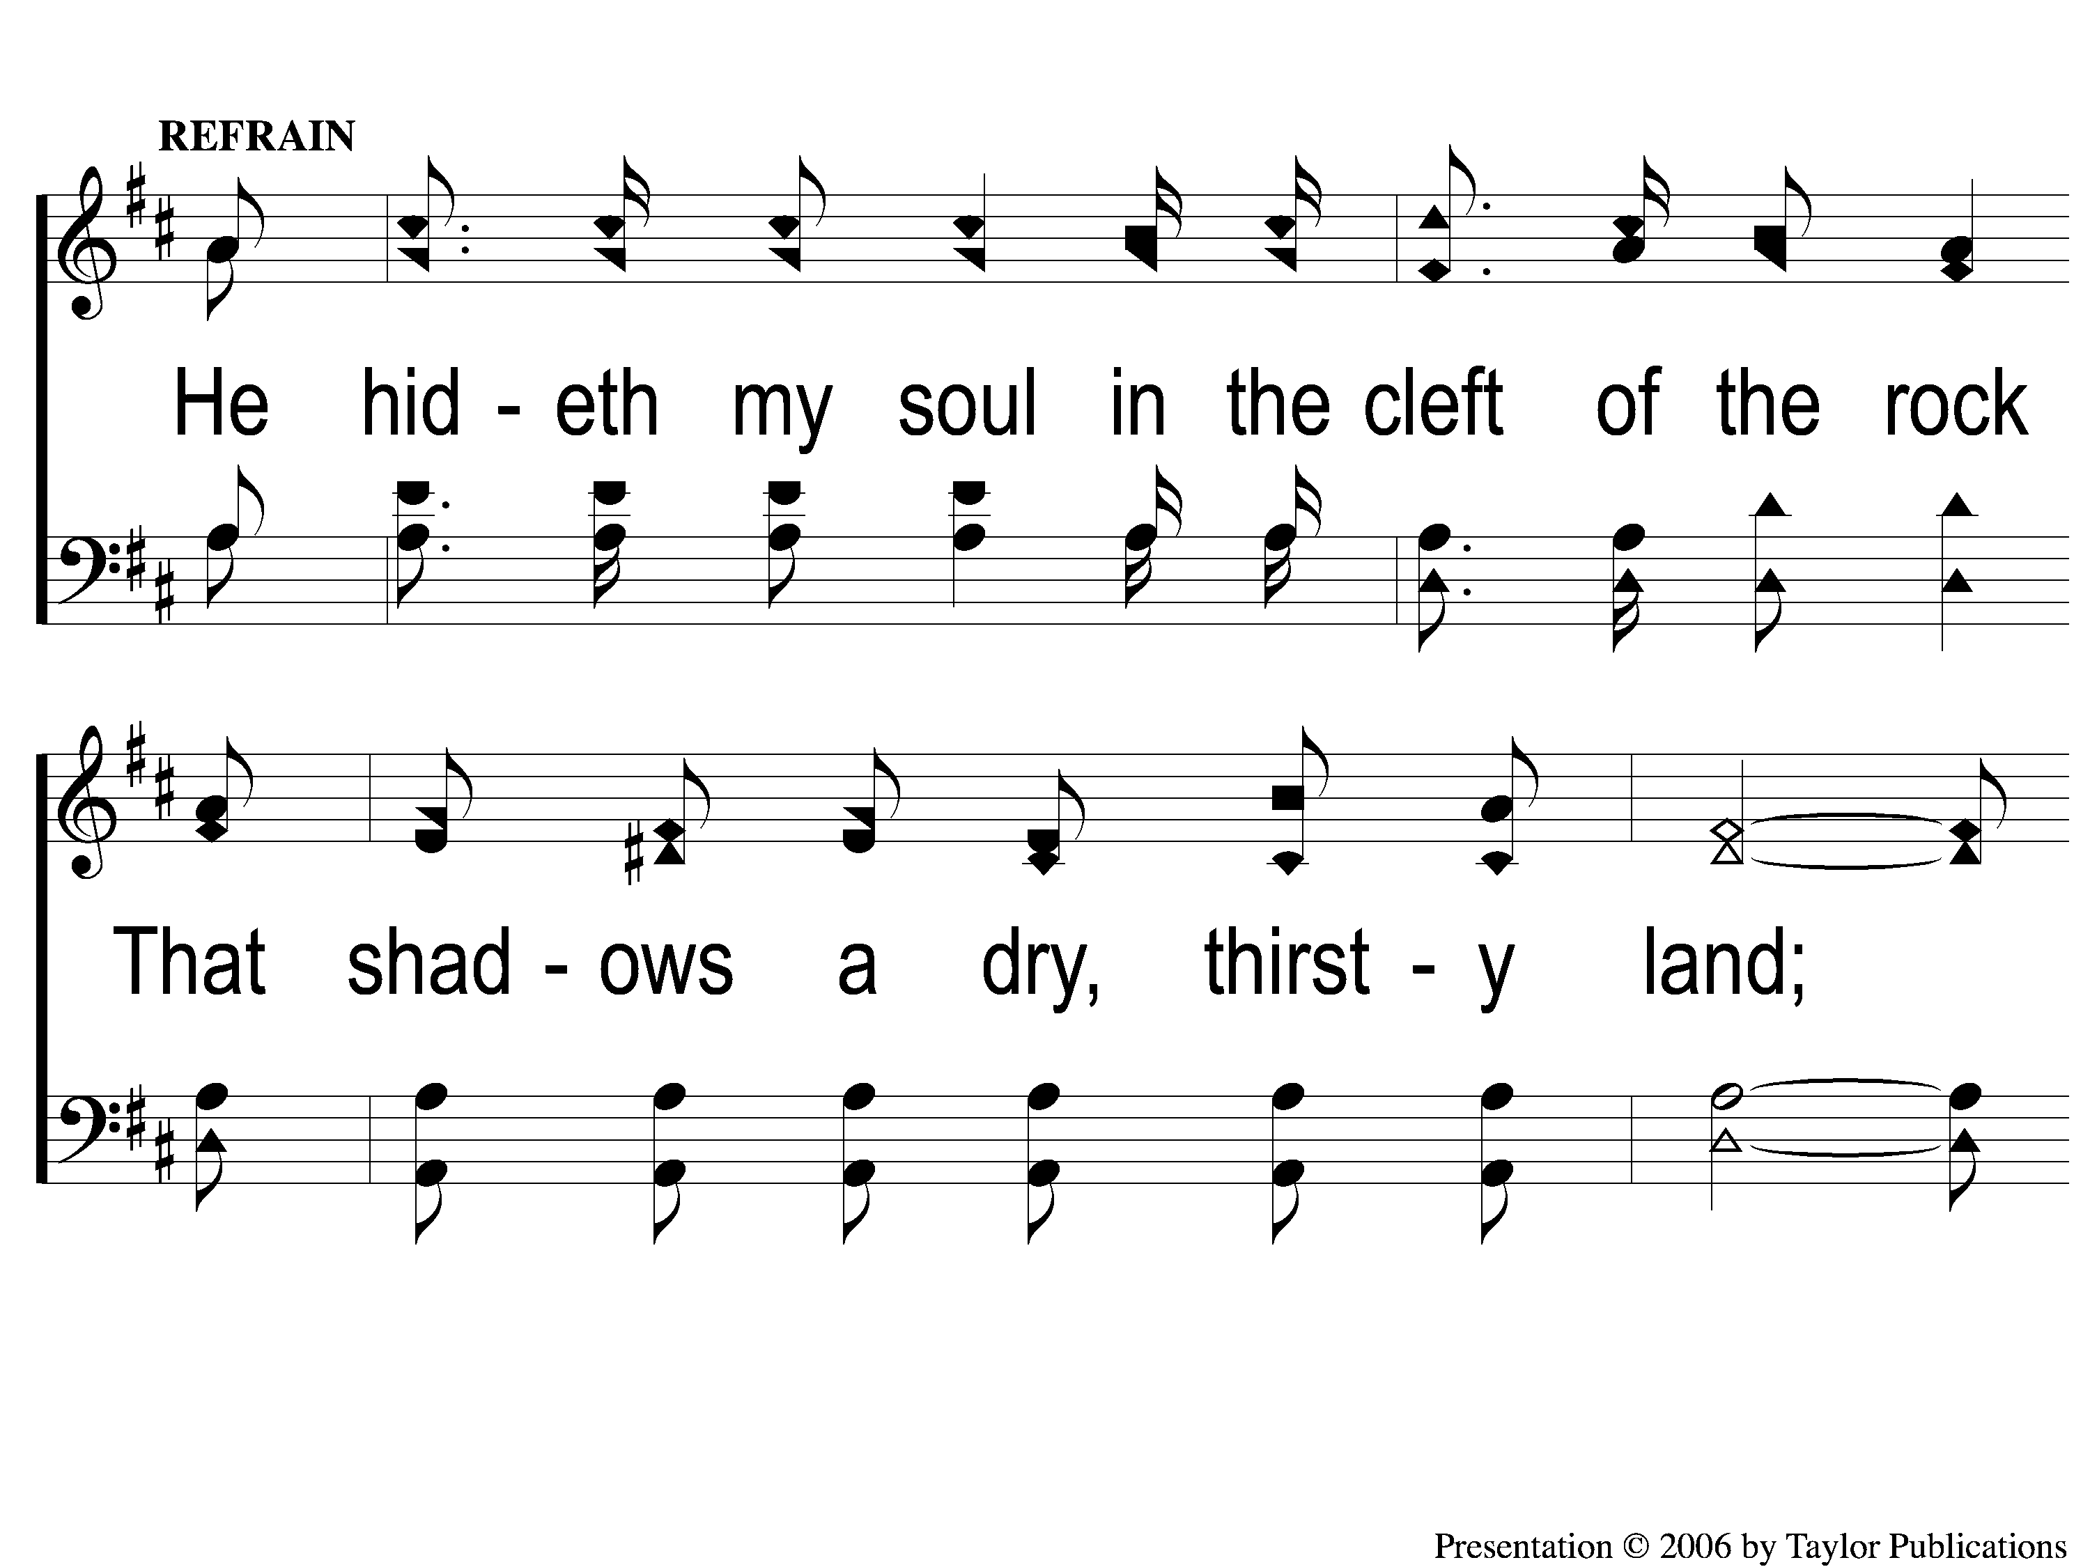
C-1 A Wonderful Savior(Crosby)
A Wonderful Savior
508

Slide 29
C-2 A Wonderful Savior(Crosby)
A Wonderful Savior
508

Slide 30
C-3 A Wonderful Savior(Crosby)
A Wonderful Savior
508

Slide 31
2-1 A Wonderful Savior(Crosby)
A Wonderful Savior
508

Slide 32
2-2 A Wonderful Savior(Crosby)
A Wonderful Savior
508

Slide 33
C-1 A Wonderful Savior(Crosby)
A Wonderful Savior
508

Slide 34
C-2 A Wonderful Savior(Crosby)
A Wonderful Savior
508

Slide 35
C-3 A Wonderful Savior(Crosby)
A Wonderful Savior
508

Slide 36
4-1 A Wonderful Savior(Crosby)
A Wonderful Savior
508

Slide 37
4-2 A Wonderful Savior(Crosby)
A Wonderful Savior
508

Slide 38
C-1 A Wonderful Savior(Crosby)
A Wonderful Savior
508

Slide 39
C-2 A Wonderful Savior(Crosby)
A Wonderful Savior
508

Slide 40
C-3 A Wonderful Savior(Crosby)
A Wonderful Savior
508

Slide 41
I Stand In Awe
#96

Slide 42
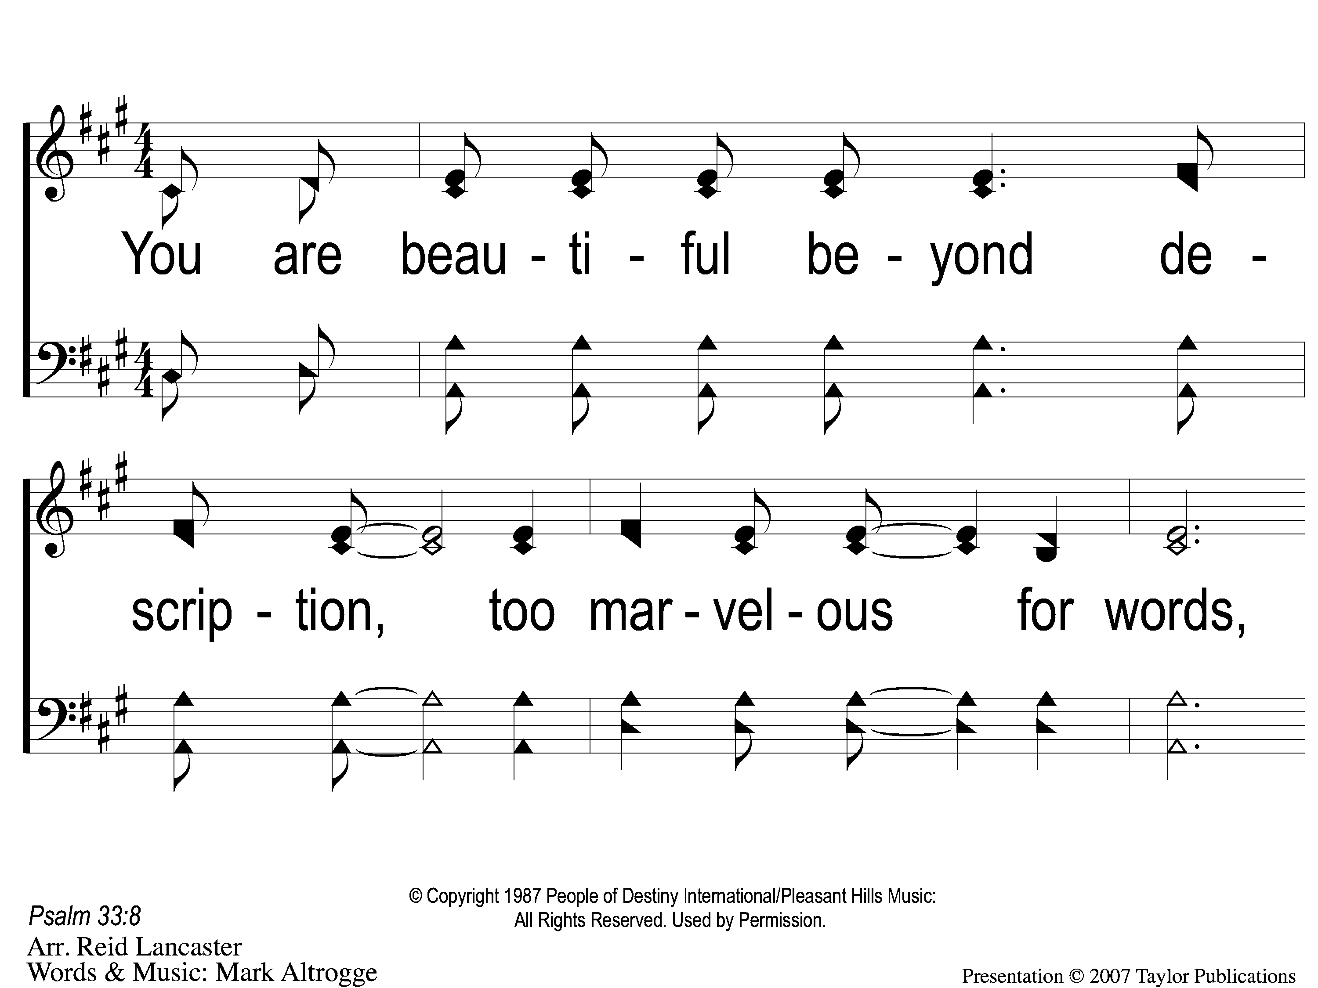
1 I Stand in Awe
I Stand in Awe
96

Slide 43
2 I Stand in Awe
I Stand in Awe
96

Slide 44
3 I Stand in Awe
I Stand in Awe
96

Slide 45
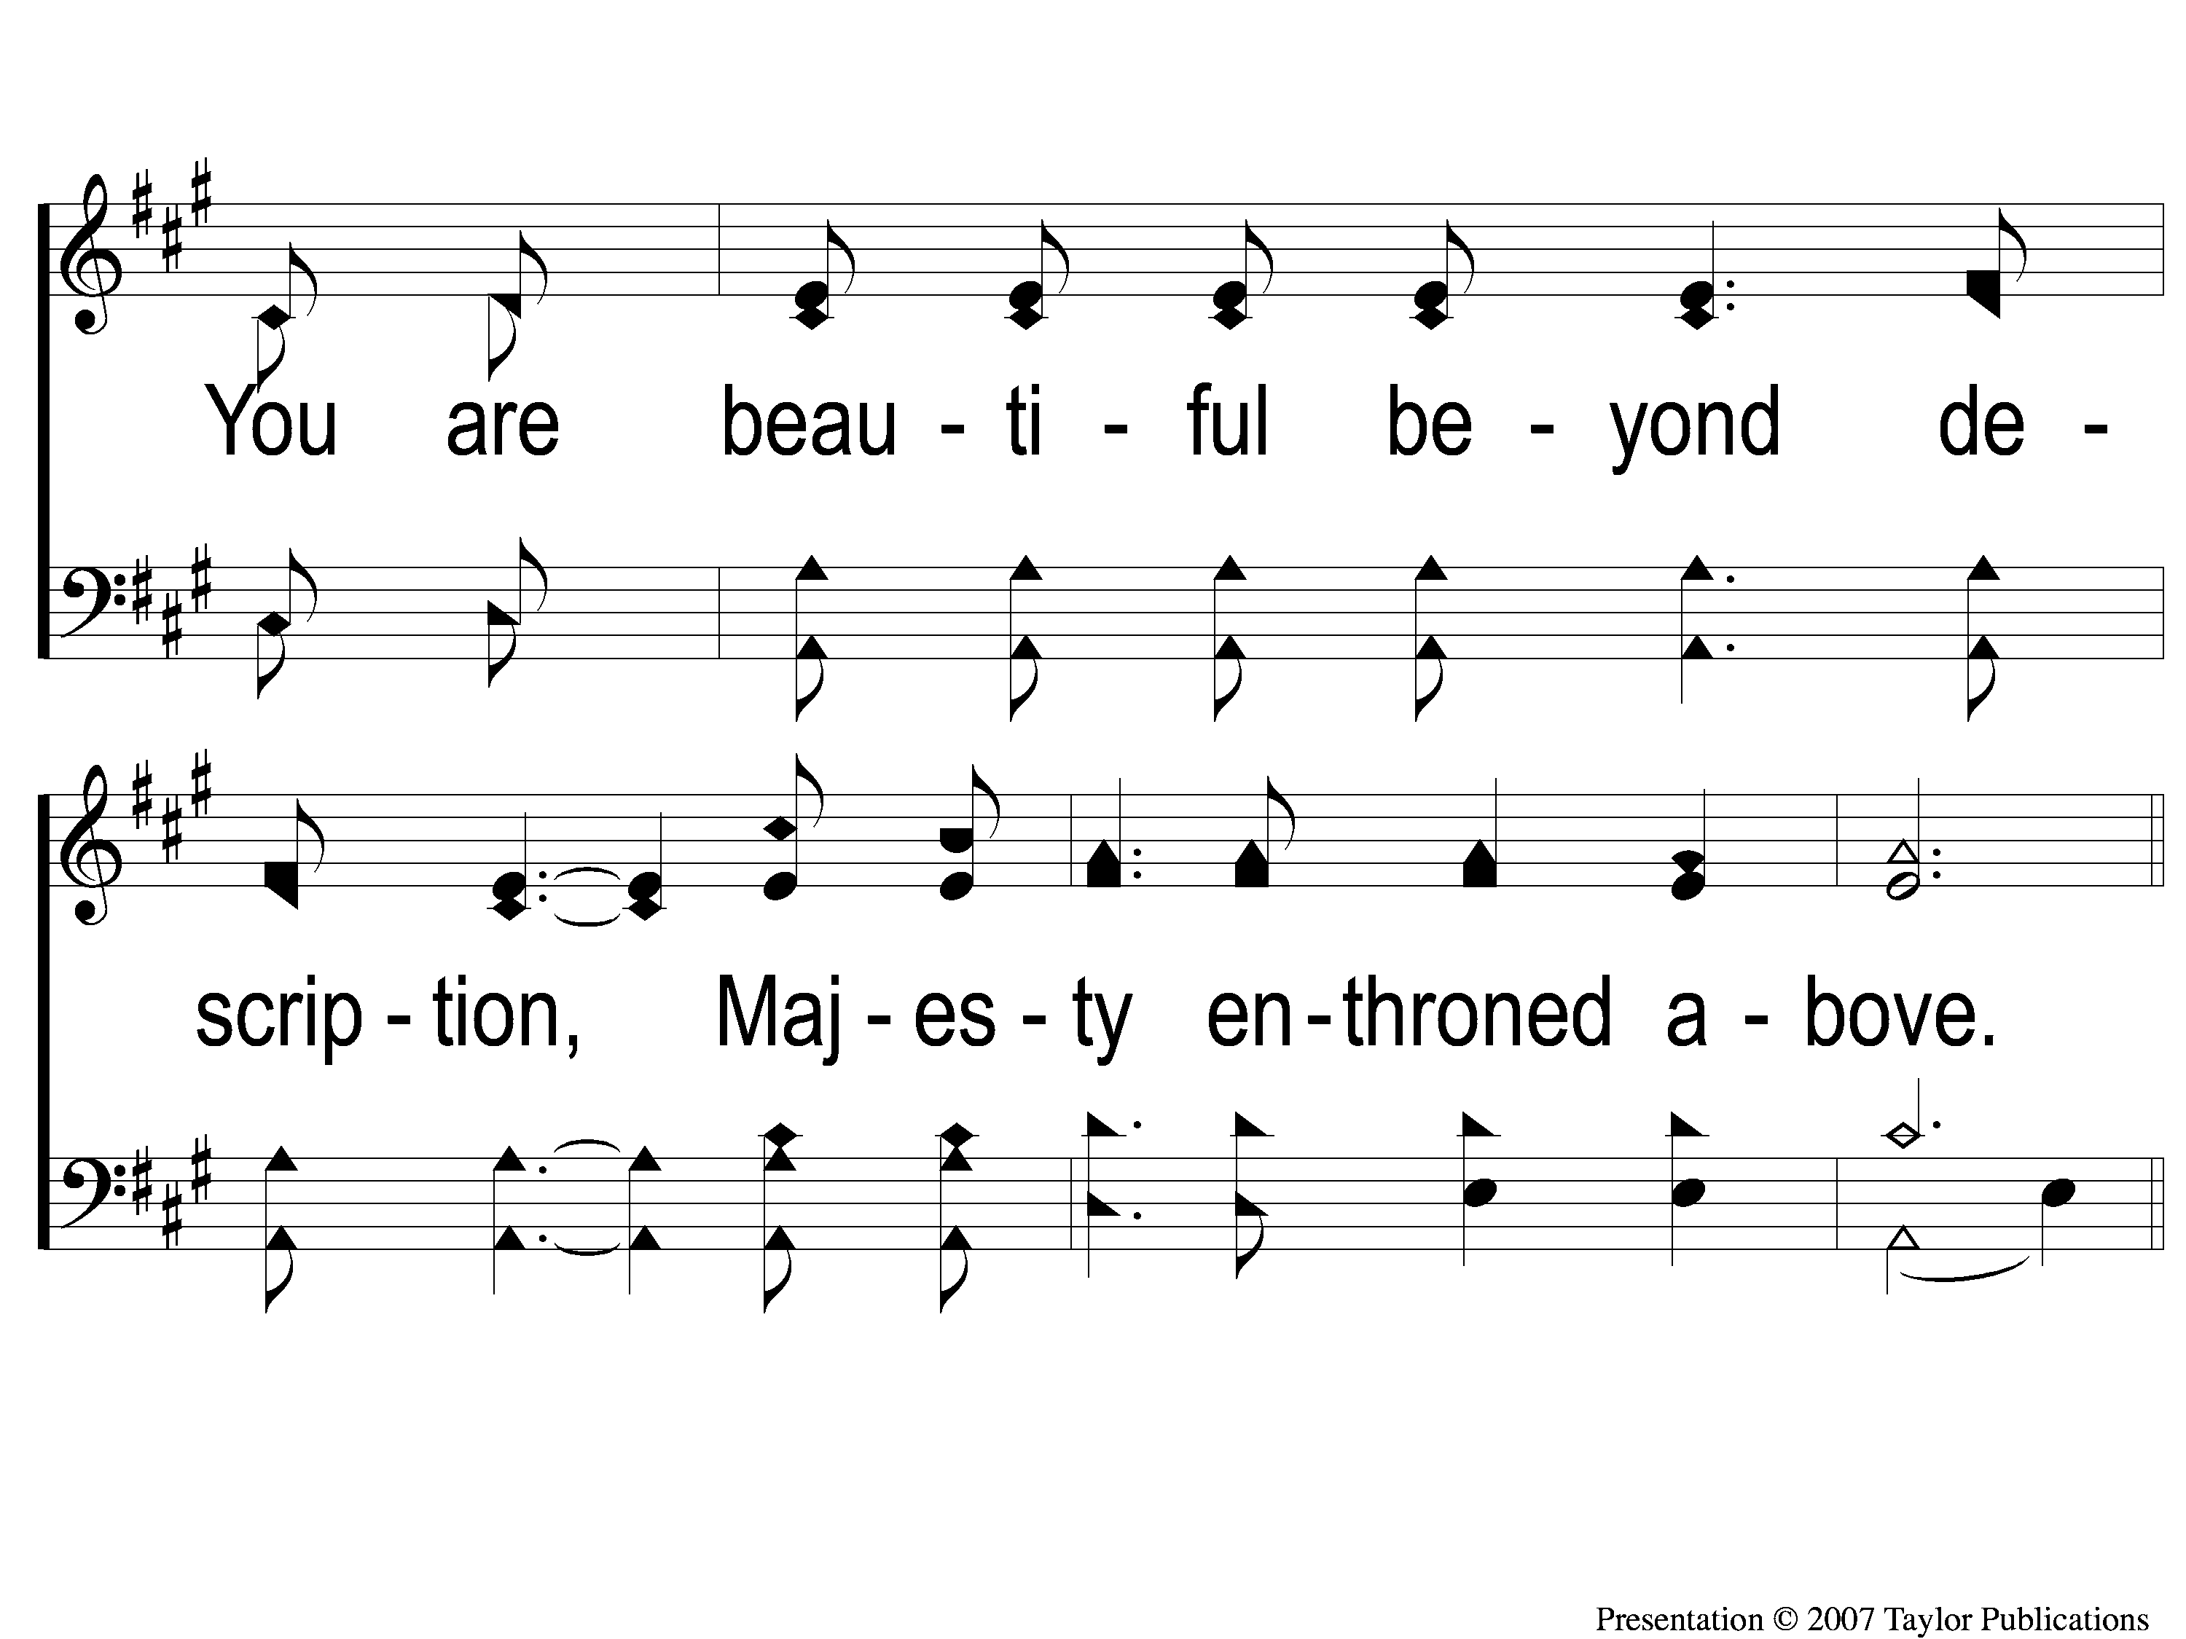
4 I Stand in Awe
I Stand in Awe
96

Slide 46
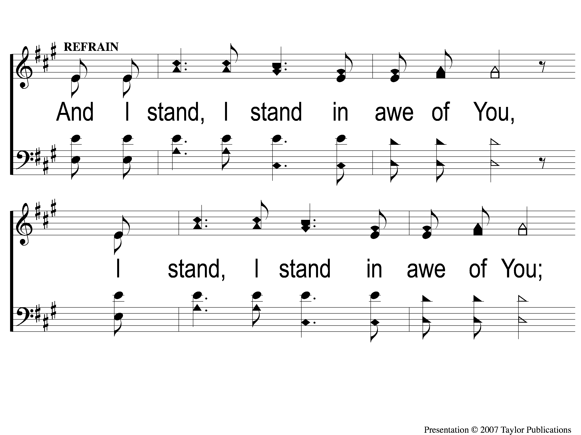
C-1 I Stand in Awe
I Stand in Awe
96

Slide 47
C-2 I Stand in Awe
I Stand in Awe
96

Slide 48
1 I Stand in Awe
I Stand in Awe
96

Slide 49
2 I Stand in Awe
I Stand in Awe
96

Slide 50
3 I Stand in Awe
I Stand in Awe
96

Slide 51
4 I Stand in Awe
I Stand in Awe
96

Slide 52
C-1 I Stand in Awe
I Stand in Awe
96

Slide 53
C-2 I Stand in Awe
I Stand in Awe
96

Slide 54
C-1 I Stand in Awe
I Stand in Awe
96

Slide 55
C-2 I Stand in Awe
I Stand in Awe
96

Slide 56
I Stand In Awe

Slide 57
“You are beautiful beyond description,
Too marvelous for words,
Too wonderful for comprehension,
Like nothing ever seen or heard.”

Slide 58
“Who can grasp Your infinite wisdom?
Who can fathom the depths of Your love?
You are beautiful beyond description,
Majesty enthroned above.”

Slide 59
Indescribable Attributes of God
Rom. 11: 33-36

Slide 60
Indescribable Attributes of God
His Nature

Slide 61
Indescribable Attributes of God
His Nature: Immortal
Isa. 57: 15
Jn. 8: 58
1 Tim. 1: 17

Slide 62
Indescribable Attributes of God
His Nature: Immaterial
1 Tim. 1: 17
Heb. 11: 27
Jn. 4:24

Slide 63
Indescribable Attributes of God
His Nature
His Wisdom

Slide 64
Indescribable Attributes of God
His Wisdom
Jms. 3: 17
Jude 25
Psa. 139: 1-6

Slide 65
Indescribable Attributes of God
His Nature
His Wisdom
His Love

Slide 66
Indescribable Attributes of God
His Love
Eph. 3: 19
Rom. 5: 6-8

Slide 67
Indescribable Attributes of God
His Nature
His Wisdom
His Love
His Forgiveness

Slide 68
Indescribable Attributes of God
His Forgiveness
Matt. 18: 21-35
Mic. 7: 18-19

Slide 69
“And I stand, I stand in awe of You
Lord, I stand, I stand in awe of You.
Holy God to whom all praise is due,
I stand in awe of You.”

Slide 70
Standing In Awe
“Awesome” – 38x in NKJV
Psa. 33: 8, 119: 161
Gen. 28: 17
Ex. 34: 10
Deut. 7: 21, 10: 17, 21

Slide 71
Standing In Awe
Heb. 12:28

Slide 72
Standing In Awe
Heb. 12:28
Worship Him

Slide 73
Standing In Awe
Heb. 12:28
Worship Him
Tell Others About Him

Slide 74
Are you Standing
In awe of God?

Slide 75
Invitation Song:
Trust & Obey

Slide 76
1-1 Trust and Obey
Trust and Obey
915

Slide 77
1-2 Trust and Obey
Trust and Obey
915

Slide 78
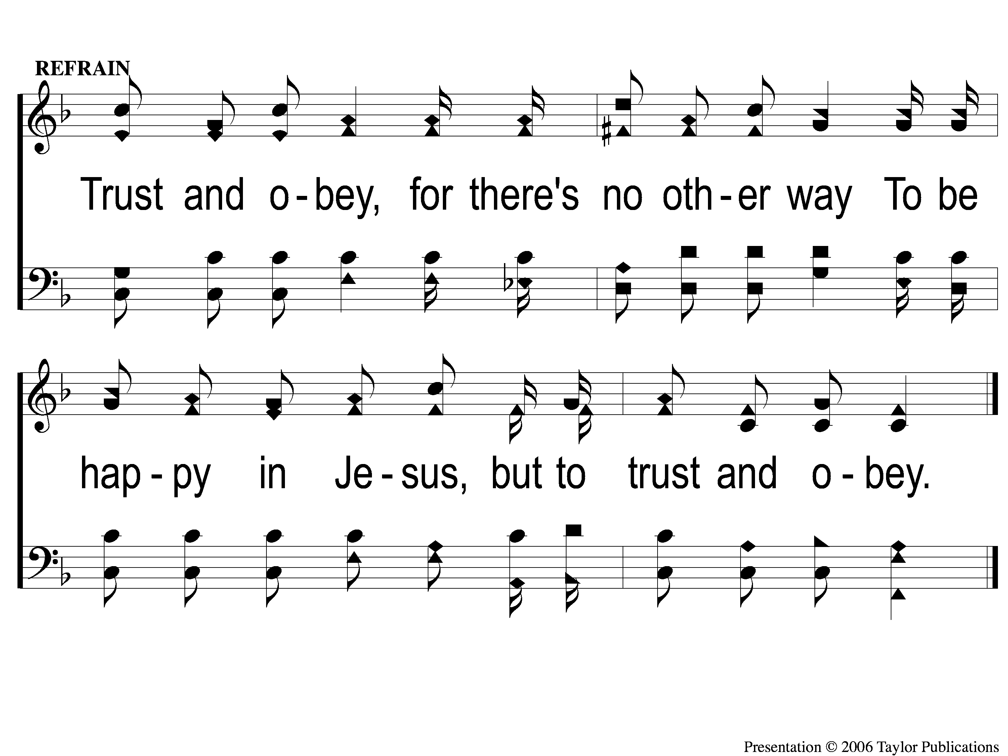
C Trust and Obey
Trust and Obey
915

Slide 79
2-1 Trust and Obey
Trust and Obey
915

Slide 80
2-2 Trust and Obey
Trust and Obey
915

Slide 81
C Trust and Obey
Trust and Obey
915

Slide 82
4-1 Trust and Obey
Trust and Obey
915

Slide 83
4-2 Trust and Obey
Trust and Obey
915

Slide 84
C Trust and Obey
Trust and Obey
915

Slide 85
5-1 Trust and Obey
Trust and Obey
915

Slide 86
5-2 Trust and Obey
Trust and Obey
915

Slide 87
C Trust and Obey
Trust and Obey
915

Slide 88
The Lord’s Supper
Acts 20:7

Slide 89
Closing Prayer

Slide 90
Jesus Is Coming Again
#727

Slide 91
1-1 Jesus is Coming Again
Jesus Is Coming Again
727

Slide 92
1-2 Jesus is Coming Again
Jesus Is Coming Again
727

Slide 93
C-1 Jesus is Coming Again
Jesus Is Coming Again
727

Slide 94
C-2 Jesus is Coming Again
Jesus Is Coming Again
727

Slide 95
C-3 Jesus is Coming Again
Jesus Is Coming Again
727

Slide 96
2-1 Jesus is Coming Again
Jesus Is Coming Again
727

Slide 97
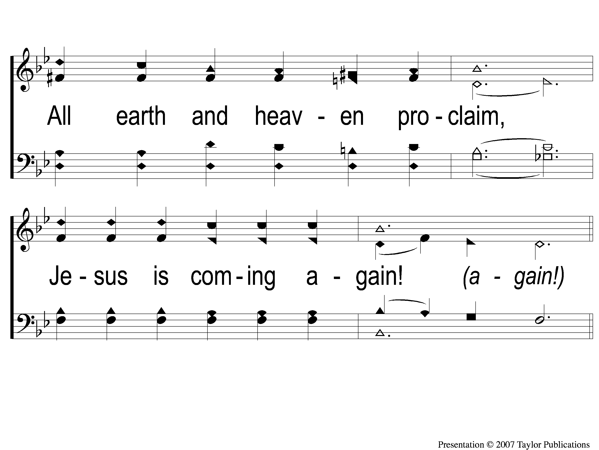
2-2 Jesus is Coming Again
Jesus Is Coming Again
727

Slide 98
C-1 Jesus is Coming Again
Jesus Is Coming Again
727

Slide 99
C-2 Jesus is Coming Again
Jesus Is Coming Again
727

Slide 100
C-3 Jesus is Coming Again
Jesus Is Coming Again
727

Slide 101
3-1 Jesus is Coming Again
Jesus Is Coming Again
727

Slide 102
3-2 Jesus is Coming Again
Jesus Is Coming Again
727

Slide 103
C-1 Jesus is Coming Again
Jesus Is Coming Again
727

Slide 104
C-2 Jesus is Coming Again
Jesus Is Coming Again
727

Slide 105
C-3 Jesus is Coming Again
Jesus Is Coming Again
727

Slide 106
Join us for
Worship & Bible Classes
Wednesday
@ 6:30pm!

