Slide 1
1-1 Faithful Love
Faithful Love
18

Slide 2
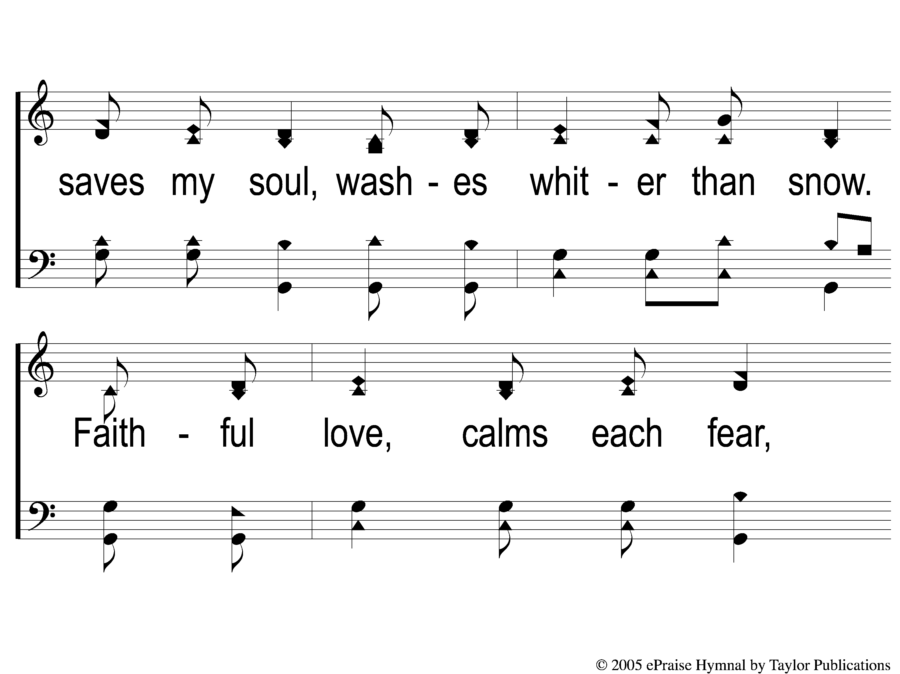
1-2 Faithful Love
Faithful Love
18

Slide 3
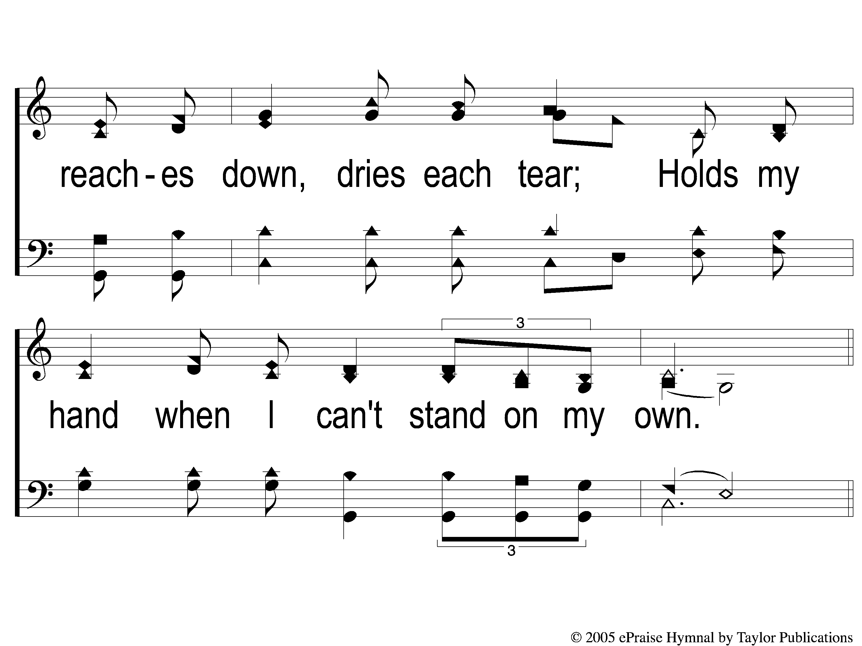
1-3 Faithful Love
Faithful Love
18

Slide 4
C-1 Faithful Love
Faithful Love
18

Slide 5
C-2 Faithful Love
Faithful Love
18

Slide 6
RESTORE REBUILD RENEW
welcome
we are glad to
Have you with us
IN 2022
WHEELER
CHURCH
OF
CHRIST

Slide 7
Song:
Jesus Hold My Hand
#412

Slide 8
1-1 Jesus Hold My Hand
Jesus, Hold My Hand
412

Slide 9
1-2 Jesus Hold My Hand
Jesus, Hold My Hand
412

Slide 10
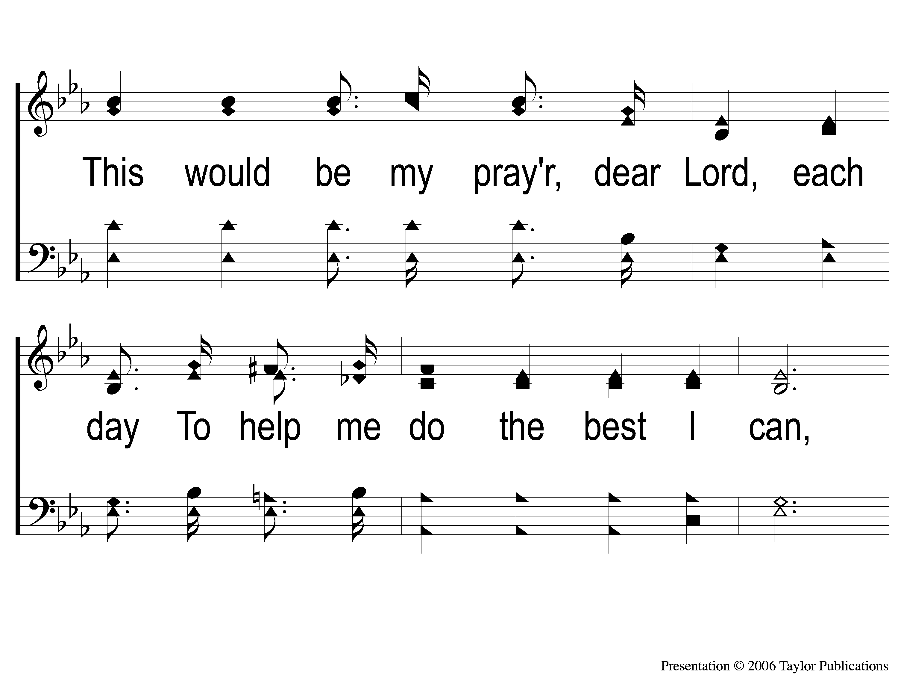
1-3 Jesus Hold My Hand
Jesus, Hold My Hand
412

Slide 11
1-4 Jesus Hold My Hand
Jesus, Hold My Hand
412

Slide 12
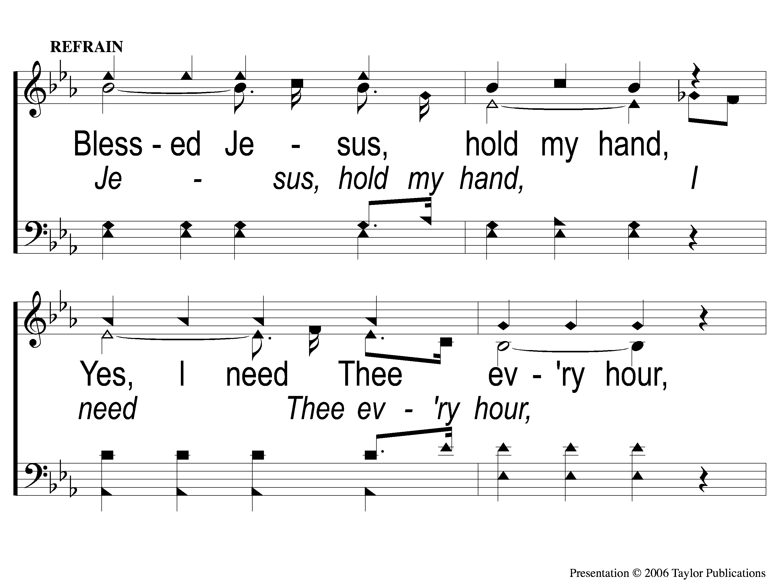
C-1 Jesus Hold My Hand
Jesus, Hold My Hand
412

Slide 13
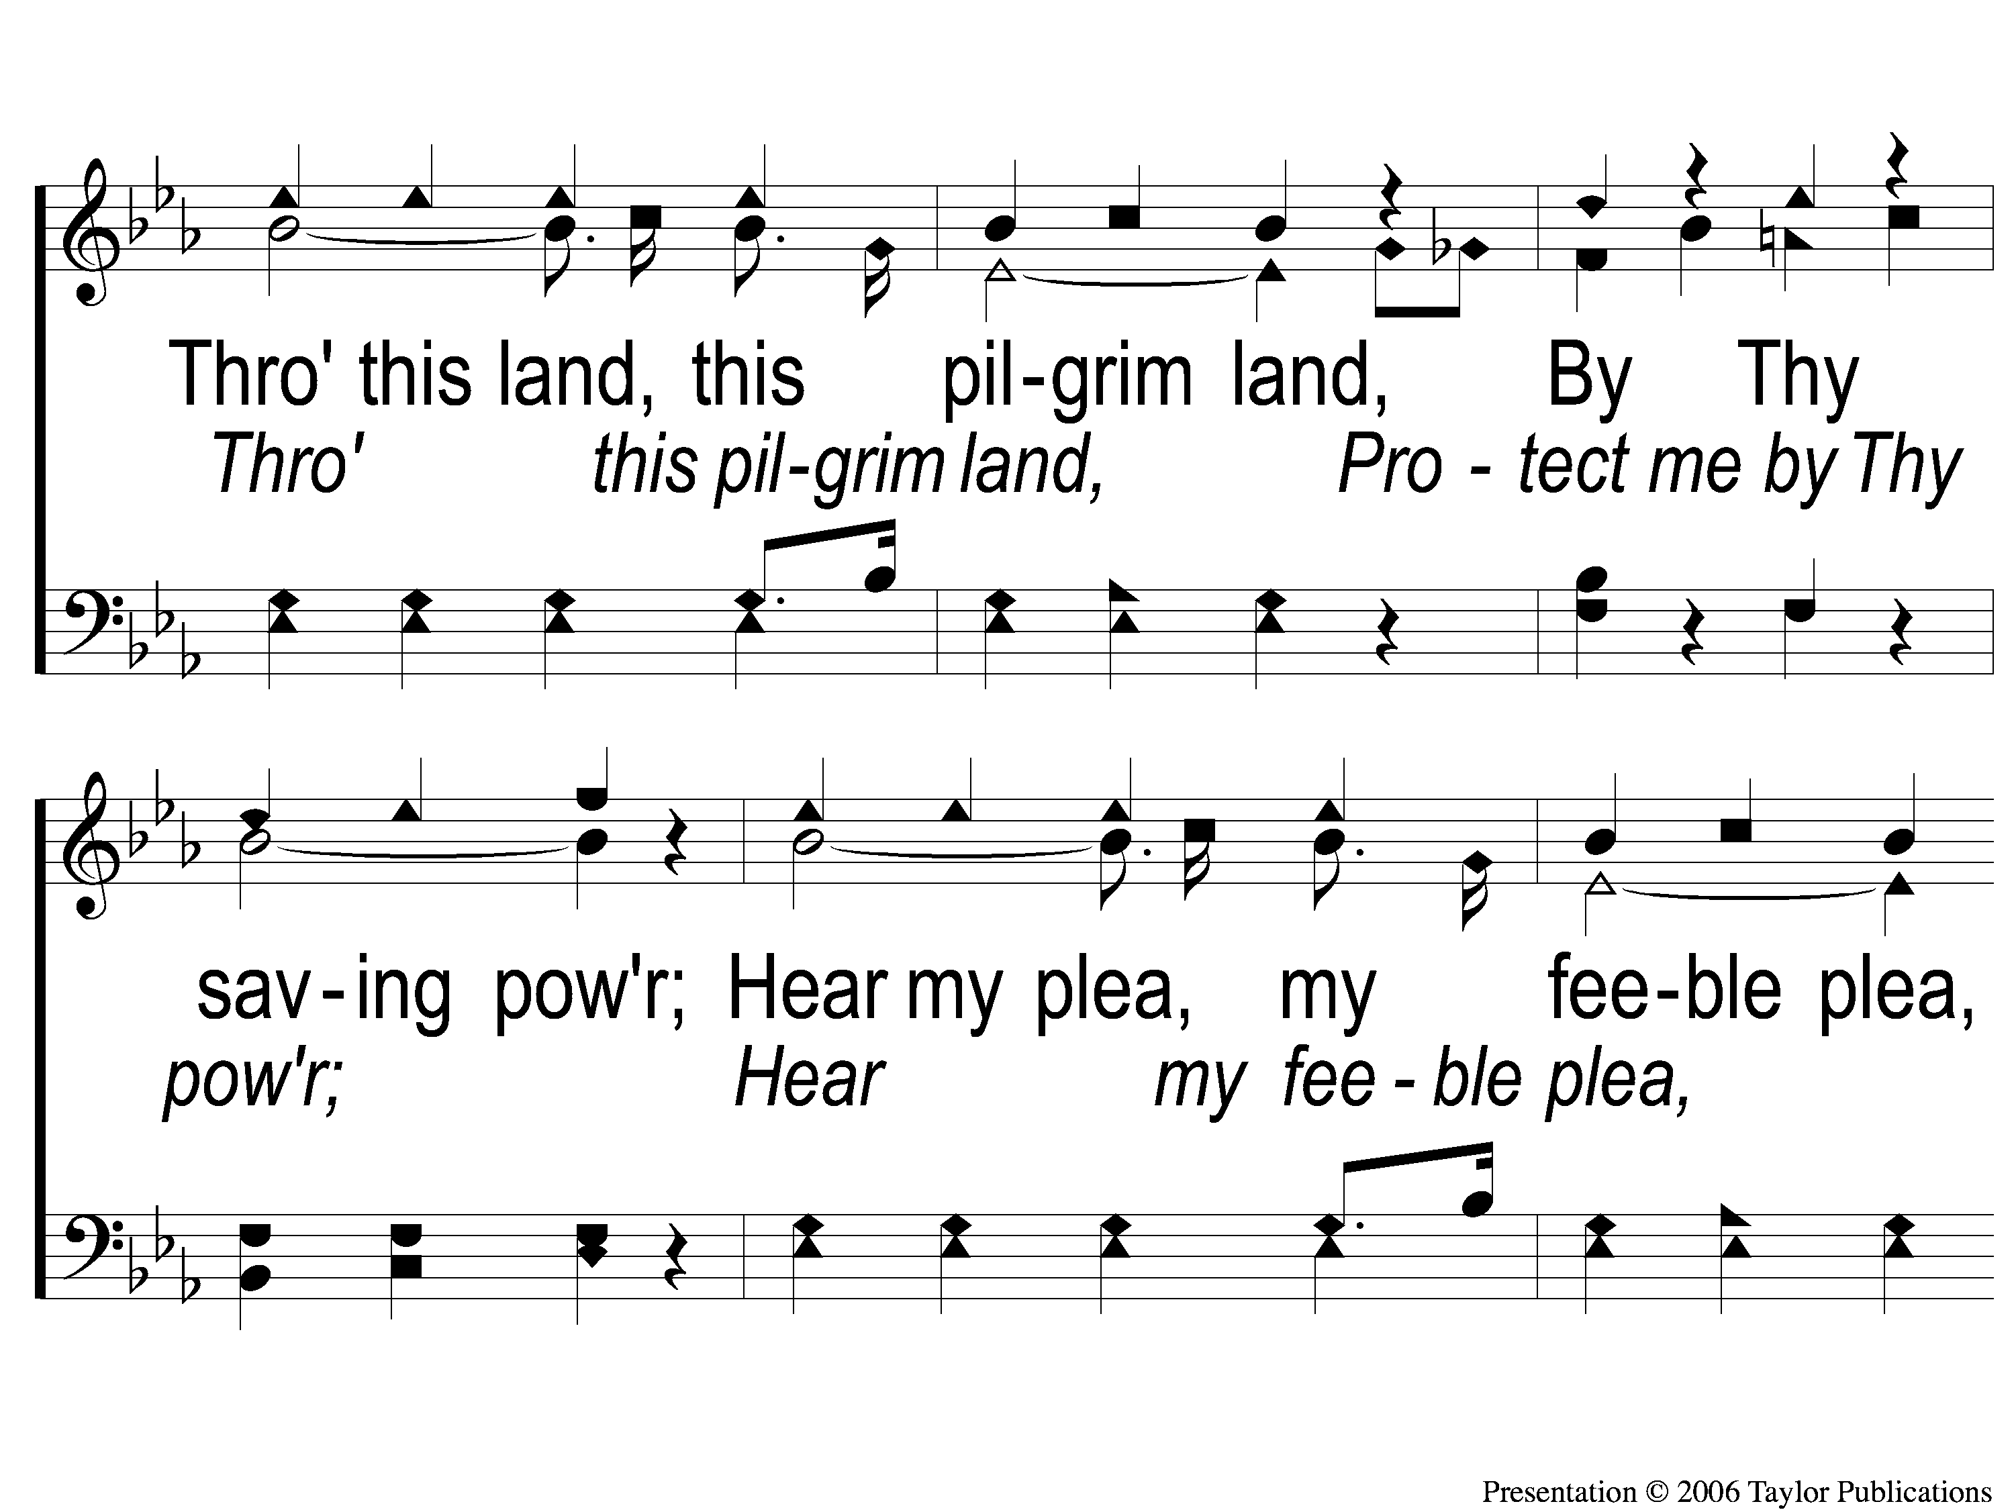
C-2 Jesus Hold My Hand
Jesus, Hold My Hand
412

Slide 14
C-3 Jesus Hold My Hand
Jesus, Hold My Hand
412

Slide 15
3-1 Jesus Hold My Hand
Jesus, Hold My Hand
412

Slide 16
3-2 Jesus Hold My Hand
Jesus, Hold My Hand
412

Slide 17
3-3 Jesus Hold My Hand
Jesus, Hold My Hand
412

Slide 18
3-4 Jesus Hold My Hand
Jesus, Hold My Hand
412

Slide 19
C-1 Jesus Hold My Hand
Jesus, Hold My Hand
412

Slide 20
C-2 Jesus Hold My Hand
Jesus, Hold My Hand
412

Slide 21
C-3 Jesus Hold My Hand
Jesus, Hold My Hand
412

Slide 22
Song:
I Stand Amazed
#147

Slide 23
1-1 I Stand Amazed
I Stand Amazed
147

Slide 24
1-2 I Stand Amazed
I Stand Amazed
147

Slide 25
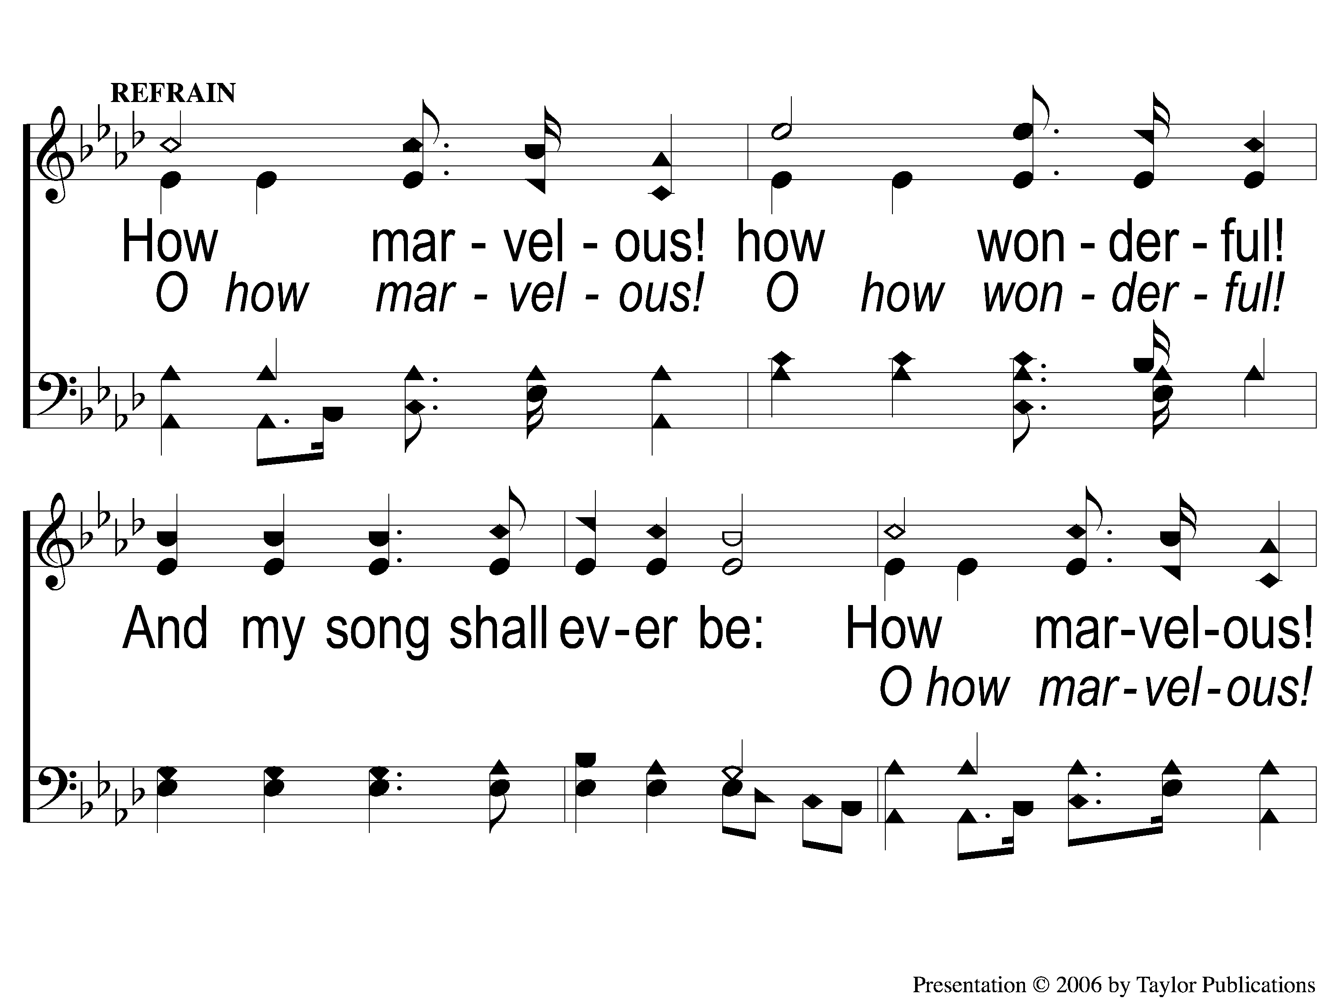
C-1 I Stand Amazed
I Stand Amazed
147

Slide 26
C-2 I Stand Amazed
I Stand Amazed
147

Slide 27
2-1 I Stand Amazed
I Stand Amazed
147

Slide 28
2-2 I Stand Amazed
I Stand Amazed
147

Slide 29
C-1 I Stand Amazed
I Stand Amazed
147

Slide 30
C-2 I Stand Amazed
I Stand Amazed
147

Slide 31
4-1 I Stand Amazed
I Stand Amazed
147

Slide 32
4-2 I Stand Amazed
I Stand Amazed
147

Slide 33
C-1 I Stand Amazed
I Stand Amazed
147

Slide 34
C-2 I Stand Amazed
I Stand Amazed
147

Slide 35
Opening Prayer

Slide 36
Song:
Tell Me The Story of Jesus
#387

Slide 37
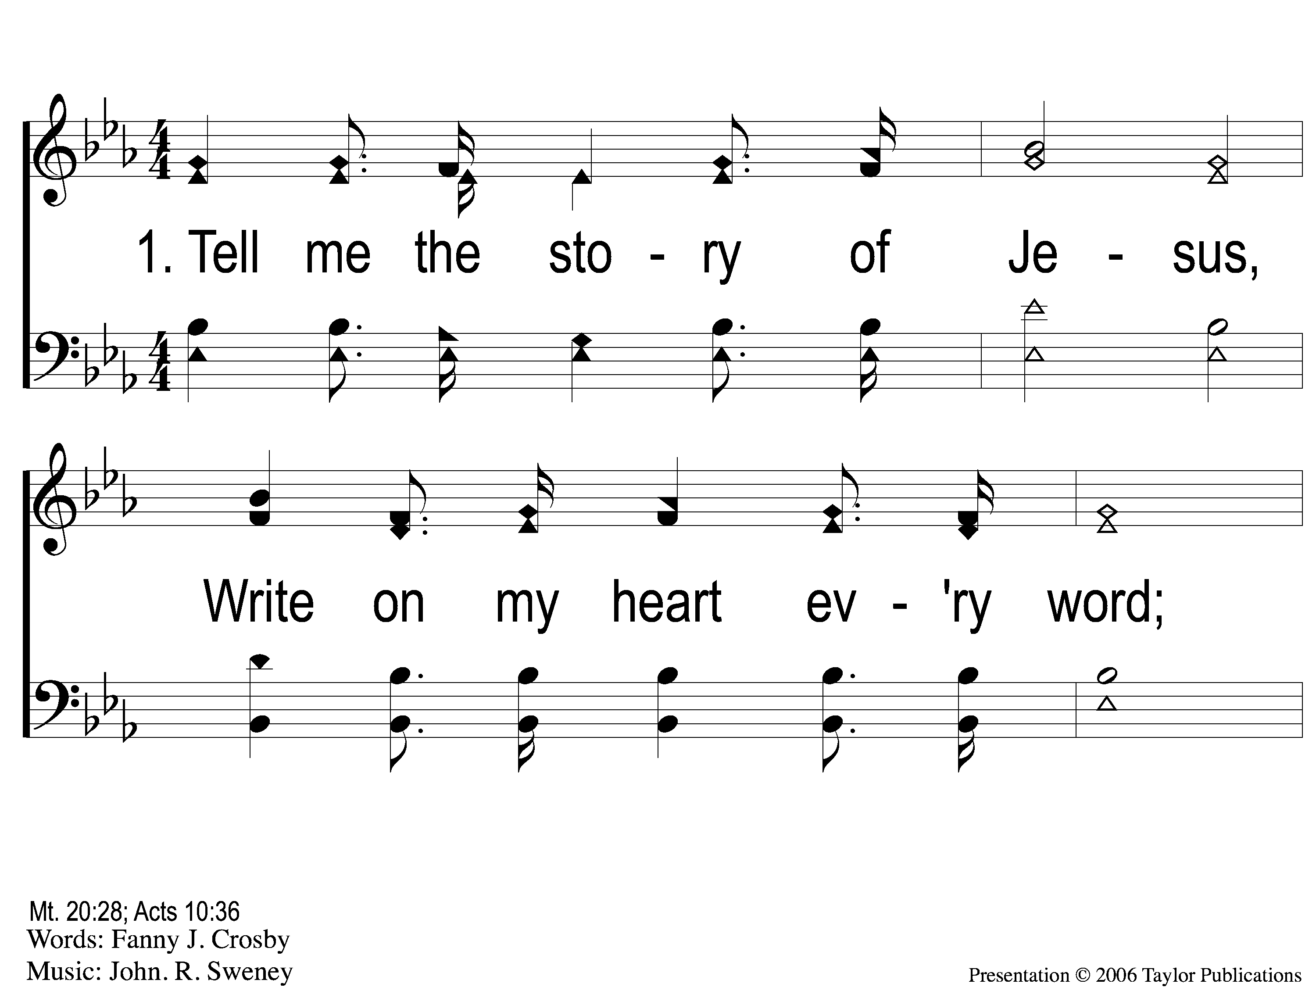
1-1 Tell Me the Story of Jesus
Tell Me the Story of Jesus
387

Slide 38
1-2 Tell Me the Story of Jesus
Tell Me the Story of Jesus
387

Slide 39
1-3 Tell Me the Story of Jesus
Tell Me the Story of Jesus
387

Slide 40
1-4 Tell Me the Story of Jesus
Tell Me the Story of Jesus
387

Slide 41
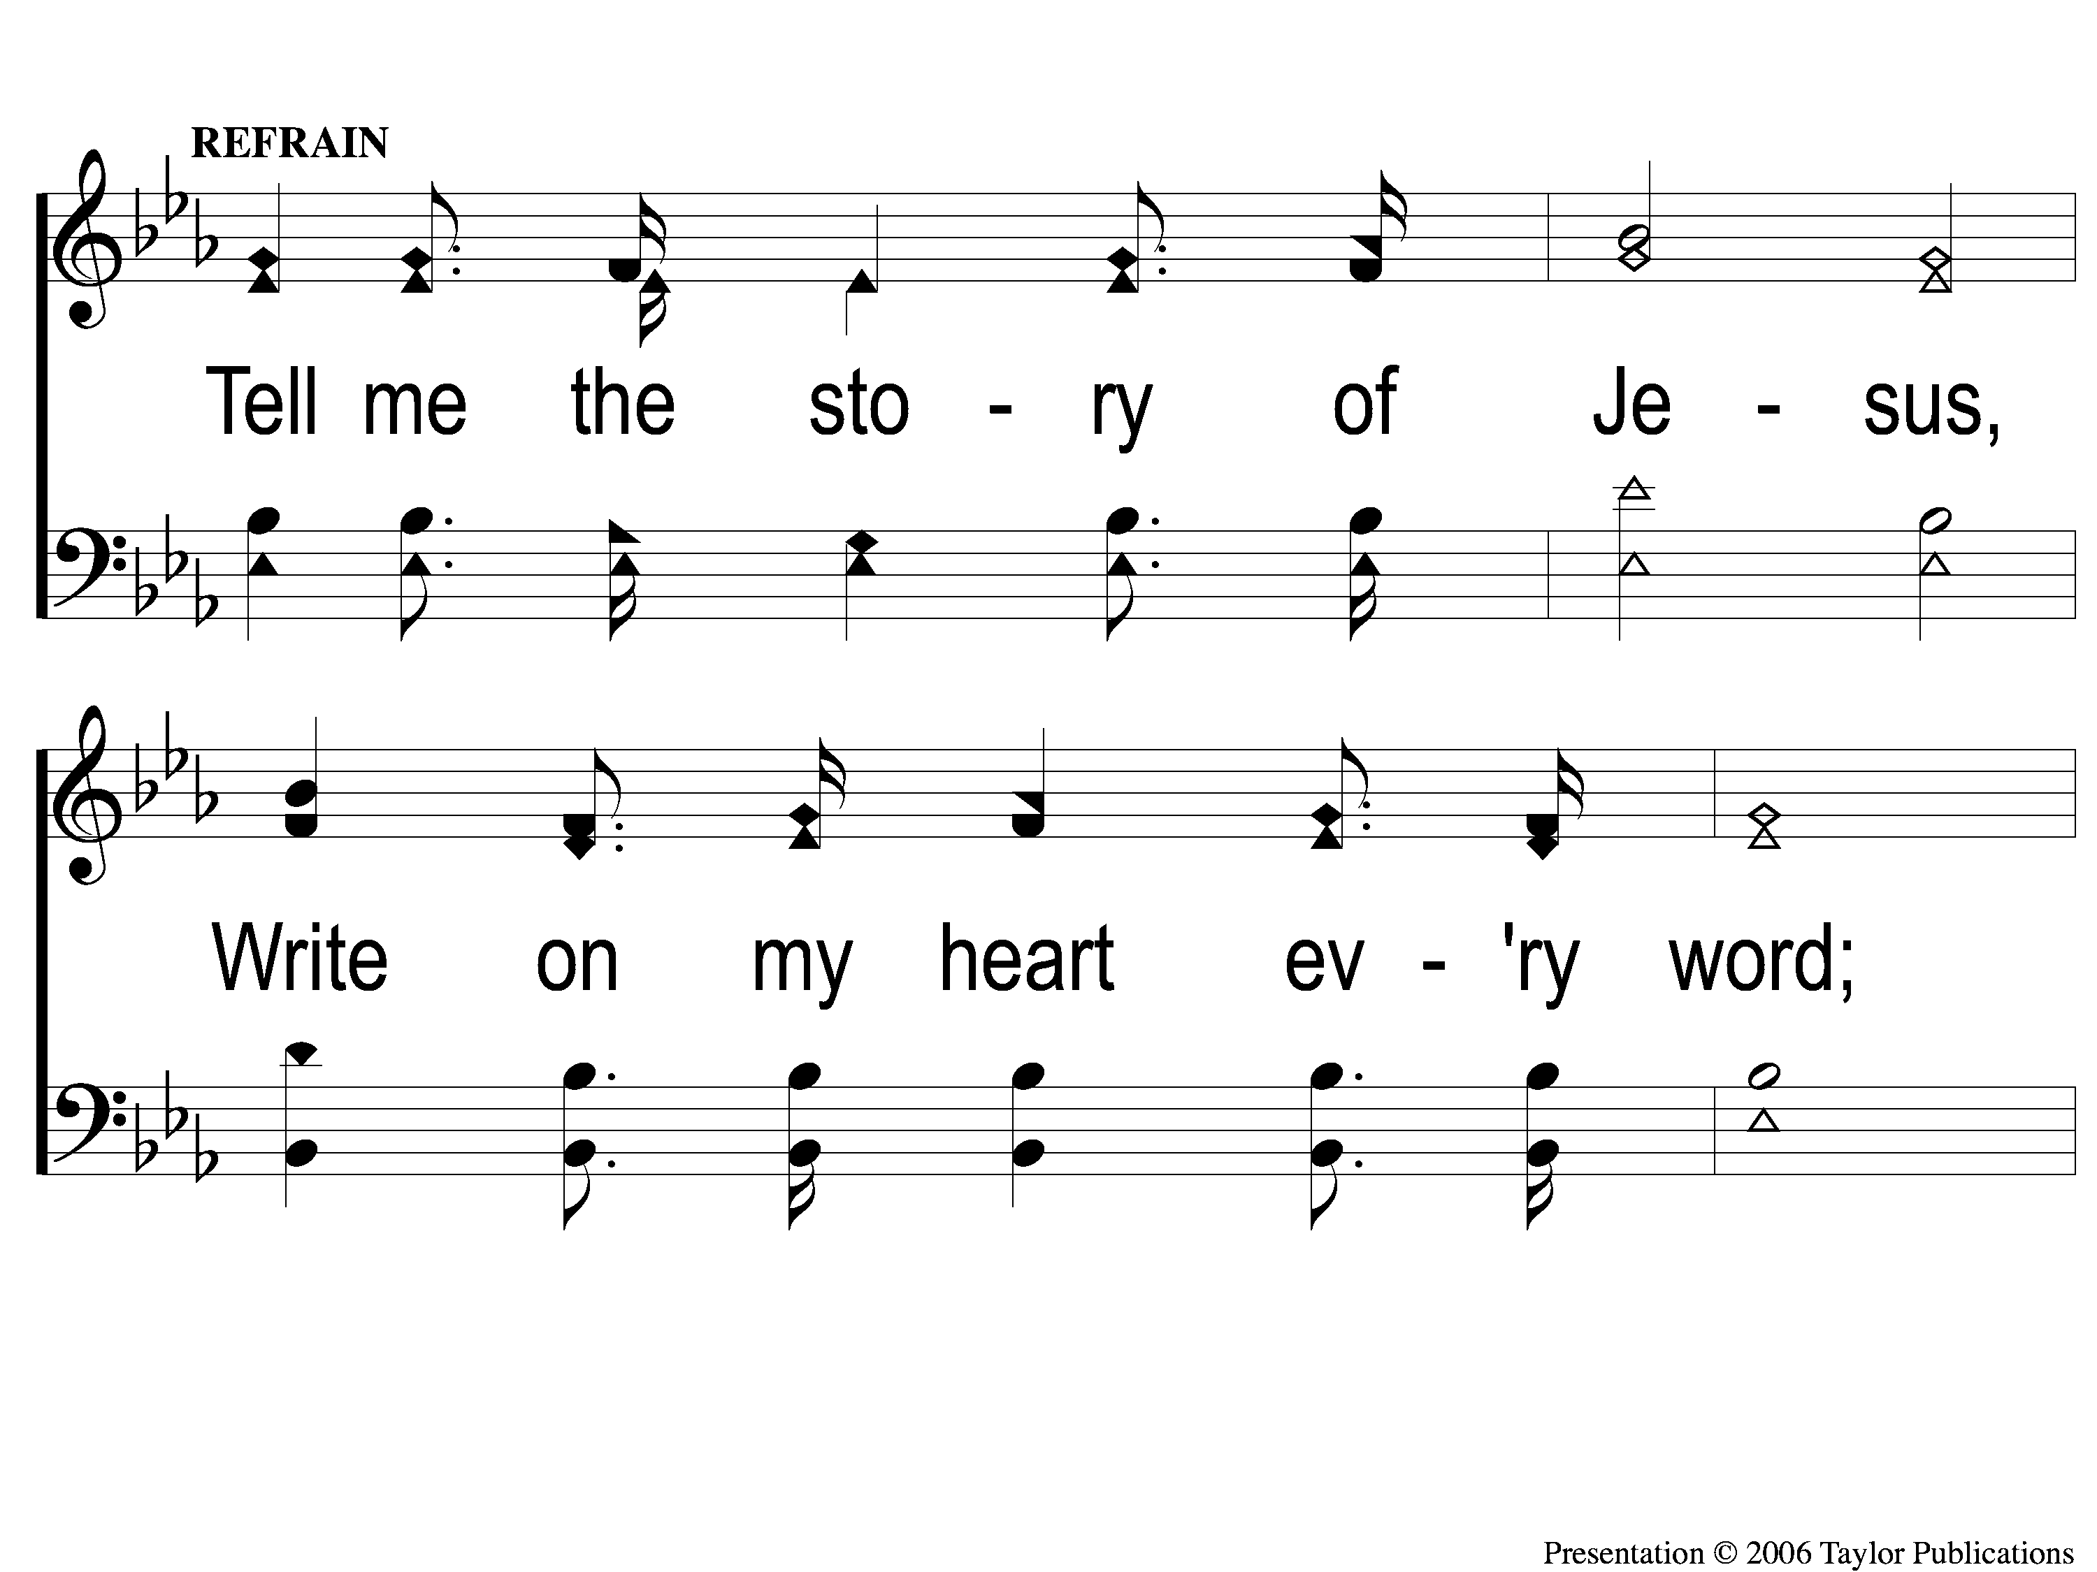
C-1 Tell Me the Story of Jesus
Tell Me the Story of Jesus
387

Slide 42
C-2 Tell Me the Story of Jesus
Tell Me the Story of Jesus
387

Slide 43
2-1 Tell Me the Story of Jesus
Tell Me the Story of Jesus
387

Slide 44
2-2 Tell Me the Story of Jesus
Tell Me the Story of Jesus
387

Slide 45
2-3 Tell Me the Story of Jesus
Tell Me the Story of Jesus
387

Slide 46
2-4 Tell Me the Story of Jesus
Tell Me the Story of Jesus
387

Slide 47
C-1 Tell Me the Story of Jesus
Tell Me the Story of Jesus
387

Slide 48
C-2 Tell Me the Story of Jesus
Tell Me the Story of Jesus
387

Slide 49
3-1 Tell Me the Story of Jesus
Tell Me the Story of Jesus
387

Slide 50
3-2 Tell Me the Story of Jesus
Tell Me the Story of Jesus
387

Slide 51
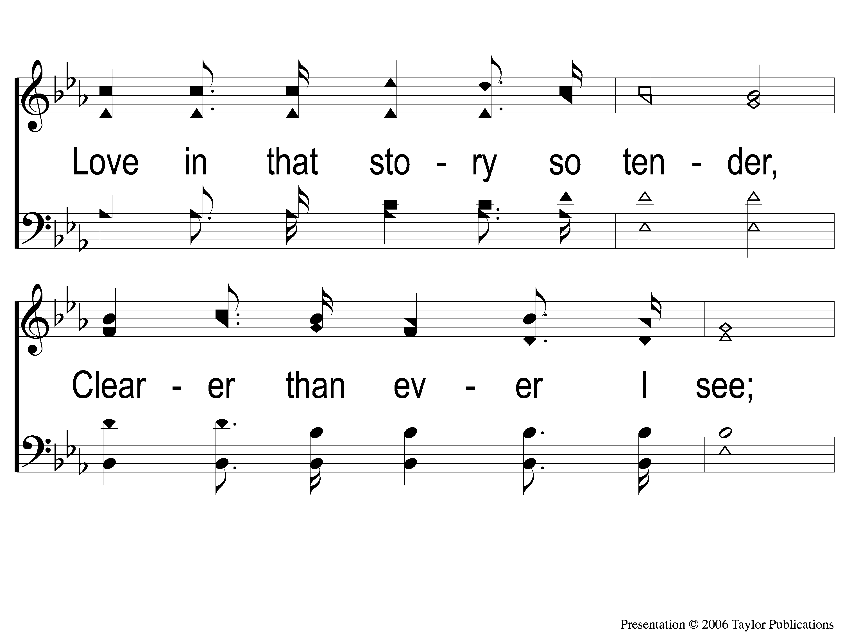
3-3 Tell Me the Story of Jesus
Tell Me the Story of Jesus
387

Slide 52
3-4 Tell Me the Story of Jesus
Tell Me the Story of Jesus
387

Slide 53
C-1 Tell Me the Story of Jesus
Tell Me the Story of Jesus
387

Slide 54
C-2 Tell Me the Story of Jesus
Tell Me the Story of Jesus
387

Slide 55
Scripture Reading:
Matthew 22:34-40

Slide 56
RESTORE REBUILD RENEW
IN 2022

Slide 57
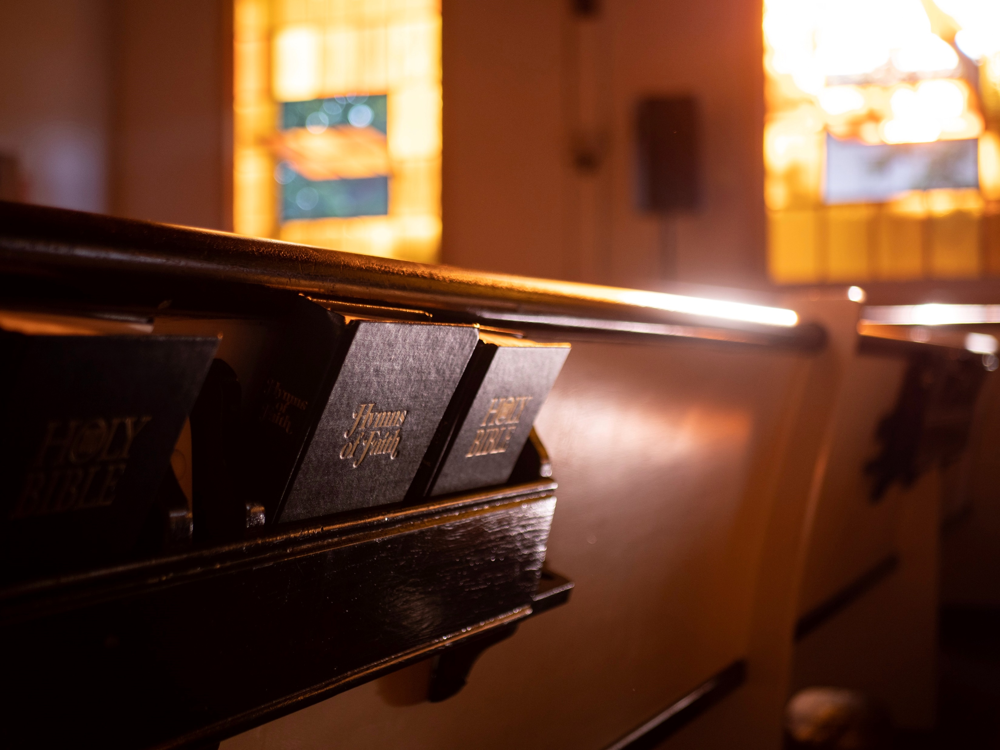
Renewed
by
Hymns

Slide 58
Song:
Love The Lord Your God

Slide 59
Brief History of the Song
Author: Graeme Stewart
Occupation: Youth Minister
Date: 1974

Slide 60
One Question For Jesus

Slide 61
One Question For Jesus
Why is there suffering?
What will make me truly happy?
How can I be sure of my salvation?

Slide 62
The Greatest Commandment
Matthew 22:34-40

Slide 63
The Greatest Commandment
Context of Matthew 22:34-40
Jesus Teaching in the Temple (21:23)

Slide 64
The Greatest Commandment
Context of Matthew 22:34-40
Jesus Teaching in the Temple (21:23)
Jesus Questioned by Leaders (22:15, 23)

Slide 65
The Greatest Commandment
3 Ironies of Matthew 22:34-40
Godly Leaders meeting for Ungodly Purpose

Slide 66
The Greatest Commandment
3 Ironies of Matthew 22:34-40
Godly Leaders meeting for Ungodly Purpose
Law experts tempting the Lawgiver

Slide 67
The Greatest Commandment
3 Ironies of Matthew 22:34-40
Godly Leaders meeting for Ungodly Purpose
Law experts tempting the Lawgiver
The Word of God silences words of Man

Slide 68
The Greatest Commandment
Matthew 22:37-38
What is the Greatest Commandment?

Slide 69
The Greatest Commandment
Matthew 22:37-38
What is the Greatest Commandment?
Love God with all you have!
Deut. 6:5, 10:12, 30:6

Slide 70
The Greatest Commandment
Matthew 22:39
What is the 2nd Greatest Commandment?

Slide 71
The Greatest Commandment
Matthew 22:39
What is the 2nd Greatest Commandment?
Love others as yourself!
Matt. 7:12, Jn. 13:34, Rom. 13:8-10

Slide 72
The Greatest Commandment
Matthew 22:40
Why does the Law hang on these two?

Slide 73
The Greatest Commandment
Matthew 22:40
Why does the Law hang on these two?
Love is the Motivation for God’s Laws
1 Cor. 13:3

Slide 74
Do You Love
God?

Slide 75
Why Keep Jesus Waiting?
#927
Invitation
Song:

Slide 76
1-1 Why Keep Jesus Waiting
Why Keep Jesus Waiting?
927

Slide 77
1-2 Why Keep Jesus Waiting
Why Keep Jesus Waiting?
927

Slide 78
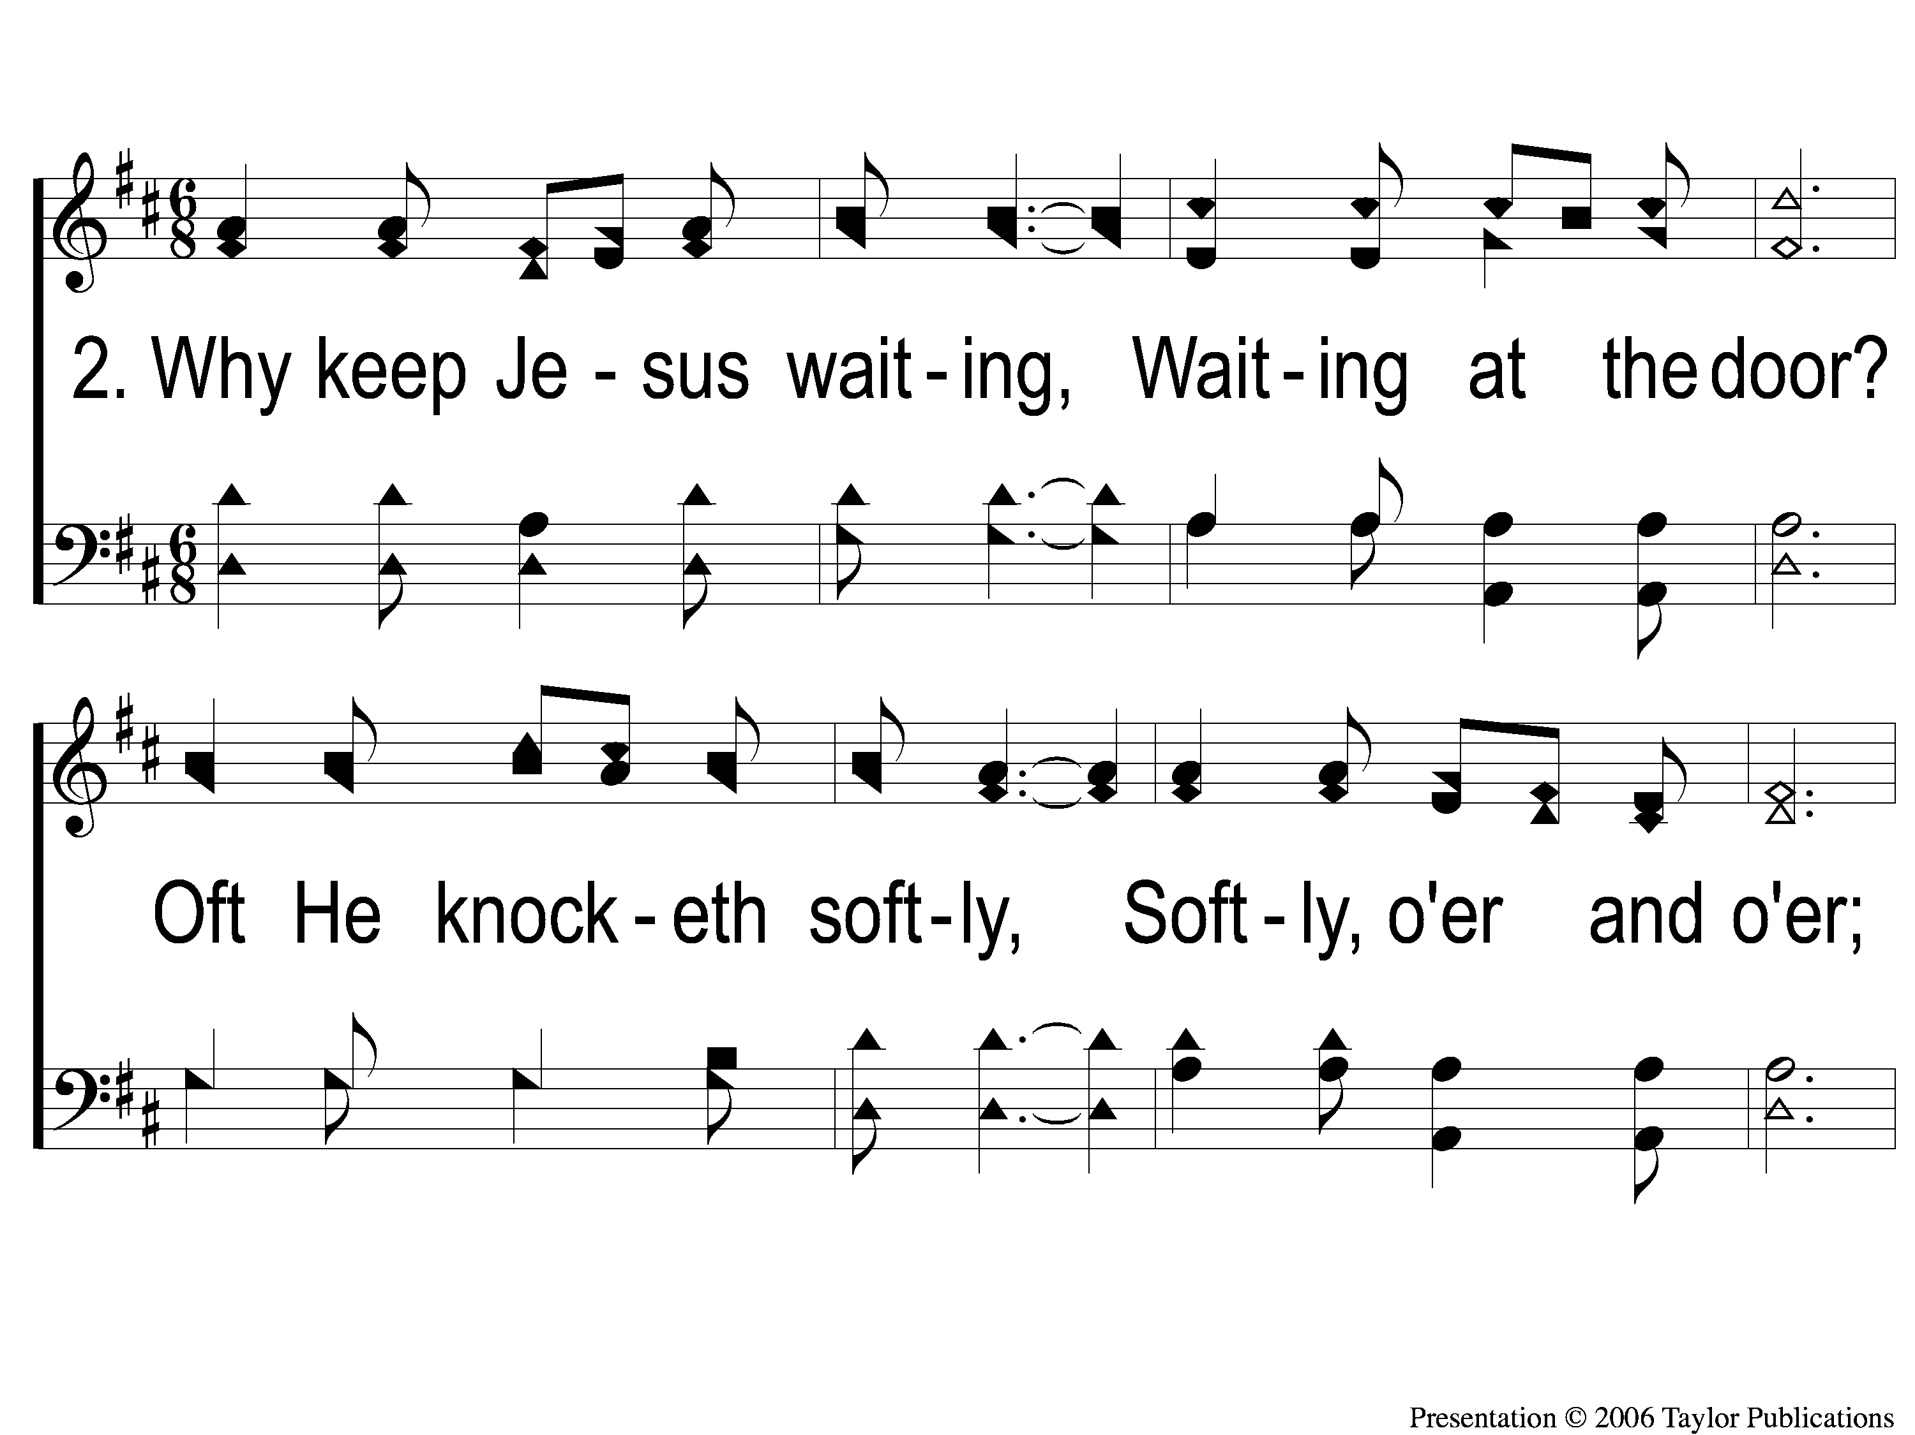
2-1 Why Keep Jesus Waiting
Why Keep Jesus Waiting?
927

Slide 79
2-2 Why Keep Jesus Waiting
Why Keep Jesus Waiting?
927

Slide 80
3-1 Why Keep Jesus Waiting
Why Keep Jesus Waiting?
927

Slide 81
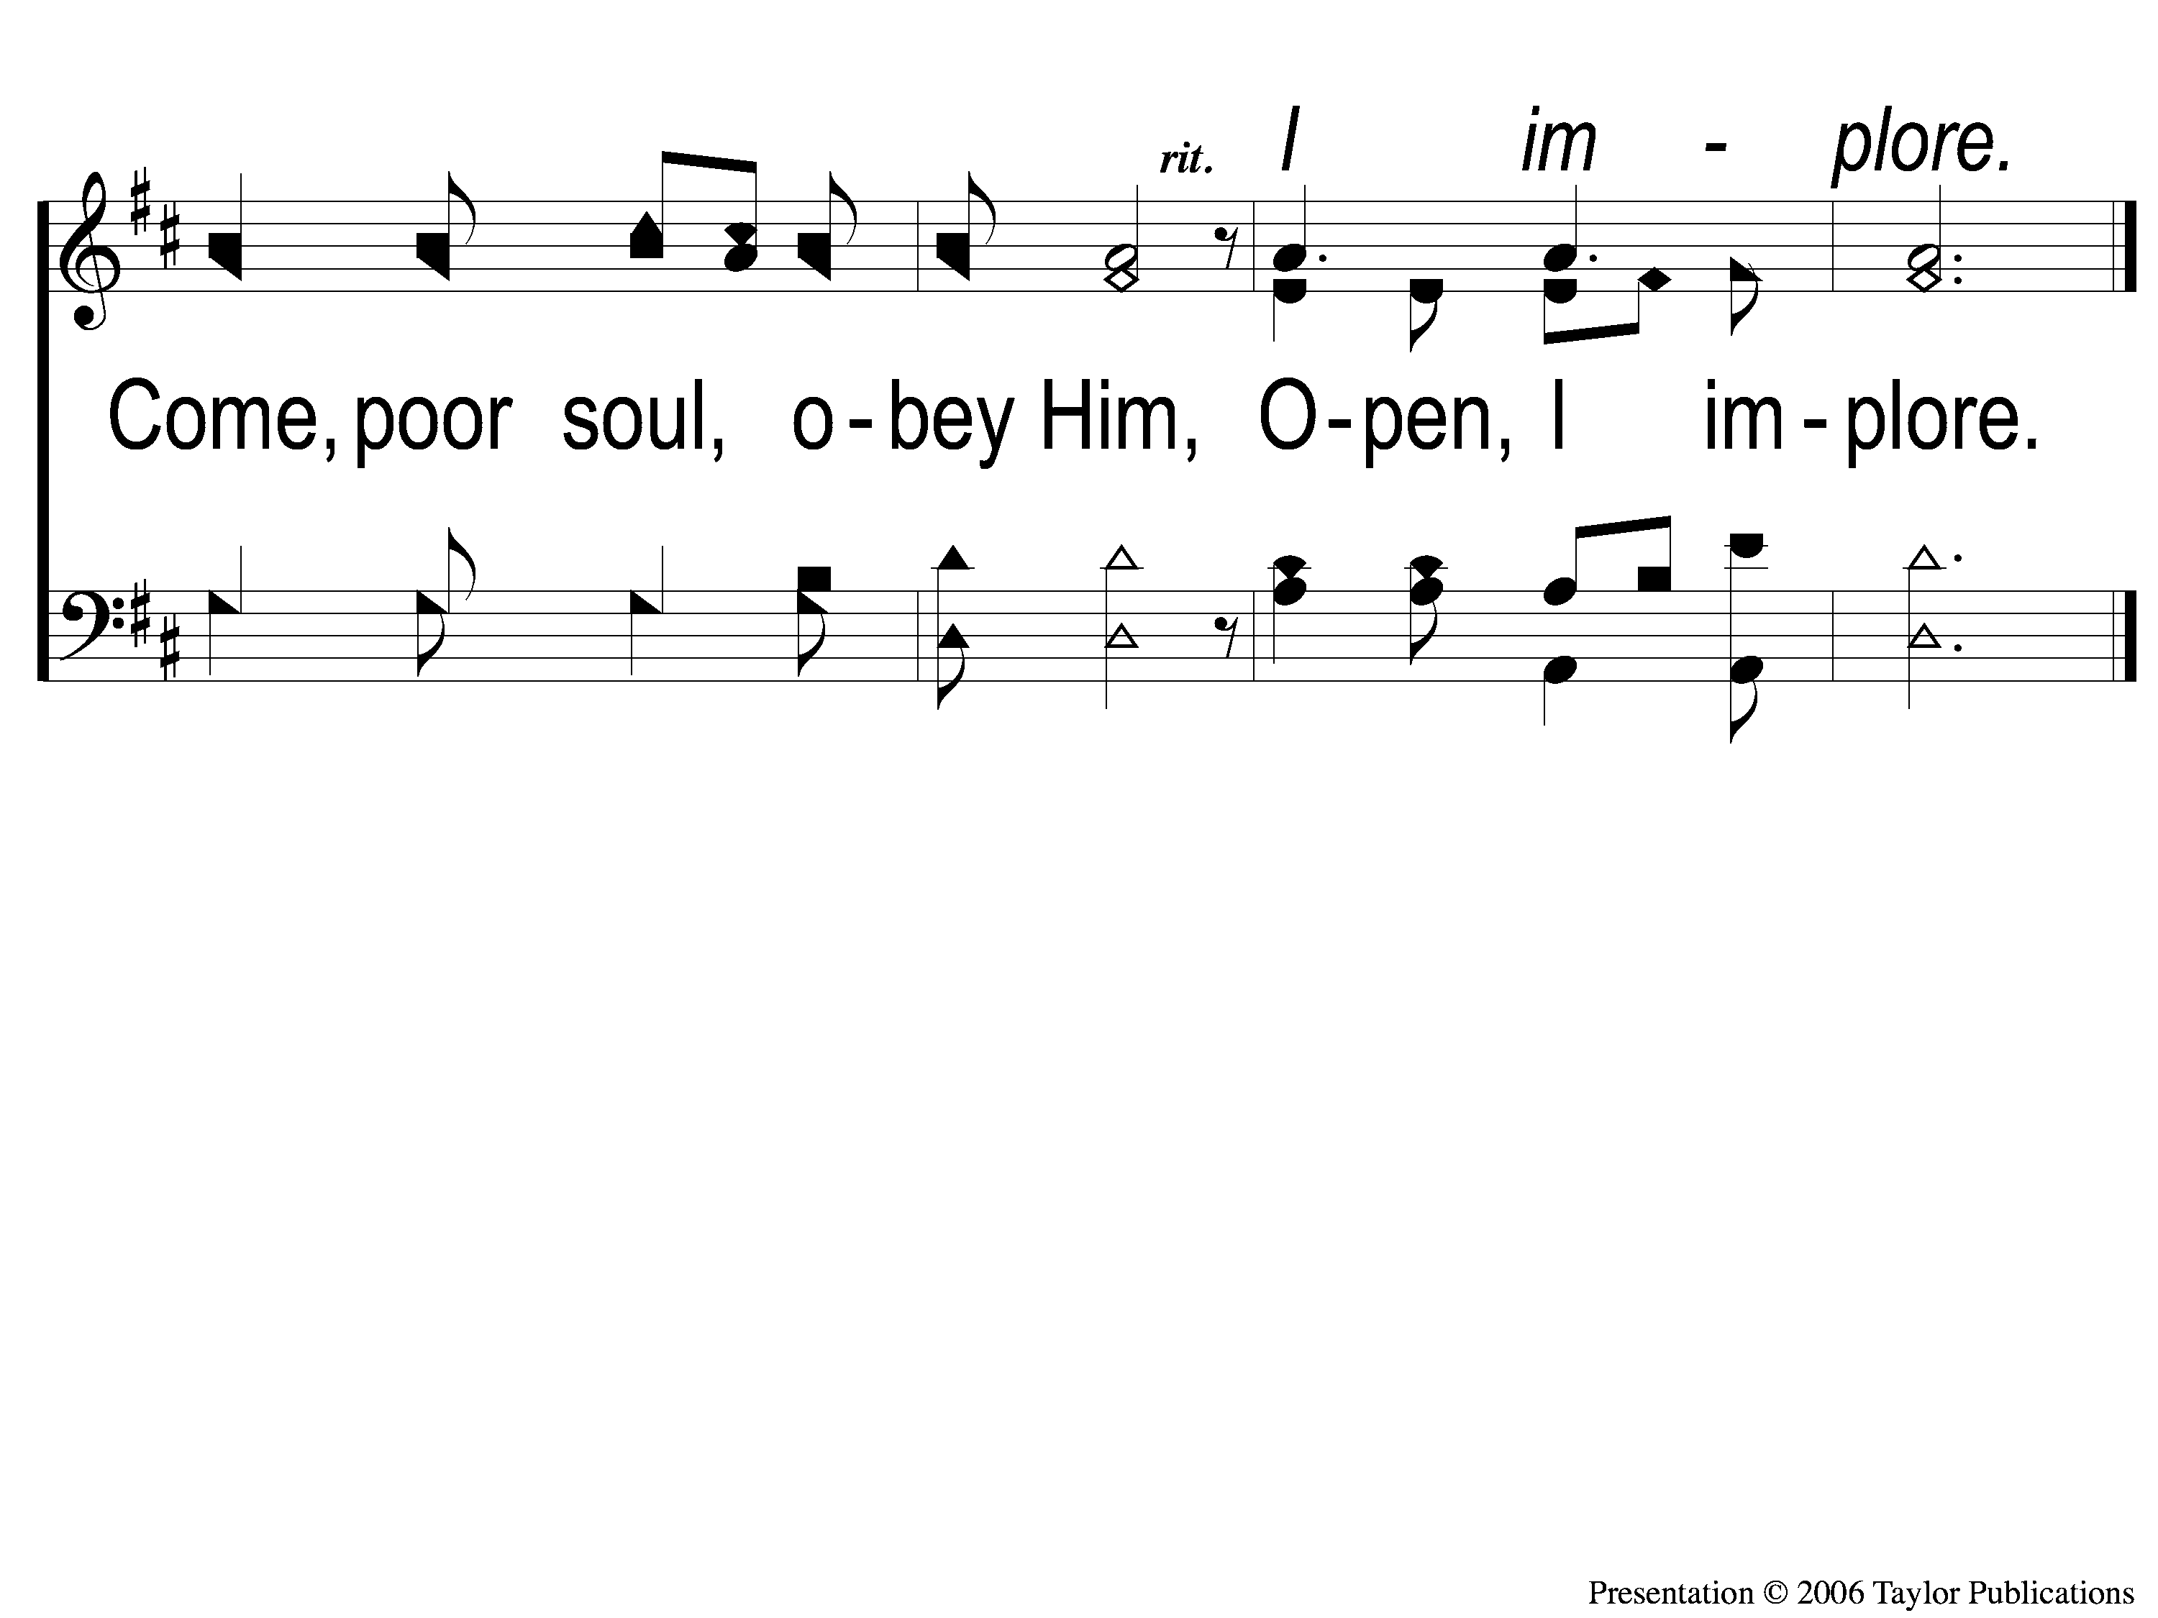
3-2 Why Keep Jesus Waiting
Why Keep Jesus Waiting?
927

Slide 82
The Contribution:
1 Peter 4:10
“As each one has received a gift, minister it to one another, as good stewards of the manifold grace of God.”

Slide 83
Song:
Why Did My Savior
Come To Earth?
#382

Slide 84
1-1 Why Did My Savior Come to Earth?
Why Did My Savior Come to Earth?
382

Slide 85
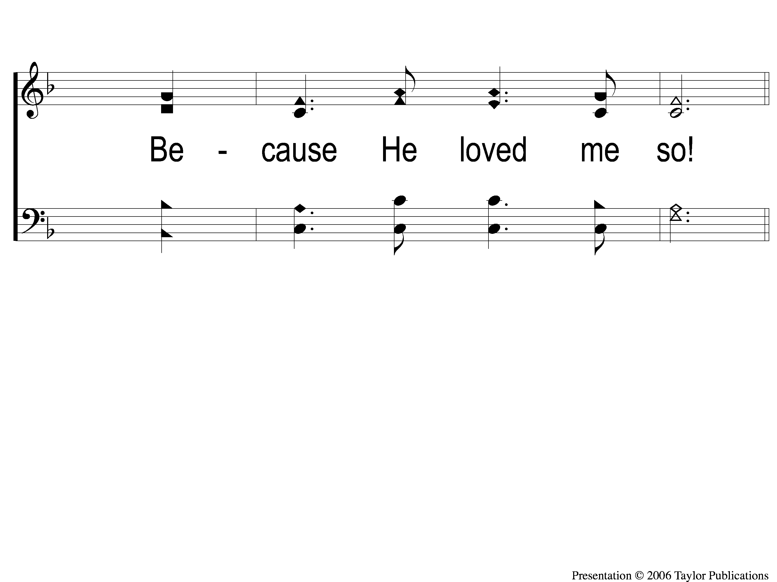
1-2 Why Did My Savior Come to Earth?
Why Did My Savior Come to Earth?
382

Slide 86
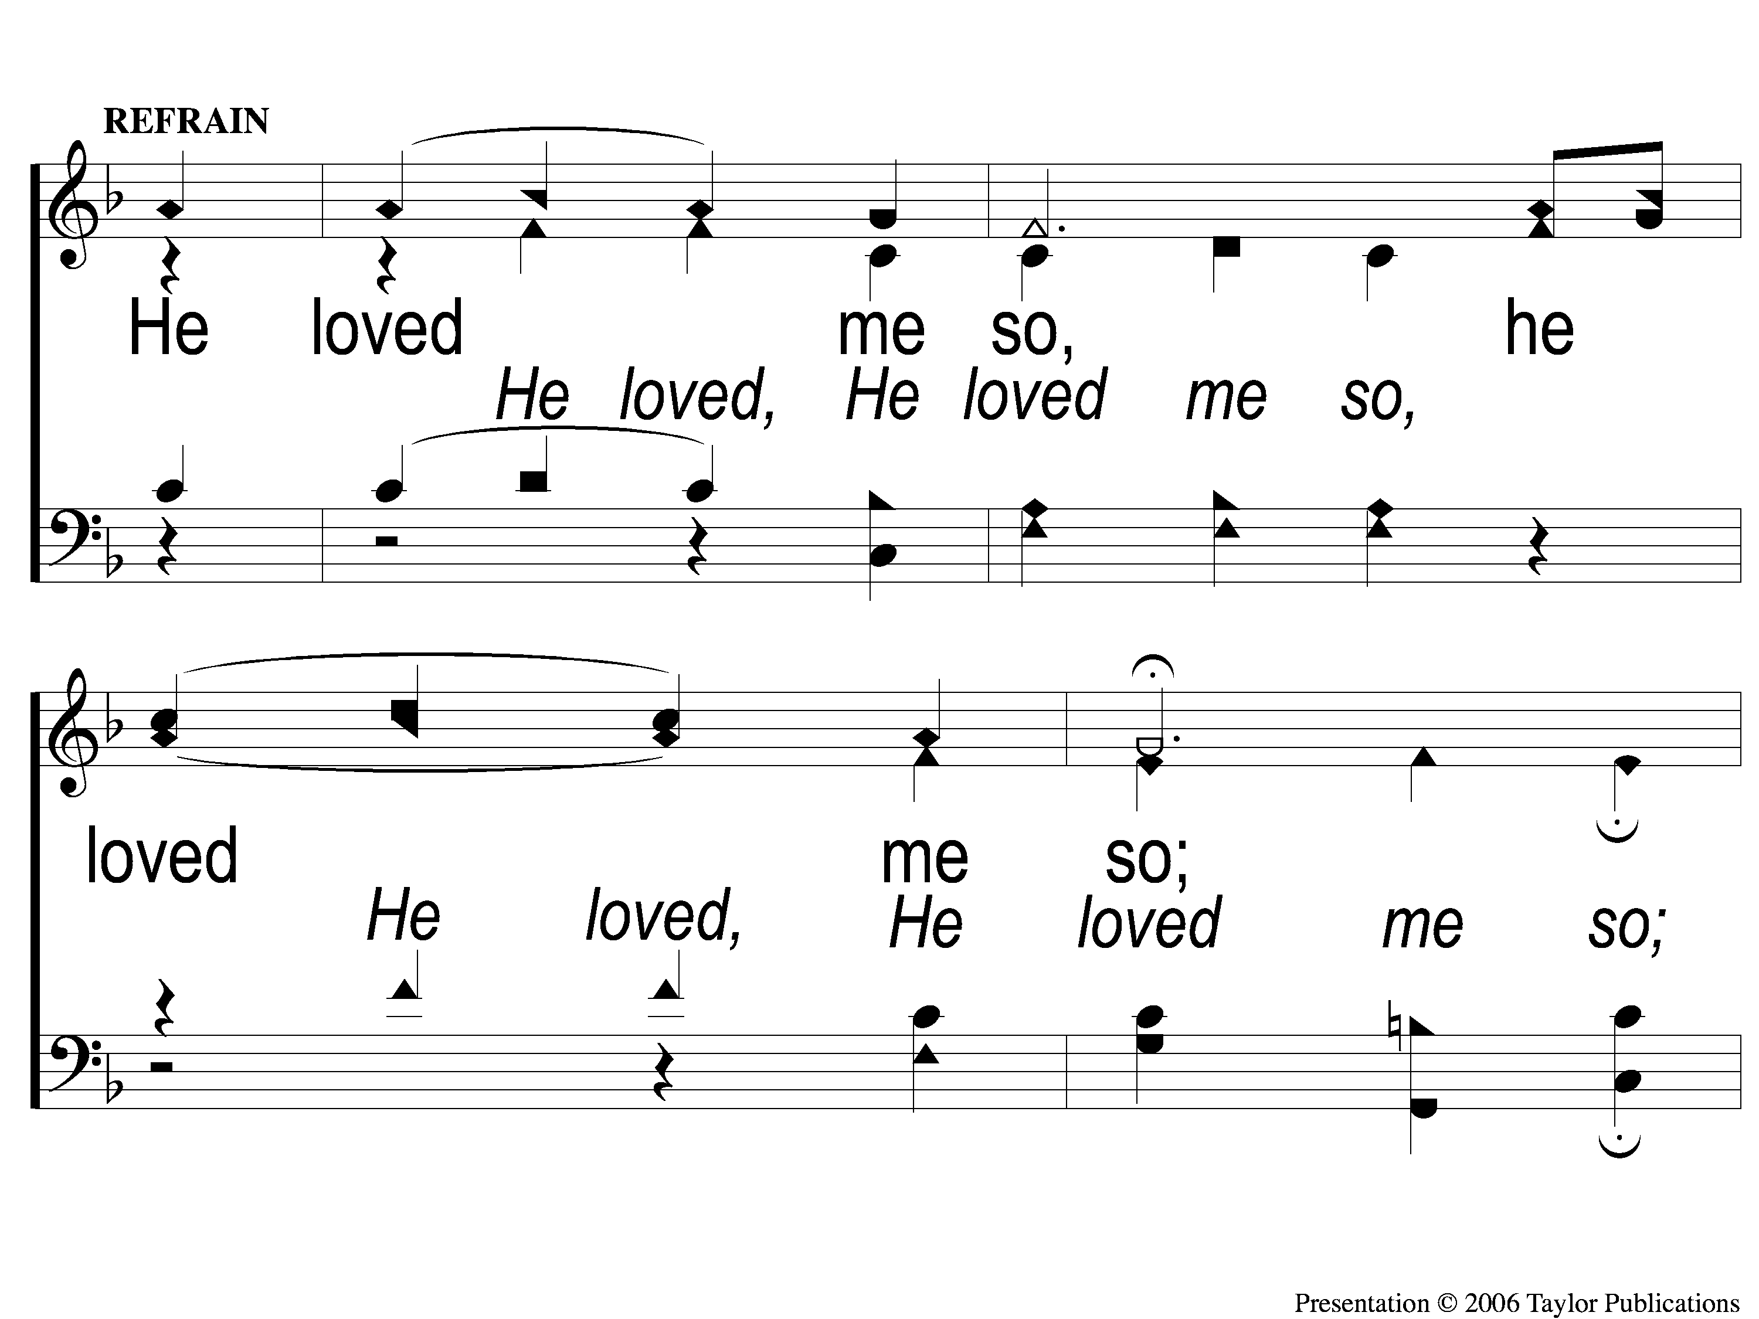
C-1 Why Did My Savior Come to Earth?
Why Did My Savior Come to Earth?
382

Slide 87
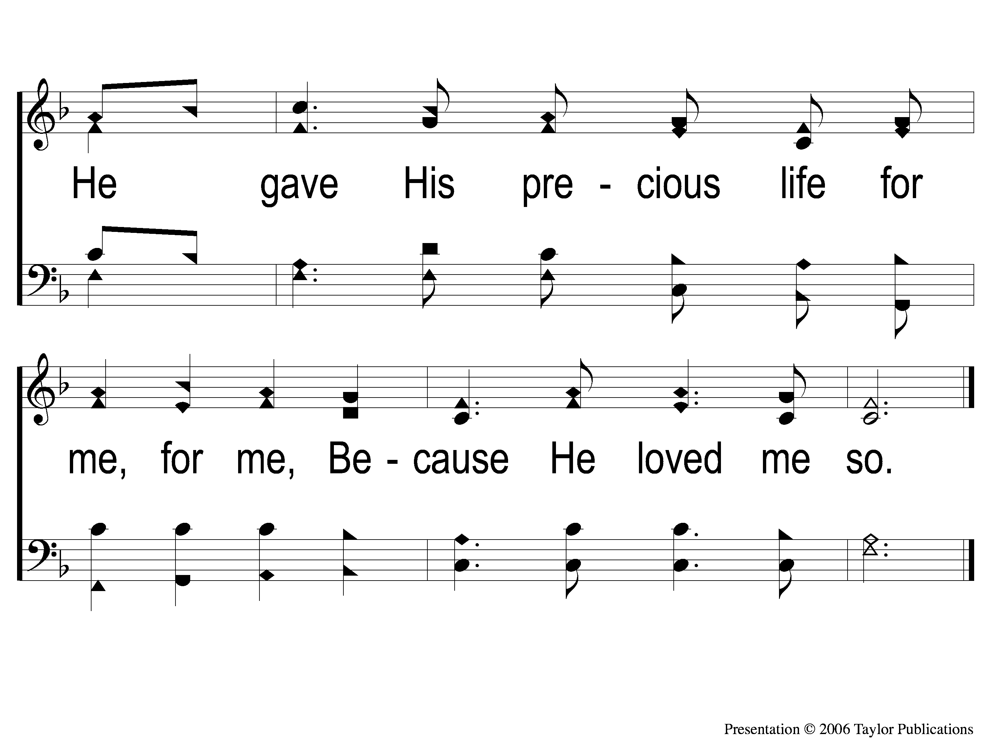
C-2 Why Did My Savior Come to Earth?
Why Did My Savior Come to Earth?
382

Slide 88
2-1 Why Did My Savior Come to Earth?
Why Did My Savior Come to Earth?
382

Slide 89
2-2 Why Did My Savior Come to Earth?
Why Did My Savior Come to Earth?
382

Slide 90
C-1 Why Did My Savior Come to Earth?
Why Did My Savior Come to Earth?
382

Slide 91
C-2 Why Did My Savior Come to Earth?
Why Did My Savior Come to Earth?
382

Slide 92
3-1 Why Did My Savior Come to Earth?
Why Did My Savior Come to Earth?
382

Slide 93
3-2 Why Did My Savior Come to Earth?
Why Did My Savior Come to Earth?
382

Slide 94
C-1 Why Did My Savior Come to Earth?
Why Did My Savior Come to Earth?
382

Slide 95
C-2 Why Did My Savior Come to Earth?
Why Did My Savior Come to Earth?
382

Slide 96
The Unleavened Bread
Ephesians 5:11-13
“Therefore remember that you, once Gentiles in the flesh—who are called Uncircumcision by what is called the Circumcision made in the flesh by hands— that at that time you were without Christ, being aliens from the commonwealth of Israel and strangers from the covenants of promise, having no hope and without God in the world. But now in Christ Jesus you who once were far off have been brought near by the blood of Christ.”

Slide 97
The Fruit
of the Vine
Ephesians 1:7-10
“In Him we have redemption through His blood, the forgiveness of sins, according to the riches of His grace which He made to abound toward us in all wisdom and prudence, having made known to us the mystery of His will, according to His good pleasure which He purposed in Himself, that in the dispensation of the fullness of the times He might gather together in one pall things in Christ, both which are in heaven and which are on earth—in Him.”

Slide 98
Closing Prayer

Slide 99
Song:
A Common Love
#705

Slide 100
Today
Join us in the MPB for
A Fellowship Meal & Devo
Wednesday
Worship & Classes & 6:30 PM
RESTORE REBUILD RENEW
IN 2022
WHEELER
CHURCH
OF
CHRIST

