Slide 1
Welcome
Presented by: Wib Newton
wib@newhoperesources.com (806)350-5862 www.newhoperesources.com

Slide 2
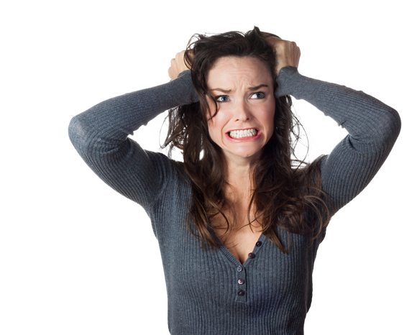
Outside Stressors on Marriage
COVID (hibernation, vaccine/no vaccine, anxiety, school, etc.
Political Climate
Social Unrest
Supply Chain
Media/Social Media

Slide 3
Benefits of Marriage
$$
Deal with stress better
Lower cases of stress & depression
Improved health and lifestyle
Improved life expectancy & recovery rates
Better sleep
Physical security
LOVE & COMPANIONSHIP

Slide 4
Divorce Rate
50%
Cohabitating couples could be higher

Slide 5
Passion

Slide 6
Realization

Slide 7
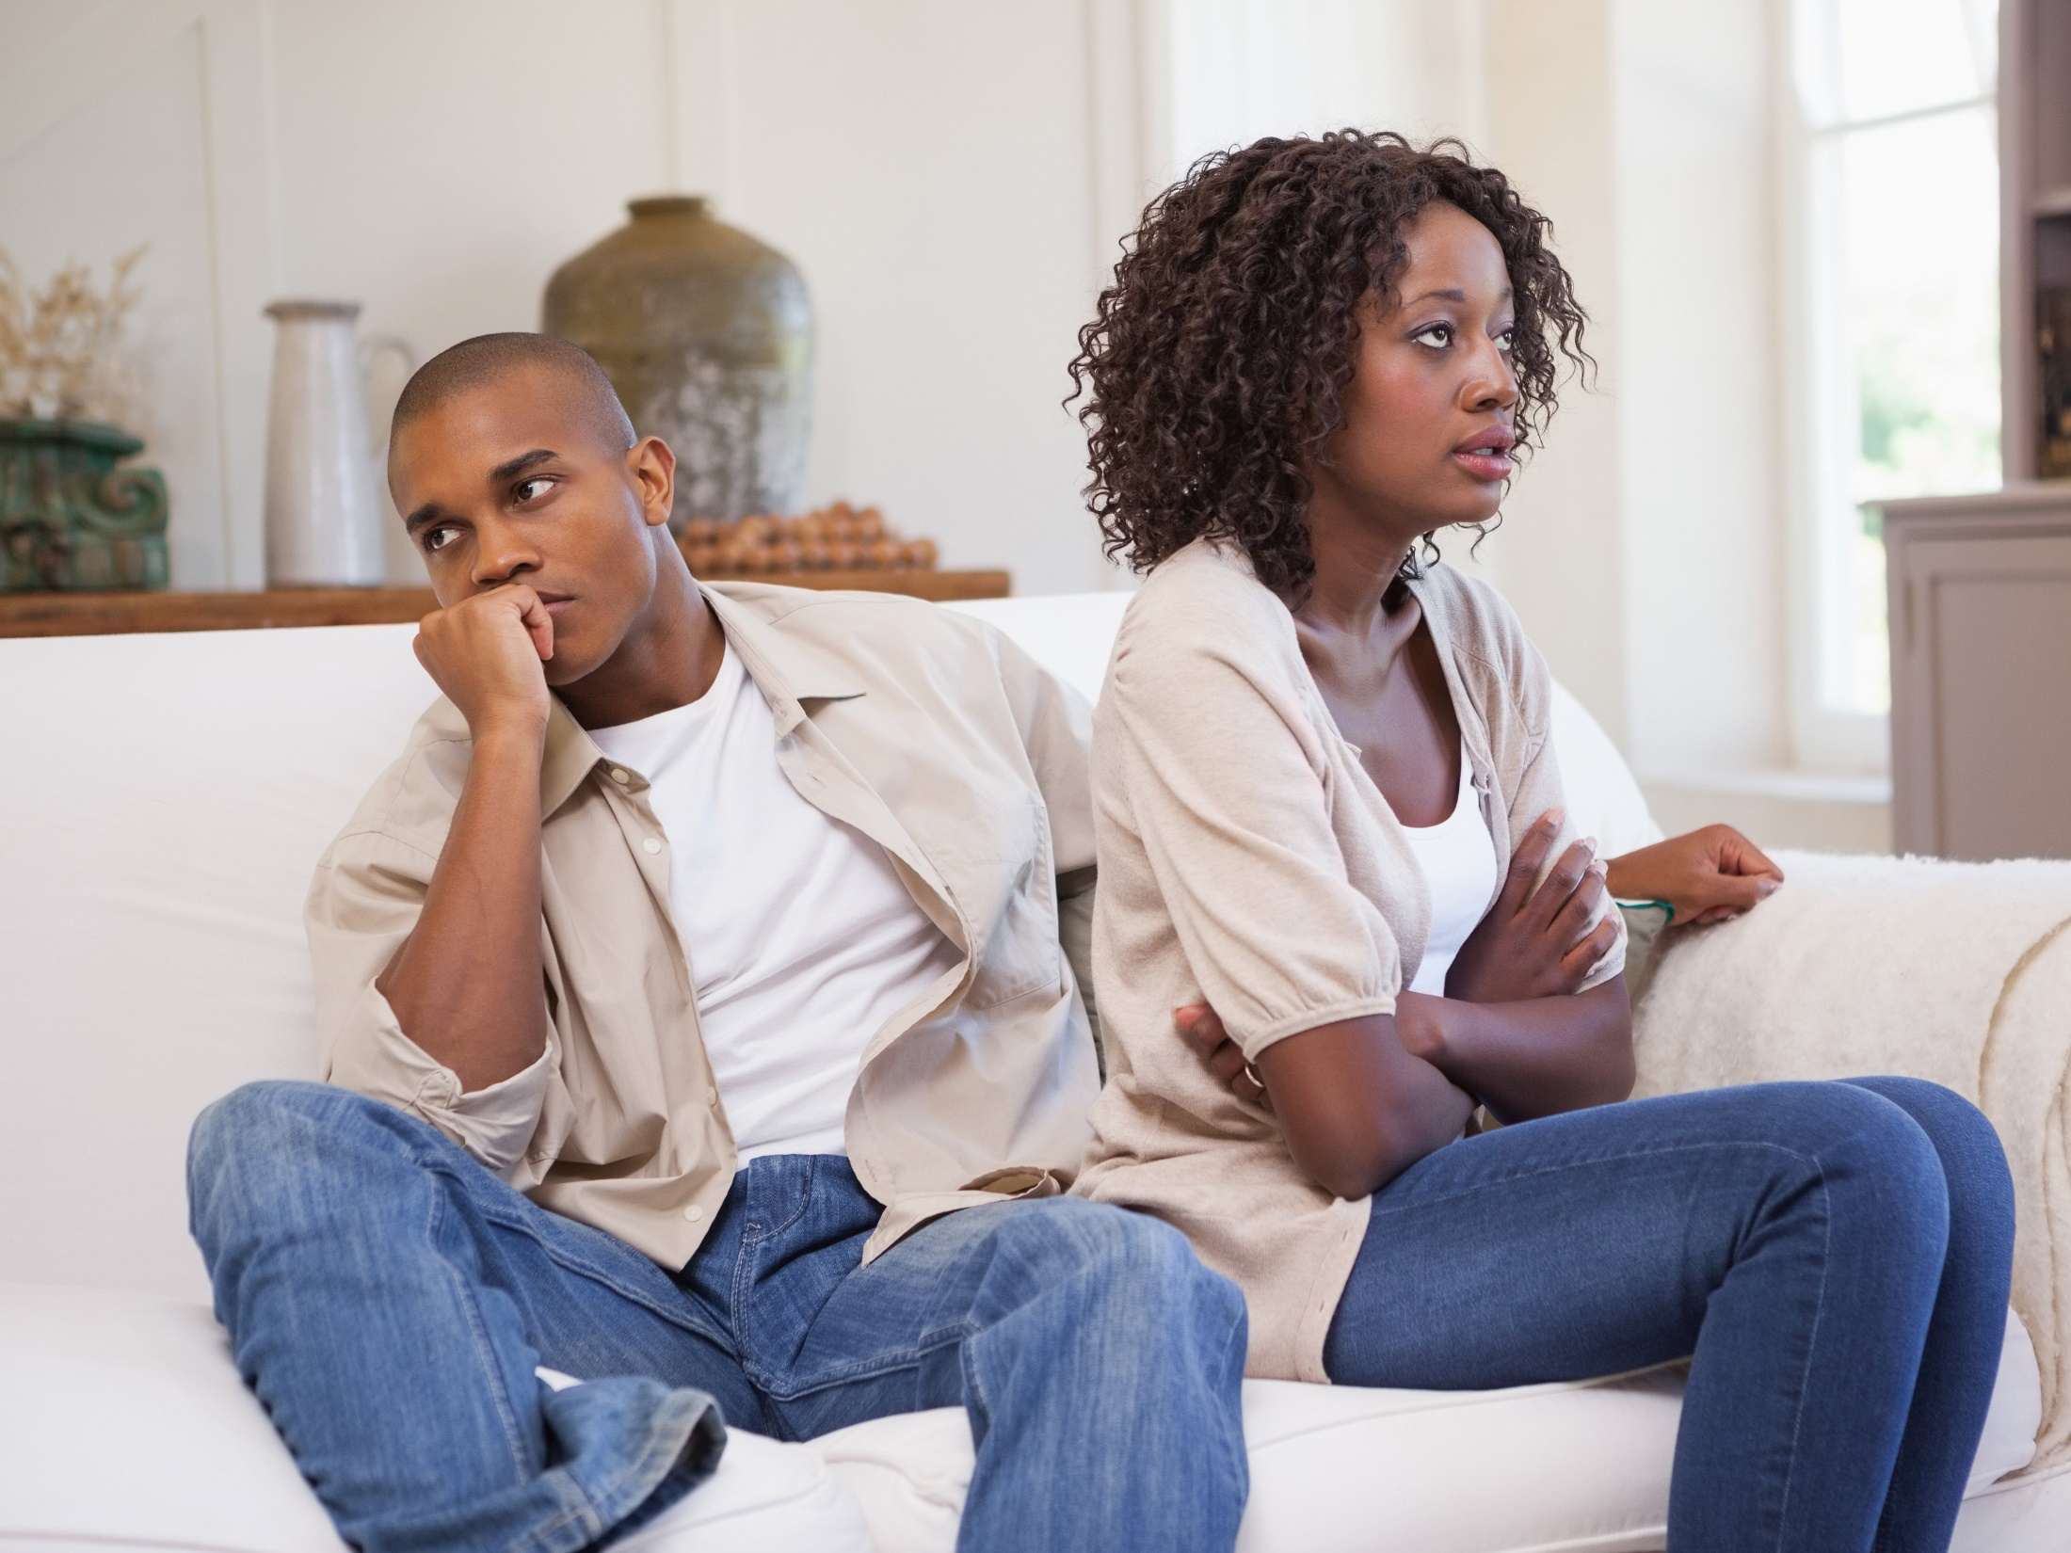
Rebellion

Slide 8
Cooperation

Slide 9
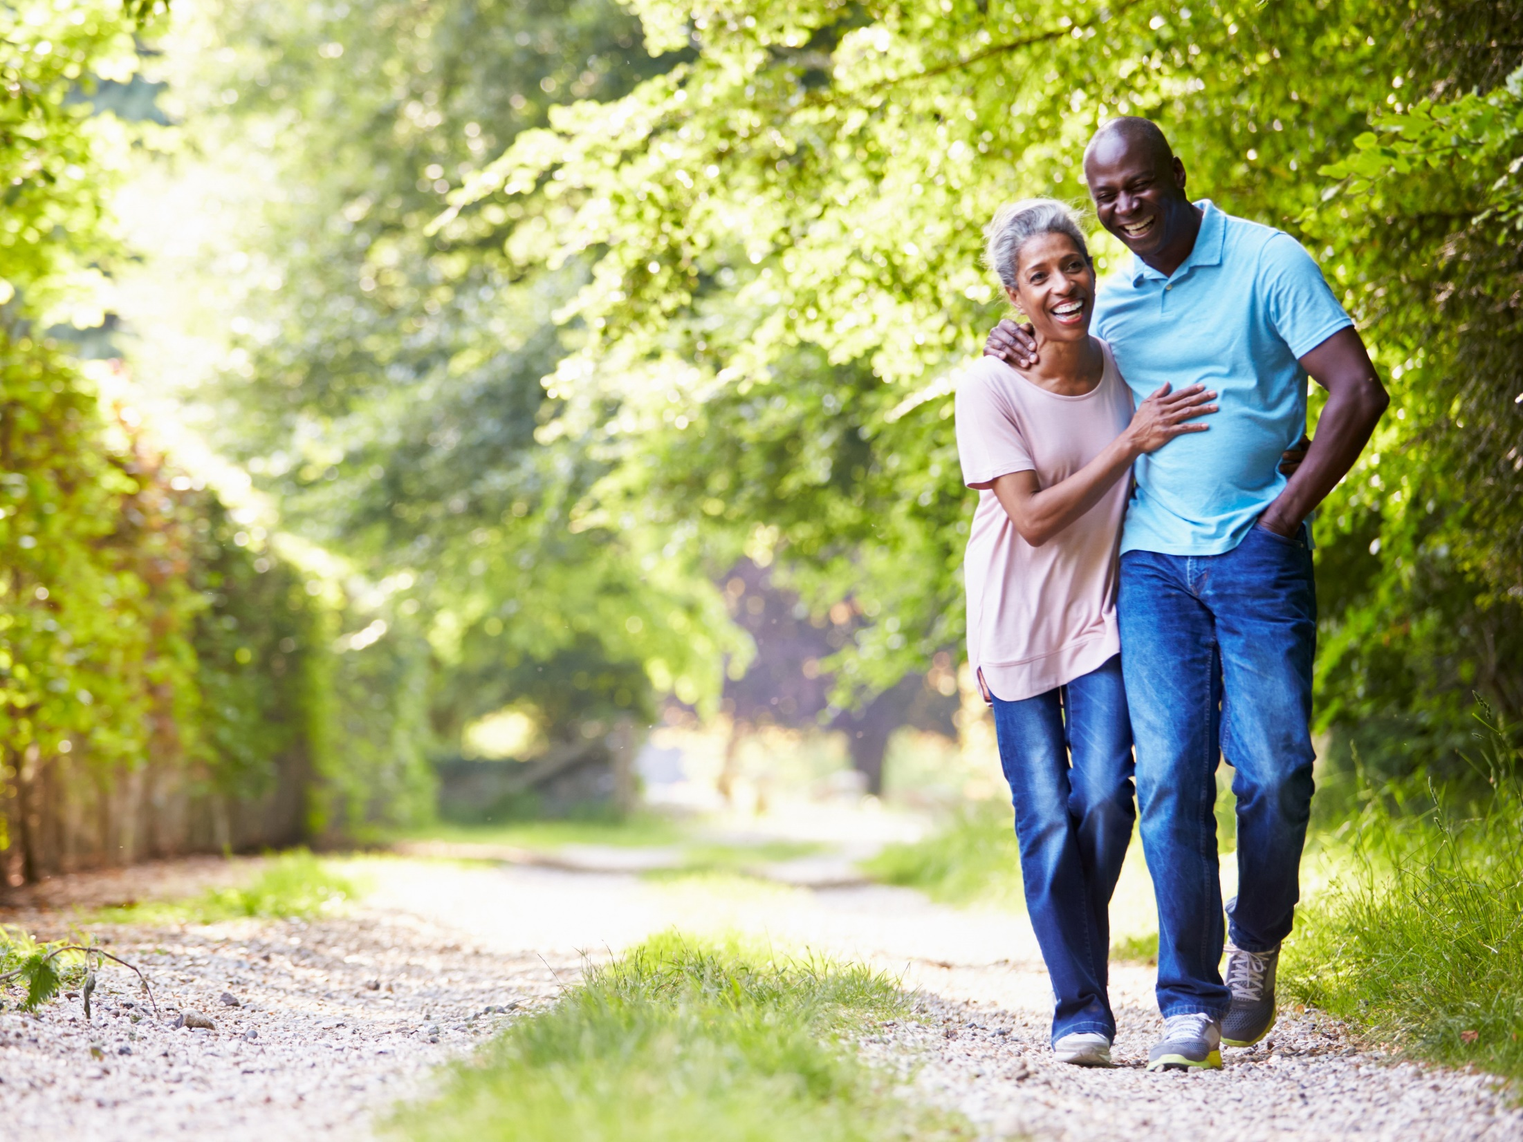
Reunion

Slide 10
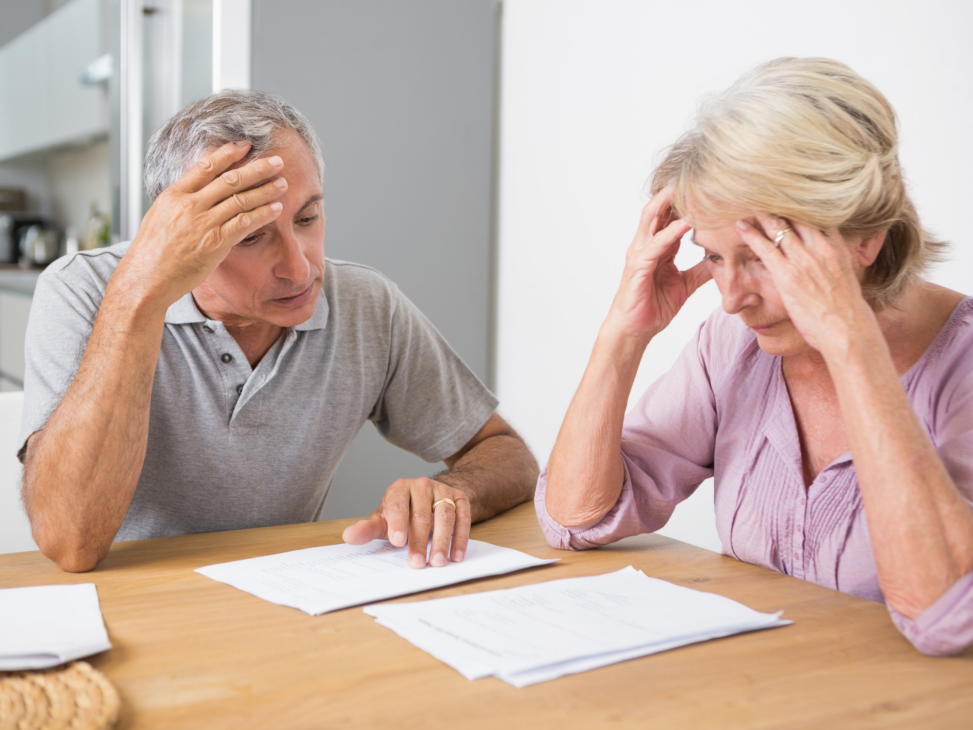
Struggles

Slide 11
Love Stages
Finances
Pregnancy
Injury
Satisfaction
Job Loss
Time

Slide 12
The Anatomy of Love
Passion
Friendship
Commitment

Slide 13
Passion: “Motivational” Side
sensual
sexual
intense desire for physical
possessive
boarders on obsession
leads to extreme levels of
preoccupation
Passion

Slide 14
Intimacy: “Emotional” Side
takes emotional risks
holds nothing back
total trust
honesty
sharing
communication
support
Intimacy

Slide 15
Commitment: “Cognitive” Side
secures the love when passion
burns low
personal unchanging commitment
bring longevity to love
is a major source of health
of one’s love
defines the “strength” of a marriage
Commitment

Slide 16
Romantic Love
Passion
Intimacy

Slide 17
Foolish Love
Passion
Commitment

Slide 18
Companionate Love
Intimacy
Commitment

Slide 19
Consummate Love
Passion
Intimacy
Commitment

Slide 20
How do couples make this journey successfully ?

Slide 21
Play
Hold
Nurture
Talk
Time

Slide 22
Play
Hold
Nurture
Talk
Time

Slide 24
Friends First

Slide 25
Strengths of Happy Couples verses Unhappy Couples Regarding Couple Closeness
Closeness Issues | Happy Couples % of Agreement | Unhappy Couples % of Agreement
Togetherness as a priority | 97% | 28%
Enjoy spending free time with spouse | 97% | 43%
Friends and family do not interfere with the couple | 81% | 38%

Slide 26
Key:
Make the Marriage a Priority Throughout the Marriage

Slide 27
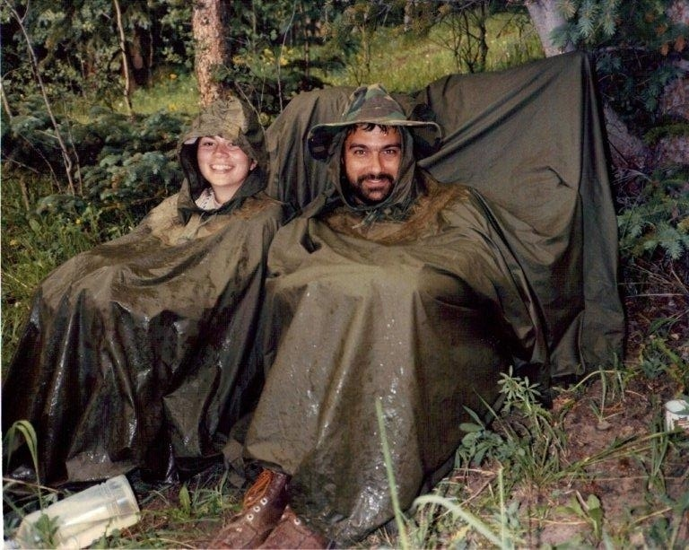

Slide 28
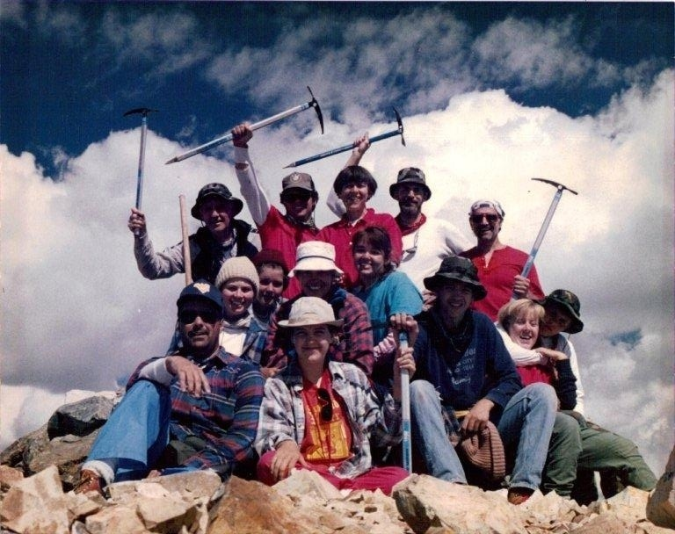

Slide 29
Tips for Marital Success
Friends First
Commit!

Slide 30
When You Say “I
Commitment #1- I’m committed to staying in the marriage
Commitment #2- I’m committed to make this the best relationship possible.

Slide 31
Colossians 3: 12 God has chosen you and made you his holy people. He loves you. So you should always clothe yourselves with mercy, kindness, humility, gentleness, and patience. 13 Bear with each other and forgive each other. If someone does wrong to you, forgive that person because the Lord forgave you. 14 Even more than all this, clothe yourself in love. Love is what holds you all together in perfect unity. 15 Let the peace that Christ gives control your thinking, because you were all called together in one body[d] to have peace. Always be thankful.

Slide 32
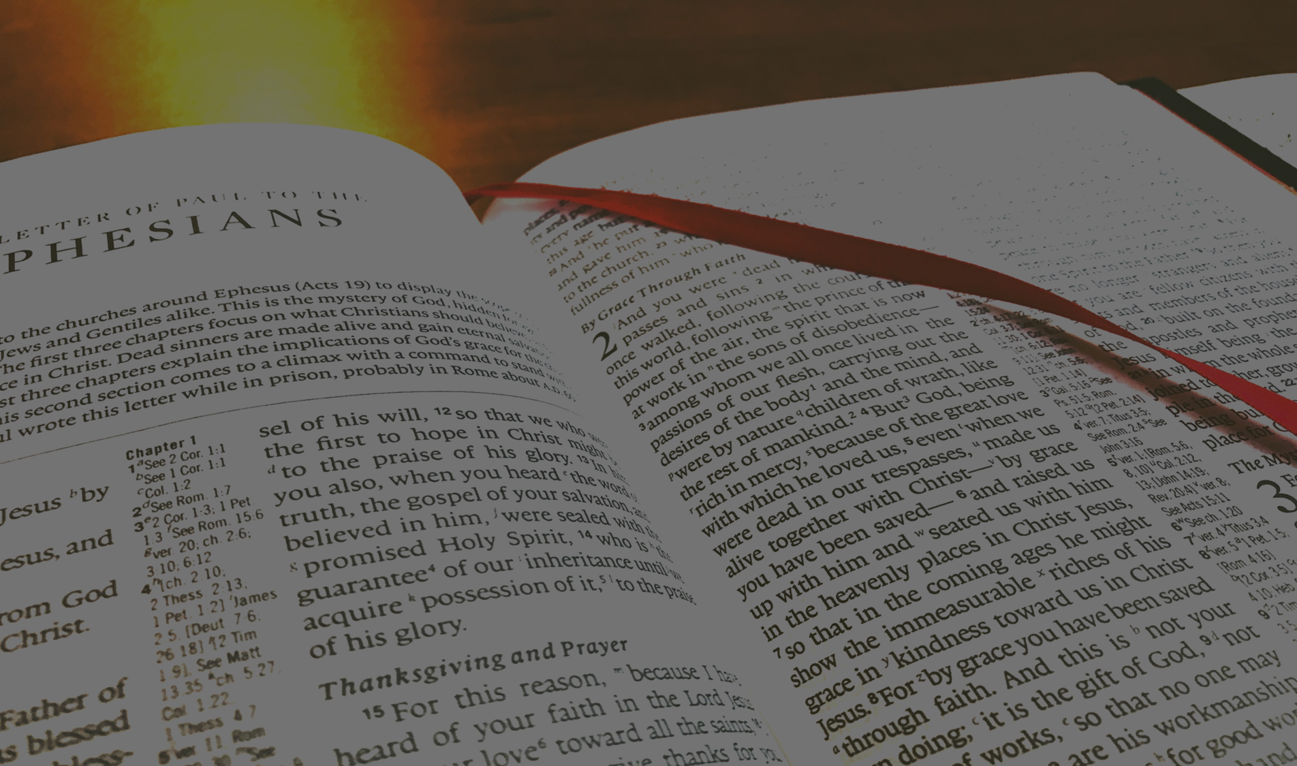
Proverbs 12:18
Careless words stab like a sword, but wise words bring healing..
Colossians 3:8
But now also put these things out of your life: anger, bad temper, doing or saying things to hurt others, and using evil words when you talk.

Slide 33
Ephesians 4:26-27 ²⁶ When you are angry, do not sin, and be sure to stop being angry before the end of the day. ²⁷ Do not give the devil a way to defeat you
James 1:19 My dear brothers and sisters, always be willing to listen and slow to speak. Do not become angry easily,

Slide 34
What keeps these wonderful, life-giving behaviors from taking place on regular basis?

Slide 35
Break

Slide 36
4 Basic Ways of Behaving Badly
Blame
Shame Self
Control
Escape

Slide 37
What is the #1 Skill Needed for Successful Marriage?

Slide 38
Tips for Marital Success
Friends First
Commit!
Emotional Self-Regulations

Slide 39
Galatians 5:22 But the Spirit produces the fruit of love, joy, peace, patience, kindness, goodness, faithfulness, 23 gentleness, self-control. There is no law that says these things are wrong. 24 Those who belong to Christ Jesus have crucified their own sinful selves. They have given up their old selfish feelings and the evil things they wanted to do. 25 We get our new life from the Spirit, so we should follow the Spirit. 26 We must not be proud or make trouble with each other or be jealous of each other.

Slide 40
2 Peter 1: 5 For this very reason, make every effort to add to your faith excellence, to excellence, knowledge; 6 to knowledge, self-control; to self-control, perseverance; to perseverance, godliness; 7 to godliness, brotherly affection; to brotherly affection, unselfish love. 8 For if these things are really yours and are continually increasing, they will keep you from becoming ineffective and unproductive in your pursuit of knowing our Lord Jesus Christ more intimately.

Slide 41
The Importance of Self-Control
Self-control is a big influence on the course of how people live and operate in life.
When looking at the most important influences on issues like college students’ grades, research has shown:
Self-control was the only measure among dozens of personality traits that had predictive power on grade-point average.
Also holds true on SAT scores as well as the student’s IQ scores

Slide 42
Importance of Self-Control
Individuals who are better at self-control are better regarded by peers
Are good at forming and maintaining secure relationships with others
More empathetic with others
They are more stable psychologically with less anxiety, depression and drinking problems and get less angry and aggressive (Baumeister & Tierney, 2011).
.

Slide 43
Self-Regulation of emotions is THE most important predictor of unhappiness in relationships and resulting demise of those relationships

Slide 44
Why is self-control so difficult?
It does not come naturally. It demands attention, ability and intentionality
It is NOT popular as a virtue. We live in a society that considers emotions to reflect the “truest” part of ourselves.

Slide 45
What is the secret to Self-Control

Slide 46
Or is there something deeper?

Slide 47
What gets in the way of doing what you know you should?

Slide 48
What keeps these wonderful, life-giving behaviors from taking place on regular basis?
When you don’t feel loved
When you don’t feel Safe
When it doesn’t feel Fair
This is when we REACT

Slide 49
Does it help to know where these come from?
YES!

Slide 50
What messages of love and trust (safety) have you received growing up?

Slide 51
The Pain Cycle
Jim Feels controlled, weak, insignificant
Sue Copes: control, perfectionism, blame, stuff/avoid
Jim Copes: defensive, w/draw to avoid, independent
Sue Feels: Alone, out of control, not good enough

Slide 52
How do you think they influence your behavior now?

Slide 53
Break

Slide 54
Identity
Safety
Love
Trust
Pain
Blame
Shame
Control
Escape

Slide 55
Psalm 139:23-24
Search me, God, and know my heart; test me and know my anxious thoughts. ²⁴ See if there is any offensive way in me, and lead me in the way everlasting.

Slide 56
Proverbs 4:23
Above all else, guard your heart, for everything you do flows from it.

Slide 57
Matthew 15:19Amplified Bible (AMP)
For out of the heart come evil thoughts and plans, murders, adulteries, sexual immoralities, thefts, false testimonies, slanders (verbal abuse, irreverent speech, blaspheming).

Slide 58
Taking Off the Old & Putting on the New
Colossians 3 Since you were raised from the dead with Christ, aim at what is in heaven, where Christ is sitting at the right hand of God. ² Think only about the things in heaven, not the things on earth. ³ Your old sinful self has died, and your new life is kept with Christ in God. ⁴ Christ is your^{[a]}life, and when he comes again, you will share in his glory.⁵ So put all evil things out of your life: sexual sinning, doing evil, letting evil thoughts control you, wanting things that are evil, and greed. This is really serving a false god. ⁶ These things make God angry.^{[b]} ⁷ In your past, evil life you also did these things.

Slide 59
8 But now also put these things out of your life: anger, bad temper, doing or saying things to hurt others, and using evil words when you talk. 9 Do not lie to each other. You have left your old sinful life and the things you did before. 10 You have begun to live the new life, in which you are being made new and are becoming like the One who made you. This new life brings you the true knowledge of God. 11 In the new life there is no difference between Greeks and Jews, those who are circumcised and those who are not circumcised, or people who are foreigners, or Scythians.[c] There is no difference between slaves and free people. But Christ is in all believers, and Christ is all that is important.
12 God has chosen you and made you his holy people. He loves you. So you should always clothe yourselves with mercy, kindness, humility, gentleness, and patience. 13 Bear with each other, and forgive each other. If someone does wrong to you, forgive that person because the Lord forgave you. 14 Even more than all this, clothe yourself in love. Love is what holds you all together in perfect unity. 15 Let the peace that Christ gives control your thinking, because you were all called together in one body[d] to have peace. Always be thankful.

Slide 60
Identifying Truth
Within yourself
Significant people in your life
Spiritual resources

Slide 61
Identity
Safety
Love
Trust
Peace
Balance of Give & Take
Reliably Connect
Nurture
Self Value

Slide 62
The Pain Cycle
Jim Feels controlled, weak, insignificant
Sue Copes: control, perfectionism, blame, stuff/avoid
Jim Copes: defensive, w/draw to avoid, independent
Sue Feels: Alone, out of control, not good enough

Slide 63
The Peace Cycle
Jim's Truth: Strong, Capable, Only Control Self
Sue’s Behavior: flexible, speak up, give self grace
Jim’s Behavior: Engages, listens to understand, cooperates
Sue’s Truth: loved, capable, accepted

Slide 64
Romans 12:1-2
Therefore, I urge you, brothers and sisters, in view of God’s mercy, to offer your bodies as a living sacrifice, holy and pleasing to God—this is your true and proper worship. ² Do not conform to the pattern of this world, but be transformed by the renewing of your mind. Then you will be able to test and approve what God’s will is—his good, pleasing and perfect will.

Slide 65
II Corinthians 10:5
³ For though we live in the world, we do not wage war as the world does. ⁴ The weapons we fight with are not the weapons of the world. On the contrary, they have divine power to demolish strongholds. ⁵ We demolish arguments and every pretension that sets itself up against the knowledge of God, and we take captive every thought to make it obedient to Christ.

Slide 66
Philippians 4
⁴ Rejoice in the Lord always. I will say it again: Rejoice! ⁵ Let your gentleness be evident to all. The Lord is near. ⁶ Do not be anxious about anything, but in every situation, by prayer and petition, with thanksgiving, present your requests to God. ⁷ And the peace of God, which transcends all understanding, will guard your hearts and your minds in Christ Jesus.
⁸ Finally, brothers and sisters, whatever is true, whatever is noble, whatever is right, whatever is pure, whatever is lovely, whatever is admirable—if anything is excellent or praiseworthy—think about such things. ⁹ Whatever you have learned or received or heard from me, or seen in me—put it into practice. And the God of peace will be with you.

Slide 67
Break

Slide 68
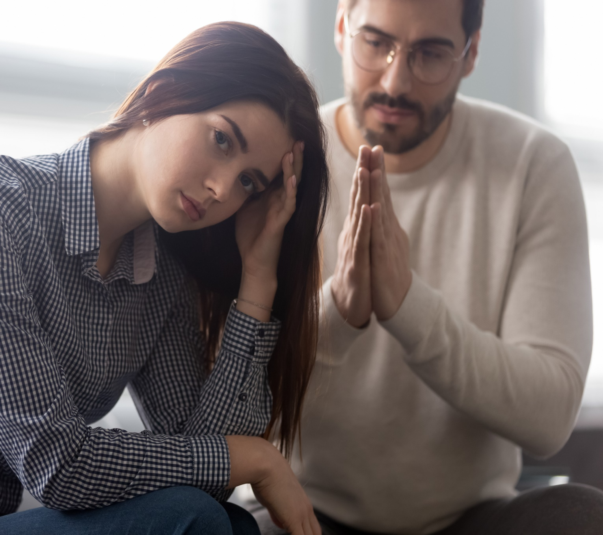
Stations of Forgiveness
Insight
Understanding
Opportunities for Compensation
Overt Apology

Slide 69
Five Obstacles to Marriage Counseling
Domestic violence
Active affair
Active addiction
Severe psychological disorder
“T” Trauma

Slide 70
Thank You!
Presented by: Wib Newton
wib@newhoperesources.com (806)350-5862 www.newhoperesources.com

